Slide 1
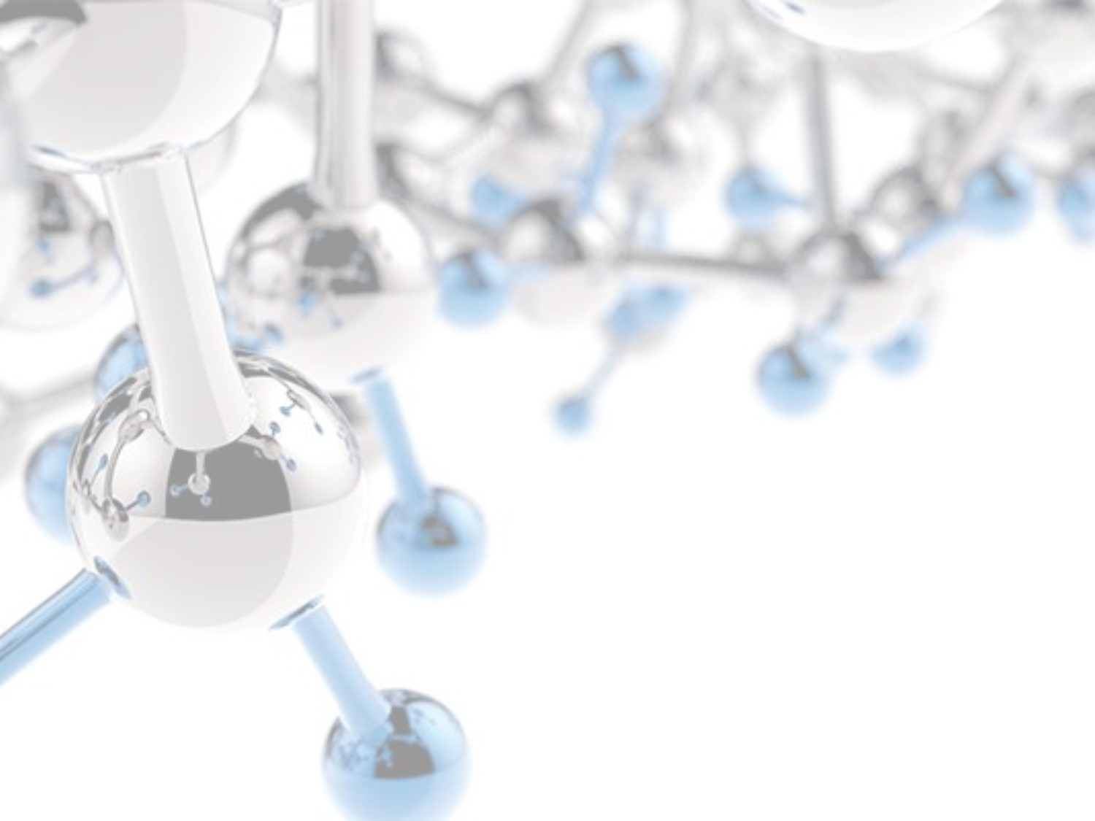




Autonomous Optimisation for Multistep Chemical Synthesis
Dr Adam Clayton

Slide 2
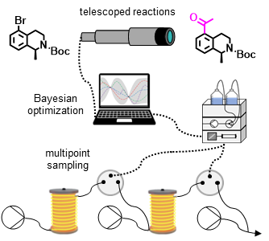
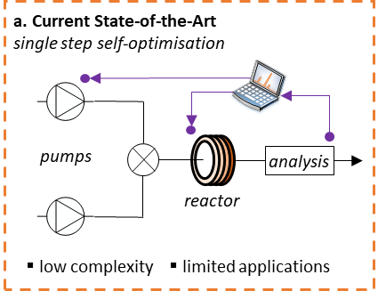
School of Chemistry & Chemical and Process Engineering
FACULTY OF ENGINEERING AND PHYSICAL SCIENCES
Multistep Synthesis
Multistep syntheses in flow:
Synthesis of APIs | Less purification waste
Minimal supply chain disruptions | Less labour intensive
No large inventories of intermediates | Highly controlled conditions
Aim: Expand the capabilities of self-optimising systems to enable rapid development of telescoped reactions.
this work

Slide 3

School of Chemistry & Chemical and Process Engineering
FACULTY OF ENGINEERING AND PHYSICAL SCIENCES
Multipoint Sampling
Multipoint sampling required to deconvolute each telescoped reaction step.
Chromatographic analysis widely used in pharma due to accurate quantification of complex reaction mixtures.
Simple valve configuration designed to enable multipoint sampling with a single HPLC instrument:
(i) Heck-Intramolecular Cyclisation
HPLC
4
6
8
10
12
from pump
Detector
Absorbance (210 nm)
(ii) Selective Deprotection
to column
Product
Reactor 1
Reactor 2
4
6
8
10
12
Time (min)

Slide 4
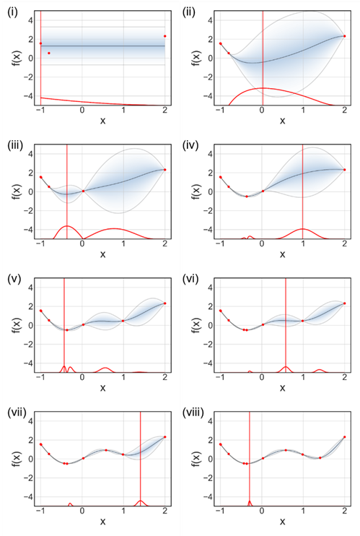
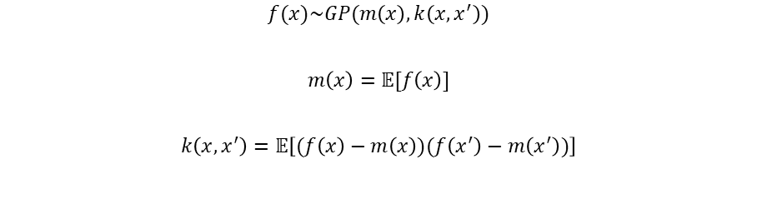





School of Chemistry & Chemical and Process Engineering
FACULTY OF ENGINEERING AND PHYSICAL SCIENCES
Bayesian Optimisation
Bayesian Optimisation (BO): balance exploration and exploitation to find global optimum.
$$f(x)\sim GP(m\left(x\right),k\left(x,x^{′}\right))$$
$$m\left(x\right)=𝔼[f\left(x\right)]$$
$$k\left(x,x^{′}\right)=𝔼\left[(f\left(x\right)−m\left(x\right))(f\left(x^{′}\right)−m\left(x^{′}\right))\right]$$
$$k_{M:v=\frac{5}{2}}\left(r\right)=\left(1+\frac{\sqrt{3r}}{l}+\frac{{5r}^{2}}{{3l}^{2}}\right)exp\left(−\frac{\sqrt{5r}}{l}\right)$$
$$ꭓ=\frac{y_{pred}−f^{∗}−c_{v}}{σ}$$
$ꭓ$ = contextual improvement
$c_{v}$ = contextual variance
$\overline{σ^{2}}$ = mean of variances
$$c_{v}=\frac{\overline{σ^{2}}}{f^{∗}}$$

Slide 5
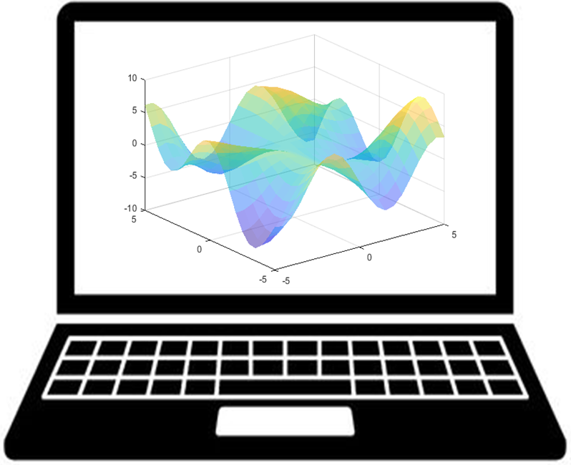
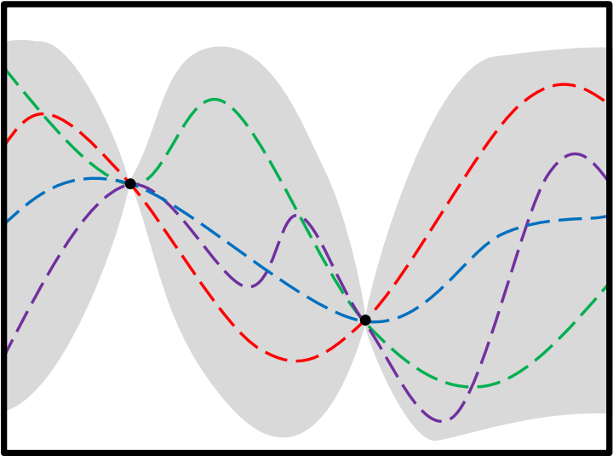
School of Chemistry & Chemical and Process Engineering
FACULTY OF ENGINEERING AND PHYSICAL SCIENCES
Autonomous Multistep Optimisation
1 (0.5 M)
Pd(OAc)₂ (1 mol%)
dppp (2 mol%)
NEt₃ (2.5 eq.)
EG:MeCN (1:1)
Bayesian Optimization
HPLC
2 (0.5 M)
EG:MeCN (1:1)
3 & 4
3 mL
250 psi
4 mL
5
EG:MeCN (1:1)
TsOH.H₂O (1.5 M)
Acetone:H2O (9:1)
Optimization Variables
t_{res,1}
(1-20 mins)
BOAEI
Equiv 2
(1-3)
Overall Yield (%)
Temperature₁
(100-180 °C)
F_{v}A:F_{v}R1
(0.2-0.4)

Slide 6
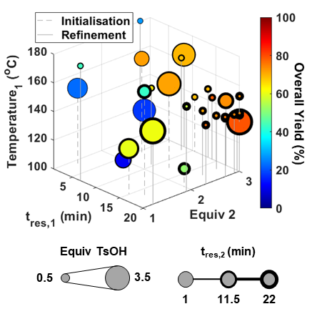
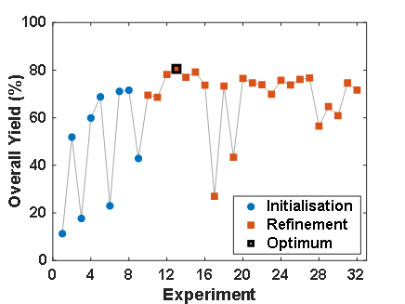
School of Chemistry & Chemical and Process Engineering
FACULTY OF ENGINEERING AND PHYSICAL SCIENCES
Optimisation Results
32 telescoped reactions conducted over 45.4 hours.
Optimum (overall yield = 81%) identified after just 13 experiments (14.1 hours).
Comparison: 42 single step reactions conducted over 26 hours (optimum identified after 16 experiments).

