Slide 1
Toward Predicting Process Outcomes in Different Solvents: Solubility and Reactivity
Dr Bao N. Nguyen, School of Chemistry, University of Leeds
1st Nov 2022
N8 CIR Machine Learning Theme Launch
Contact: b.nguyen@leeds.ac.uk

Slide 2
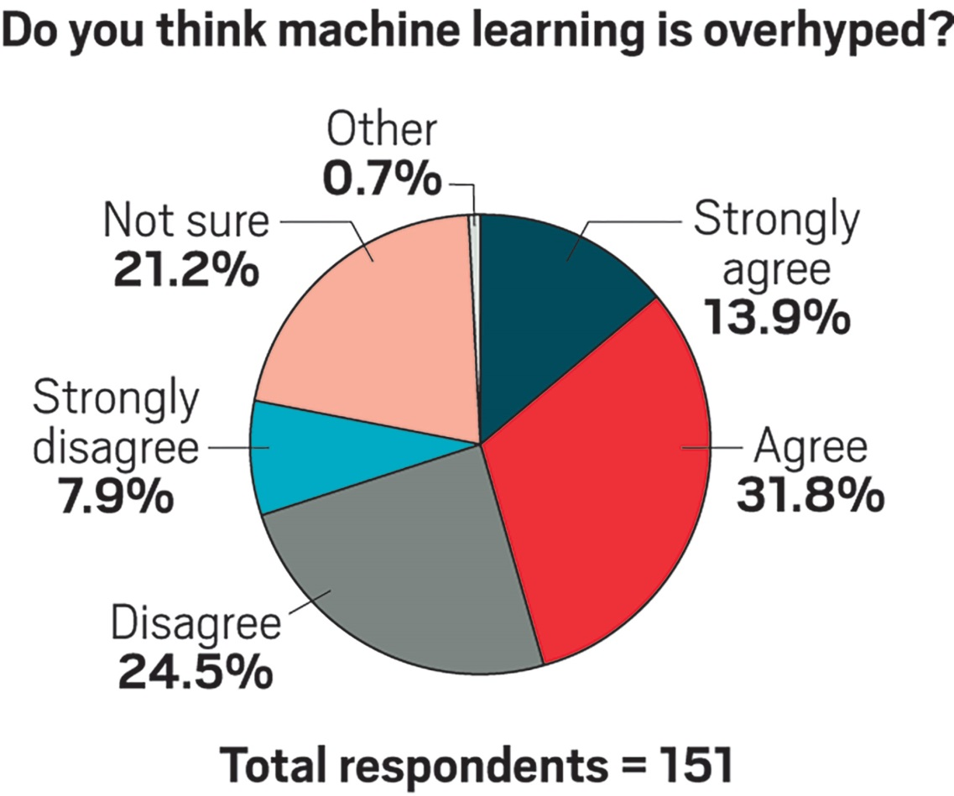
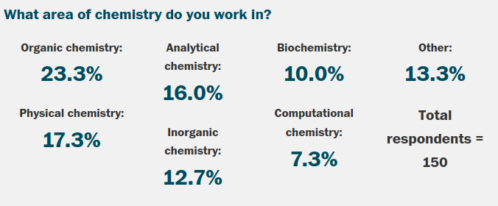
The trust problem in Chemistry
Little reliable data
Cognitive bias
Experimental bias
Spurious correlations
Interpretability
https://cen.acs.org/physical-chemistry/computational-chemistry/machine-learning-overhyped/96/i34
Notes:
2
2

Slide 3
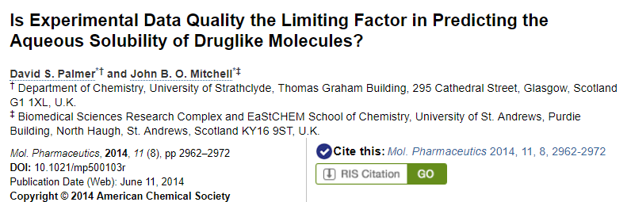
The challenges of solubility prediction
Typical experimental error is LogS ± 0.5-0.7
Traditional metrics R² and RMSE can be misleading given the errors in the training data
Two predictive thresholds (%LogS ± 0.7 and %LogS ± 1.0) are used to evaluate the models
Notes:
3
3

Slide 4
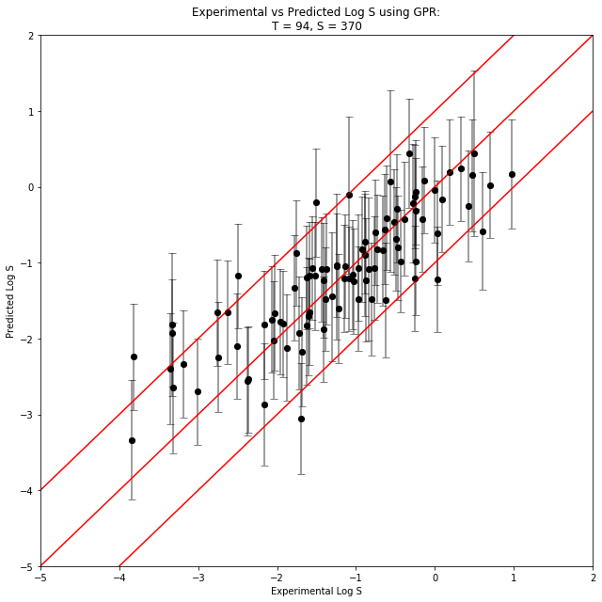
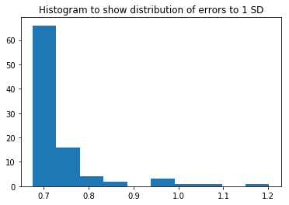
How to handle noise in data?
Metric | GP
R² | 0.70
RMSE | 0.58
%LogS±0.7 | 79.8 (98.9)
%LogS±1.0 | 90.4 (100)
GP predictions for Benzene_set
Typical error in literature solubilities is LogS ± 0.5-0.7
Nature Commun. 2020, 11, 5753

Slide 5
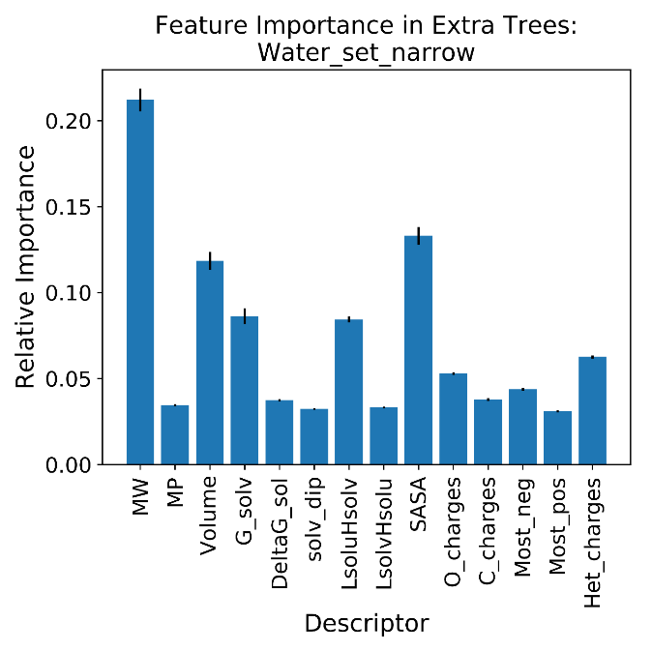
Importance of each descriptor
Impact of descriptors in H₂O
Important descriptors: MW, molar volume, ΔG_{sol}, SASA, most_neg, Het_charges
Which one can be more accurately calculated?
Nature Commun. 2020, 11, 5753

Slide 6
Importance of each descriptor
Method | %LogS±0.7 | %LogS±1.0 | %LogS±0.7 | %LogS±1.0
 | Old descriptors (PCM solvation model) |  | New descriptors (HF SMD solvation model)
ANN | 58.9 | 78.9 | 68.4 | 84.2
SVM | 71.6 | 78.9 | 72.6 | 83.2
RF | 60.0 | 75.8 | 63.2 | 80.0
ET | 66.3 | 84.2 | 69.5 | 84.2
Bag | 57.9 | 76.8 | 65.3 | 81.1
GP | 68.4 | 73.7 | 70.5 | 82.1
Water_set_wide (LogS = -12 to 2)
PCM = Polarizable continuum model (Chem. Rev. 2005, 8, 2999)
SMD = Solvent model based on density (J. Phys. Chem. B 2009, 113, 6378)
J. Chem. Phys. 149, 104102 (2018)

Slide 7
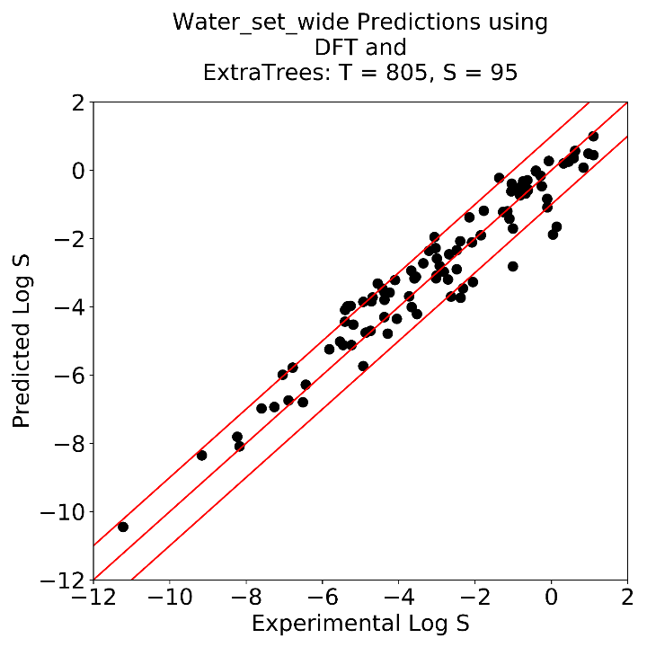
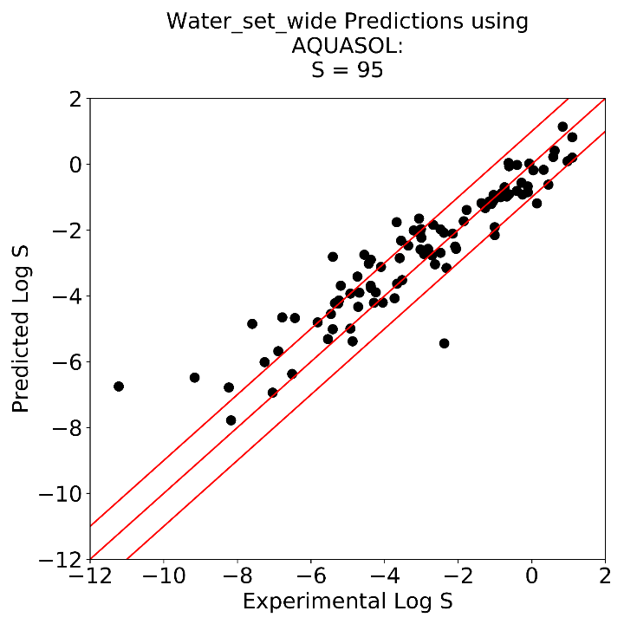
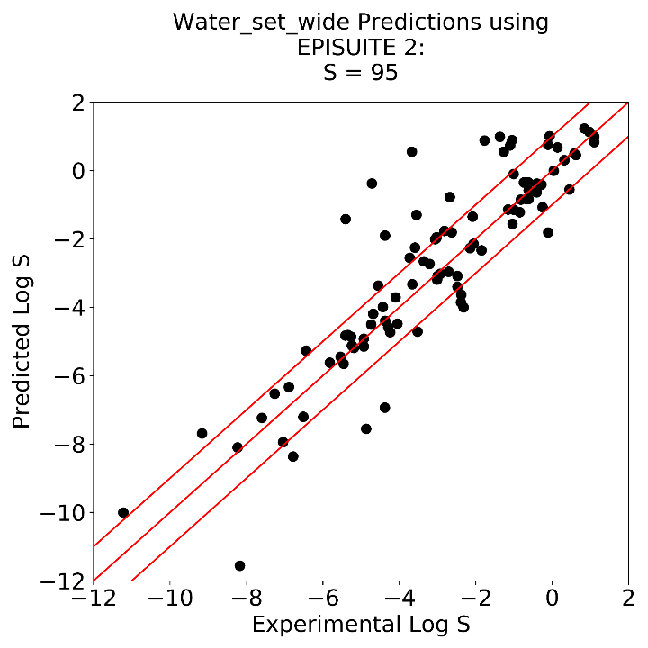
Benchmarking in H2O
AQUASOL and EPISUITE are standard FDA tools for solubility prediction
Nature Commun. 2020, 11, 5753

Slide 8
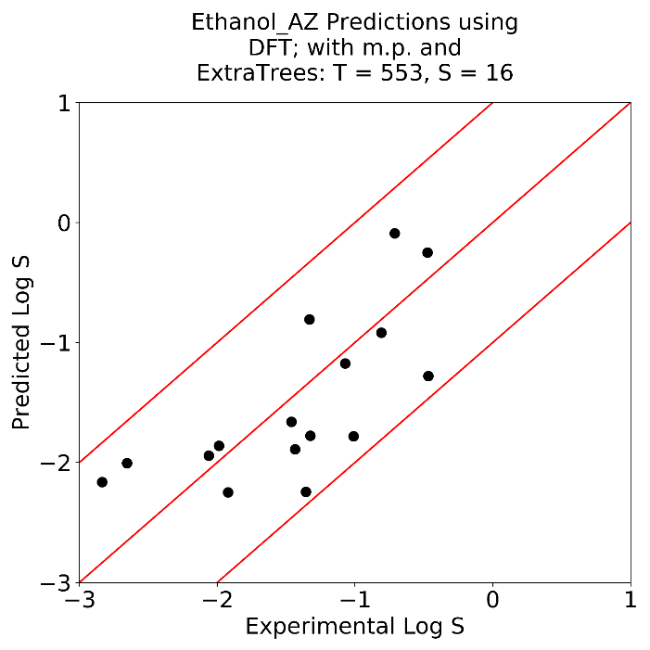
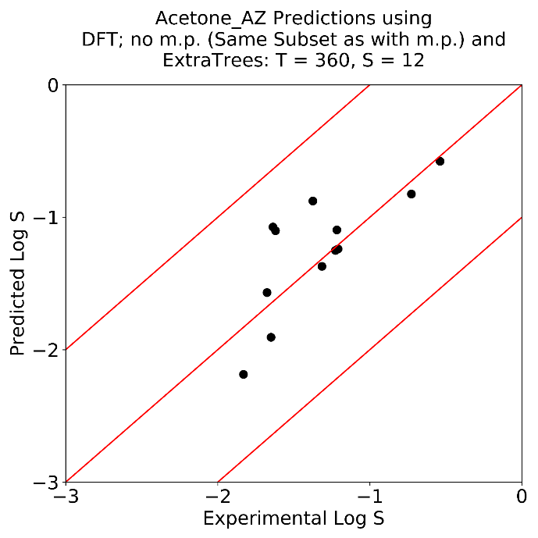
Validation in the real world
Prediction for synthetic targets and intermediates at AstraZeneca
Nature Commun. 2020, 11, 5753

Slide 9
Latest results in water
Resource efficiency
Method | CPU time to build model (s) | Model metrics
 |  | R² | RMSE | %LogS±1 | %LogS±0.7
M1 | 8227 | 0.85 | 0.93 | 78.4 | 64.4
M2 | 8643 | 0.84 | 0.97 | 77.5 | 63.7
M3 | 7821 | 0.86 | 0.90 | 76.3 | 65.6
M4 | 25478 | 0.84 | 0.96 | 76.8 | 64.0
DFT | ~300000 | 0.87 | 0.88 | 79.4 | 66.3
Accuracy vs CPU time (900 compounds)
Once the model is built, it takes less than 10s per prediction
Unpublished results

Slide 10
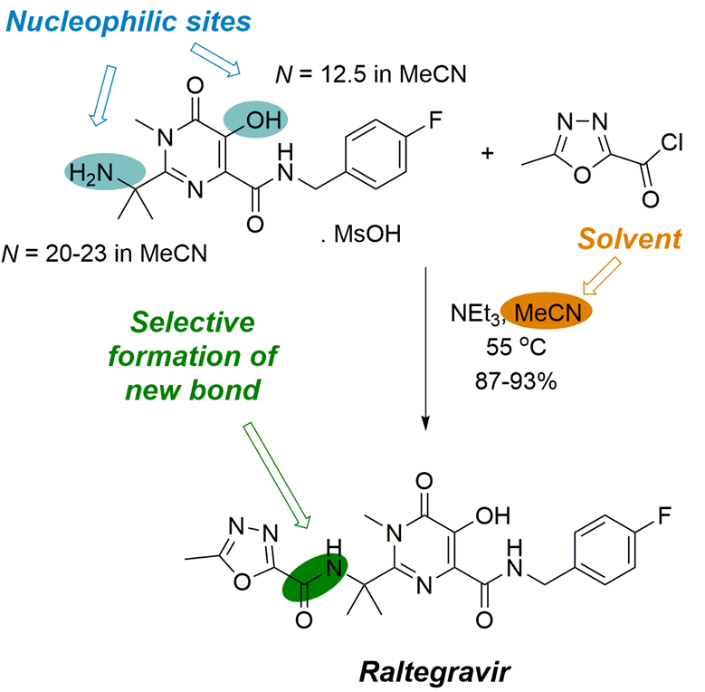
Solvent-dependent reactivity
Mayr-Patz equation:
log k = s_{N}(N + E)
N (nucleophilicity parameter) and E (electrophilicity parameter) are specific to the nucleophile and the electrophile and the solvent
s_{N} is specific to the reaction class
If we can predict these, we can predict selectivity in simple organic reactions.
J. Chem. Inf. Model. 2021, ASAP
Notes:
10
10

Slide 11
Dependence and improvements
Excellent accuracy across 4 solvents and many classes of nucleophiles
J. Chem. Inf. Model. 2021, 61, 4890
Notes:
11
11

Slide 12
Our approach
Solvent dependent nucleophilicity
Solubility
Structure
Properties
Reactivity
Reaction outcomes
Turning on F⁻ as nucleophile in water
Based on descriptors which represent physical aspects of modelled target
As accurate as the training data
Can be rationally improved through understanding of descriptors and their importance
Reproduce established physiochemical behaviours of the system
Contact: b.nguyen@leeds.ac.uk
Notes:
12
12

