Slide 1
Machine learning directed multi-objective optimization of mixed variable chemical systems
Oliver Kershaw
Prof. Richard Bourne
Dr Nicholas Warren

Slide 2
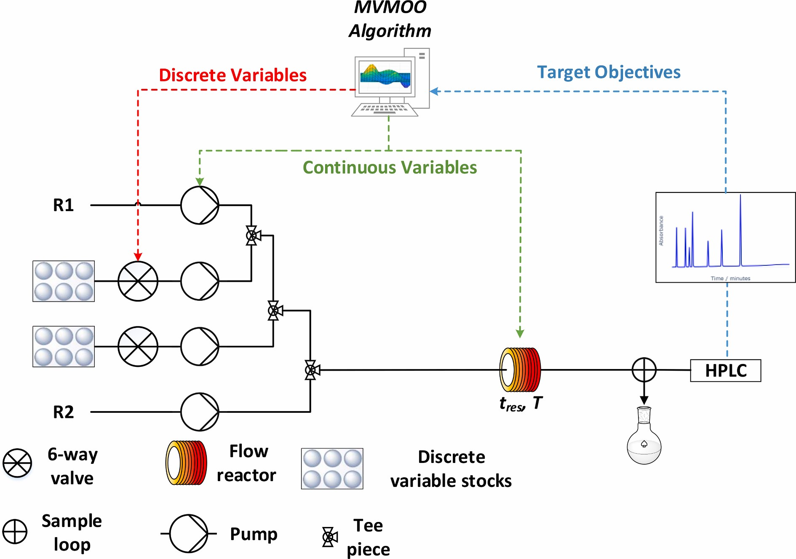
School of Chemical and Process Engineering
FACULTY OF MATHEMATICS AND PHYSICAL SCIENCES
Mixed variable optimisation
AIM: Simultaneous optimisation of categorical and continuous variables on automated continuous flow systems
Autonomously optimise chemical systems for the manufacture of APIs
Allows full variable interactions to be studied
Utilises Mixed Variable Multi-Objective Optimisation (MVMOO) algorithm (available through github)
[1] J.A. Manson, T.W. Chamberlain, R.A. Bourne, MVMOO: Mixed variable multi-objective optimisation, J. Glob. Optim. 2021, 80, 865–886. https://github.com/jmanson377/MVMOO

Slide 3
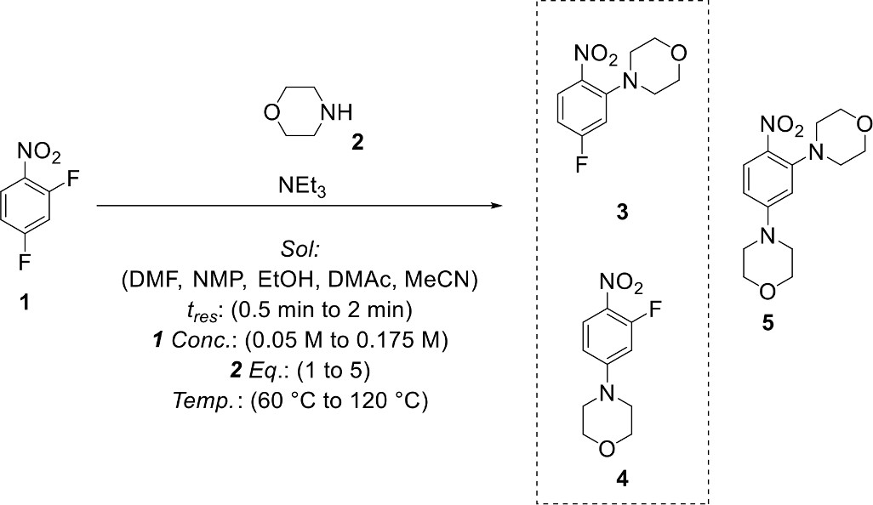
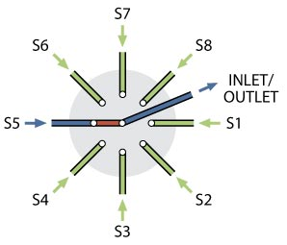
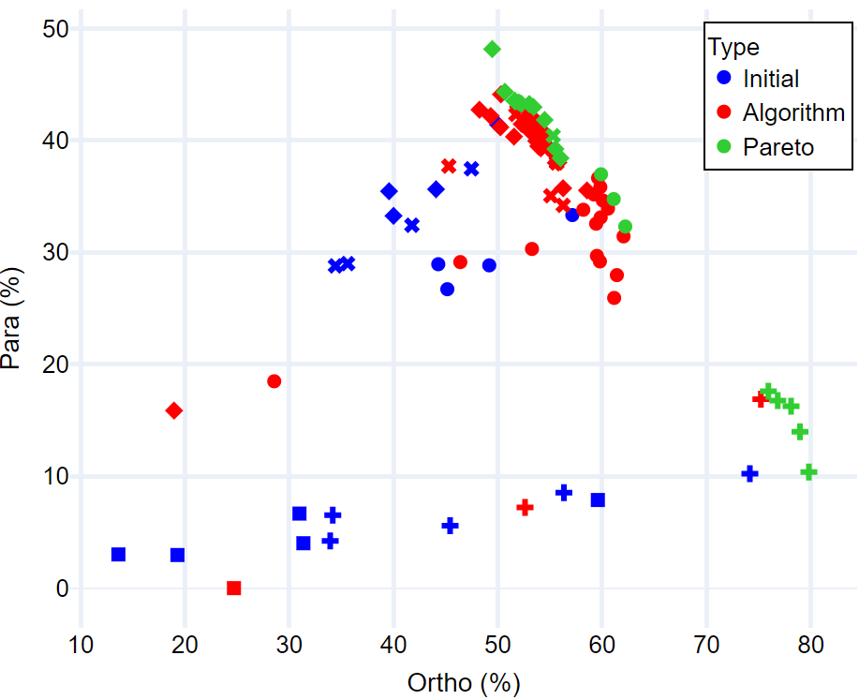
School of Chemical and Process Engineering
FACULTY OF MATHEMATICS AND PHYSICAL SCIENCES
Solvent Optimisation
6-port switching valve utilised for discrete variable selection
Optimisation completed in 18 hours – mapping Pareto front sufficiently, observing known solvent effects
[3]
[2] A. M. Schweidtmann, A. D. Clayton, N. Holmes, E. Bradford, R. A. Bourne and A. A. Lapkin, Chem. Eng. J., 2018, 352, 277–282.
[3] Internals of vici selection valves. Available from: https://www.vici.com/cval/images/c5-schem.jpg
[4] O.J. Kershaw, A.D. Clayton, J.A. Manson, A. Barthelme, J. Pavey, P. Peach, J. Mustakis, R.M. Howard, T.W. Chamberlain, N.J. Warren, R.A. Bourne, Chem. Eng. J., 2023, 451, 138443.

Slide 4
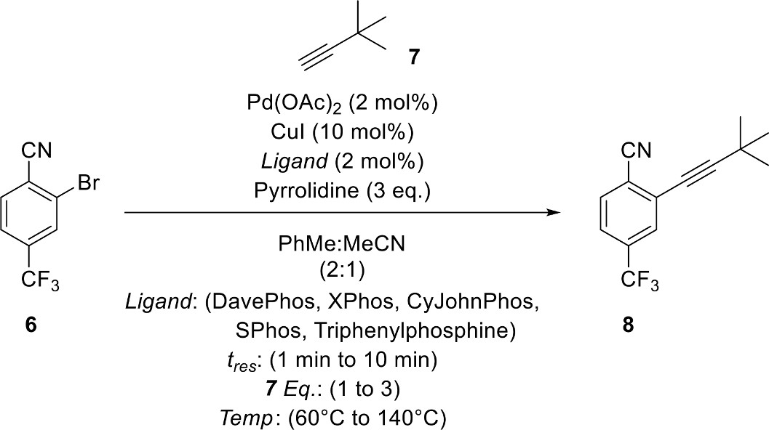
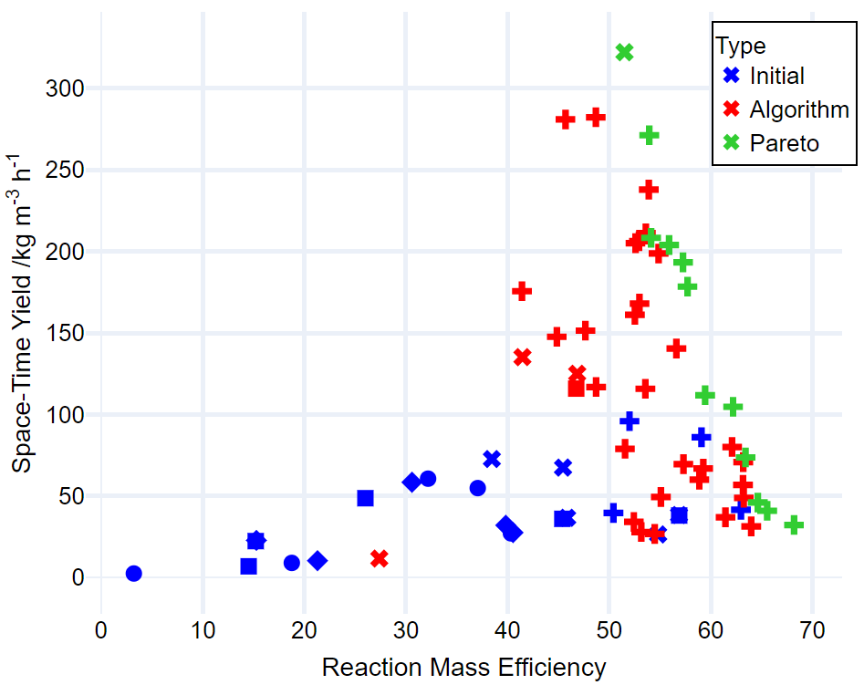
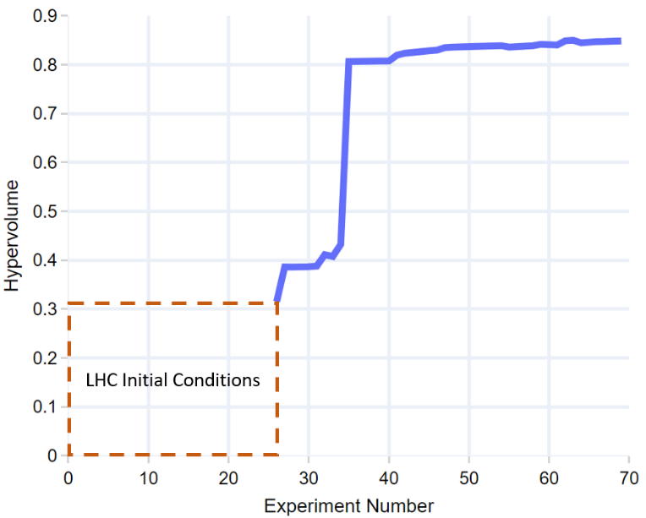
School of Chemical and Process Engineering
FACULTY OF MATHEMATICS AND PHYSICAL SCIENCES
Sonogashira Coupling
69 reactions completed over a 22h time period
Achieved an impressive overall 90% yield (corresponding to highest RME experiment)
Hypervolume monitored after 60 experiments, terminated once plateau was observed
[4] O.J. Kershaw, A.D. Clayton, J.A. Manson, A. Barthelme, J. Pavey, P. Peach, J. Mustakis, R.M. Howard, T.W. Chamberlain, N.J. Warren, R.A. Bourne, Chem. Eng. J., 2023, 451, 138443.
[5] S. Yu, A. Haight, B. Kotecki, L. Wang, K. Lukin and D. R. Hill, J. Org. Chem., 2009, 74, 9539–9542.
[6] A. D. Clayton, A. M. Schweidtmann, G. Clemens, J. A. Manson, C. J. Taylor, C. G. Niño, T. W. Chamberlain, N. Kapur, A. J. Blacker, A. A. Lapkin and R. A. Bourne, Chem. Eng. J., 2020, 384, 123340.

Slide 5
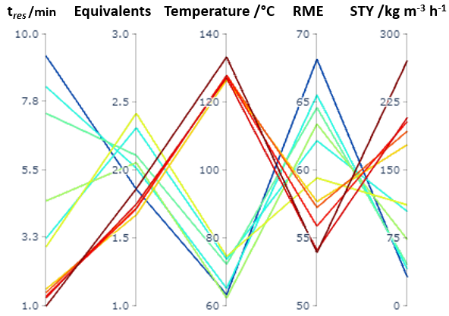
School of Chemical and Process Engineering
FACULTY OF MATHEMATICS AND PHYSICAL SCIENCES
Sonogashira Coupling
Mapped the Pareto front with 17% of experimental points making up the front
Optimisation results highlight trends that are counterintuitive based on chemical understanding, highlighting advantages of these optimisations
Highlights algorithms ability to identify and manipulate the mixed variable interactions to maximise selected objectives
[4] O.J. Kershaw, A.D. Clayton, J.A. Manson, A. Barthelme, J. Pavey, P. Peach, J. Mustakis, R.M. Howard, T.W. Chamberlain, N.J. Warren, R.A. Bourne, Chem. Eng. J., 2023, 451, 138443.
[5] S. Yu, A. Haight, B. Kotecki, L. Wang, K. Lukin and D. R. Hill, J. Org. Chem., 2009, 74, 9539–9542.
[6] A. D. Clayton, A. M. Schweidtmann, G. Clemens, J. A. Manson, C. J. Taylor, C. G. Niño, T. W. Chamberlain, N. Kapur, A. J. Blacker, A. A. Lapkin and R. A. Bourne, Chem. Eng. J., 2020, 384, 123340.

