Slide 1
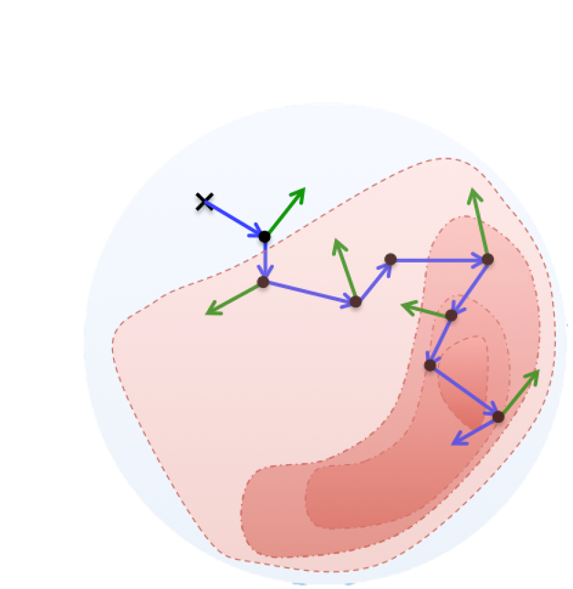
Bayesian methods for incorporating adult clinical trial evidence to improve the estimation of treatment effects in children. Ruth Walker, Centre for Reviews and Dissemination, University of York
Background Issues of conducting clinical trials in children
There is often a lower disease incidence in children compared to adults.
Children may be reluctant to receive a treatment of unknown efficacy, or take on the additional time commitment of being involved in research.
Pharmaceutical companies may be wary of the increased effort required to conduct research with children (1).
Consequences for children's healthcare
Fewer children to take part in clinical trials that investigate how well medicines work.
Less is known about the safety and efficacy of medicines in children compared to adults. This means children are not always treated with the most effective medicines.
Clinical trials
Inform healthcare decisions by determining the comparative efficacy of treatment options. This is often done by randomising patients to receive one treatment or the other and comparing their outcomes.
Bayesian methods for combining clinical trial evidence.
Decisions within healthcare are often informed by multiple clinical trials comparing treatments of interest.
Bayesian network meta-analysis (NMA) can:
Combine data from multiple clinical trials of multiple different treatments.
Allow for comparison of each treatment with every other.
Estimate ‘indirect’ treatment comparisons.
Bayesian NMA takes prior information or beliefs that are updated by the model, based upon on the clinical trial data.
Unknowns
parameters
The model includes a generalised linear regression model and uses Markov chain Monte Carlo method (MCMC) to create a posterior distribution (the probability distribution after seeing the data) for each of the unknown parameters..
When children's data is sparce, these analyses may still not be able to estimate treatment effect with much certainty.
Indirect treatment comparisons
This ‘indirect comparison’ (d_{BC}) is estimated by subtracting the estimate of a direct comparison (d_{AC}) (a treatment compared in a clinical trials) from another (d_{AC}) with a common comparator (i.e., treatment A)
$\hat{d }Ind BC$ =$\hat{ d}Dir AC$ -$\hat{d}Dir AB.$(2)
Bayesian information sharing methods (ISMs)
Incorporating adult data may help to overcome the scarcity of evidence in the children's population
Bayesian ISMs extend the traditional Bayesian NMA to ‘borrow strength’ from a separate but related population (3).
The model can include a separate linear predicator for adults and children or a meta-regression model with a binary study-level covariate for (adult/children) within the linear predictor.
These estimate the difference in treatment effect between children and adults, as an unknown parameter in the model (λ).
This approach may be safer than models that assuming adult data is generalisable to children, as there may be differences in the relative treatment effects between the two populations.
A
B
---------
C
---------
Prior distribution
MCMC methods
A class of algorithms that allows random sampling of a probabilistic space.
The methods ‘search’ for the parameters values that have a higher probability of giving rise the data, and revisits these areas more often.
In doing so it the algorithm simultaneously creates the posterior distribution and samples from it to estimate unknown parameters values.
Prior distribution
Data
Children's data
Adult data
0,1,1,0,1,0,0,1
0,1,1,0,1,0,0,1
0,1,0,1,1,0,0,1
Bayesian NMA model
Bayesian NMA model
Posterior Distribution:
Θ - treatment effect:
σ- variance:
Posterior Distribution:
Θ - treatment effect ( in children)
σ- variance (in children)
λ (difference in treatment effect between adults and children)
Anticipated impact for children’s healthcare
Including adult evidence can help to improve how certain we are about the effectiveness of medicines in children. This can:
Help healthcare providers decide which medicines to prescribe and help patients and carers better understand their treatment options
Help reach conclusions about new medicines sooner, without the need to do so many trials in children and young people. Instead, smaller clinical trials could be used to confirm findings.
References: (1) Gamalo-Siebers M, Savic J, Basu C, Zhao X, Gopalakrishnan M, Gao A, et al. 2017. 'Statistical modelling for Bayesian extrapolation of adult clinical trial information in paediatric drug evaluation. ', Pharmaceutical Statistics 2017; , 16: 232-49
(2) Dias, S., Ades, T., Welton, N. J., Jansen, J., & Sutton, AJ. (2018). Network Meta-Analysis for Decision-Making. Wiley.
(3) Nikolaidis, G.F., Woods, B., Palmer, S. et al. Classifying information-sharing methods. BMC Medical Research Methodology 21, 107 (2021).
This project is funded by the NIHR Doctoral Fellowship Programme NIHR302291. The views expressed are those of the author and not necessarily those of the NIHR or the Department of Health and Social Care.
.

