Slide 1
N8 CIR — DH Community Day
Twitter Audience Responses to Complex TV: Gomorrah — The series
Dr Alessio Baldini
Lecturer in Italian culture (University of Leeds)

Slide 2
Lightning Talk
Twitter Audience Responses
to Complex TV:
Gomorrah — The series
1.
Complex TV:
Cinematic art
and ethics
2.
Twitter data
3.
A cautionary tale
and DH

Slide 3
1. Complex TV: cinematic art and ethics
Complex TV (crime drama):
The Sopranos (1999-2007)
The Wire (2002-2008)
Breaking Bad (2008-2013)
Gomorrah — The series (2014-2021)
There is a constitutive tension between moral and artistic value because the complexity is partly a function of ‘the foregrounding of morally conflicted and transgressive characters’ (Dunleavy 2018: 109).
Fig. 1

Slide 4
1. Complex TV: cinematic art and ethics
External relationship (beyond the screen):
Production, distribution, exhibition
The effects on the audience (behavioural change)
Internal relationship (on screen): can a moral merit/demerit (say, the cinematic representation of immoral acts and characters) count as an artistic merit/demerit?
‘intended response’ (Vaage 2016: 15)
‘morally sensitive audience’ (Carroll 1996: 234), ‘target audience’ (Eaton 2012: 285)
Researching the Twitter audience response to empirically test the efficacy of the intended response (‘Empirical research is needed to uncover variation among various audience groups’ (Vaage 2016: 16))

Slide 5
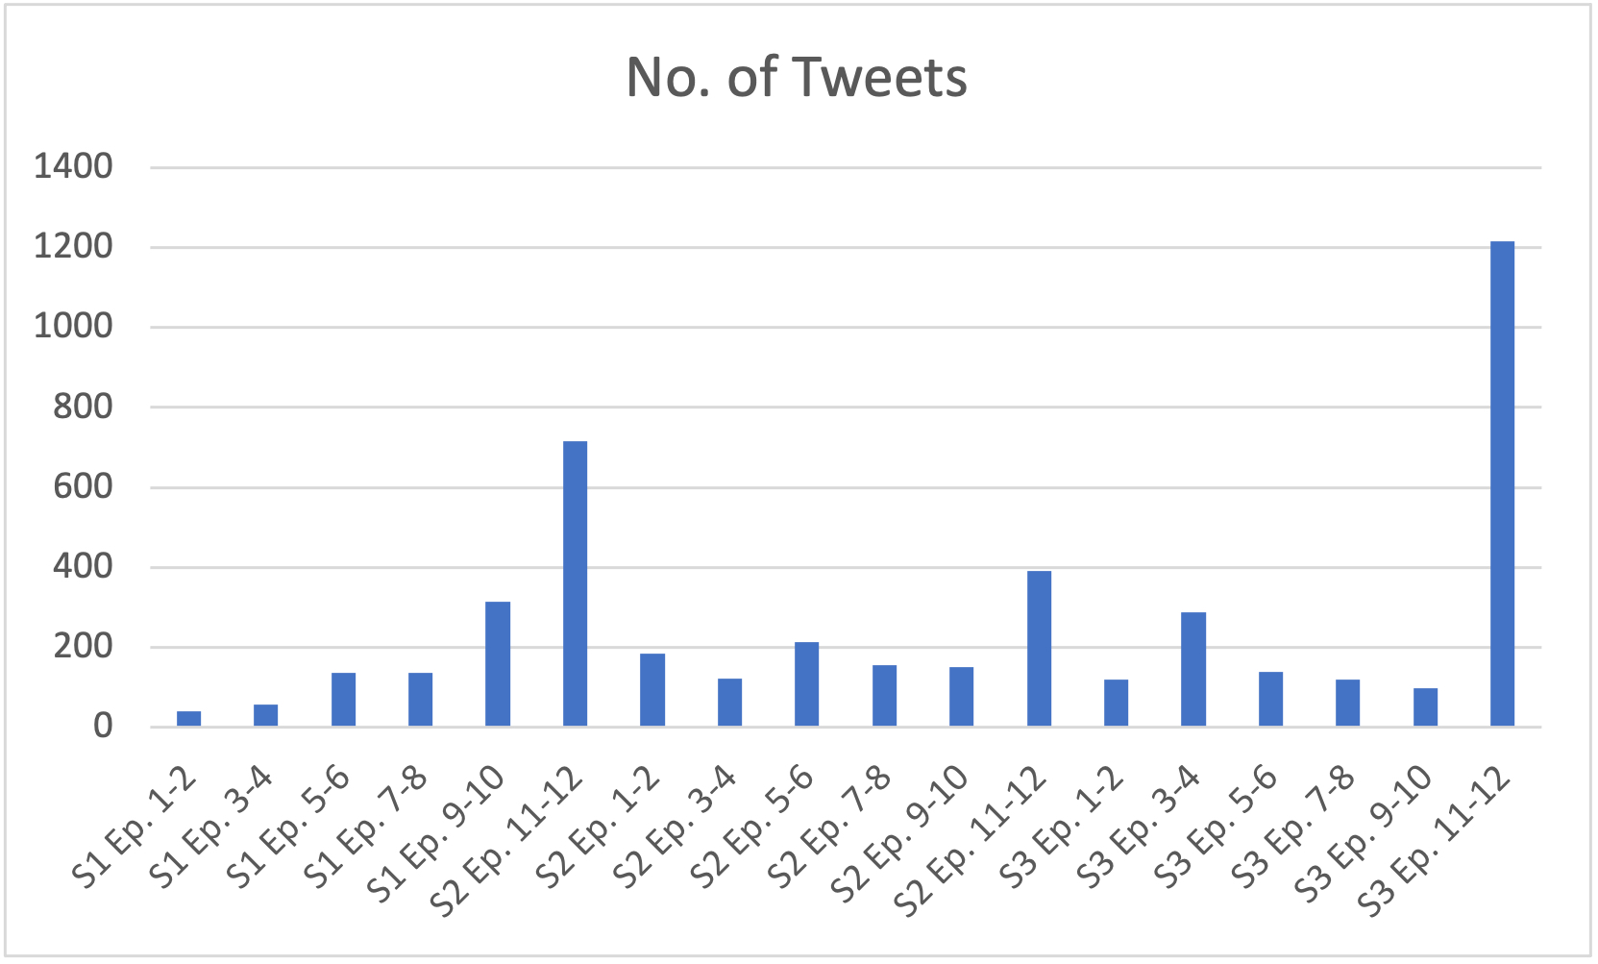
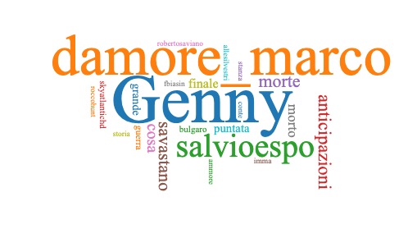
2. Twitter data
Twitter users’ response to Ciro di Marzio (main character).
Corpus = 4,590 tweets posted by 3,070 accounts:
Persistent attachment to the character: 1,215 Tweets are a lament over the loss of a beloved character (Fig. 2)
Blurring of the boundaries between character and actor: no distinction between performance, narrative function, diegesis (= narrative content) (Fig. 3)
Interest in celebrity culture (Fig. 3)
Fig. 2
Fig. 3

Slide 6
3. A cautionary tale and DH
Twitter audiences:
No sustained moral distancing from the main character
Attracted by ‘the possibility of realizing the fantasy of interacting with the famous’ (Bury 2017: 383).
A cautionary tale:
We might want to show ‘a cautious attitude to the idea that we can learn from fiction’ about morality (Currie 2020: 4)
Digital Humanities:
Twitter data can help us explore core questions in humanities (aesthetics, film theory) in a different way by empirically testing a theory

Slide 7
References
Bury, R. 2017. Television Viewing and Fan Practice in an Era of Multiple Screens. In: J. Burgess, A. E. Marwick and T. Poell (eds), The SAGE Handbook of Social Media, London: SAGE, pp. 372-389.
Carroll, N. 1996. Moderate Moralism. British Journal of Aesthetics, 36(3), pp. 223-28.
Currie, G. 2020. Imagining and Knowing: The Shape of Fiction. Oxford: Oxford University Press.
Eaton, Anne W. 2012. Robust Immoralism. The Journal of Aesthetics and Art Criticism, 70(3), pp. 281-292.
Gomorra – La serie (Gomorrah – The Series, 2014-2021, Italy: Sky Italia, Cattleya, Fandango and Beta Film).
Vaage, M. B. 2016. The Antihero in American Television. London and New York: Routledge.

Slide 8
Image credits
Gomorra (Serie) Logo / © Jonteemil / Wikimedia Commons. Available from: https://commons.wikimedia.org/ [Accessed: 6 June 2023]
No. of Tweets about Ciro di Marzio (bar chart) / © Alessio Baldini with Microsoft Excel
Twitter conversation about Ciro di Marzio (word cloud) © Alessio Baldini with Voyant tools (https://voyant-tools.org/) [Accessed: 6 June 2023]

Slide 9
N8 CIR — DH Community Day
Twitter Audience Responses to Complex TV: Gomorrah — The series
Dr Alessio Baldini
Lecturer in Italian culture (University of Leeds)

