Slide 1
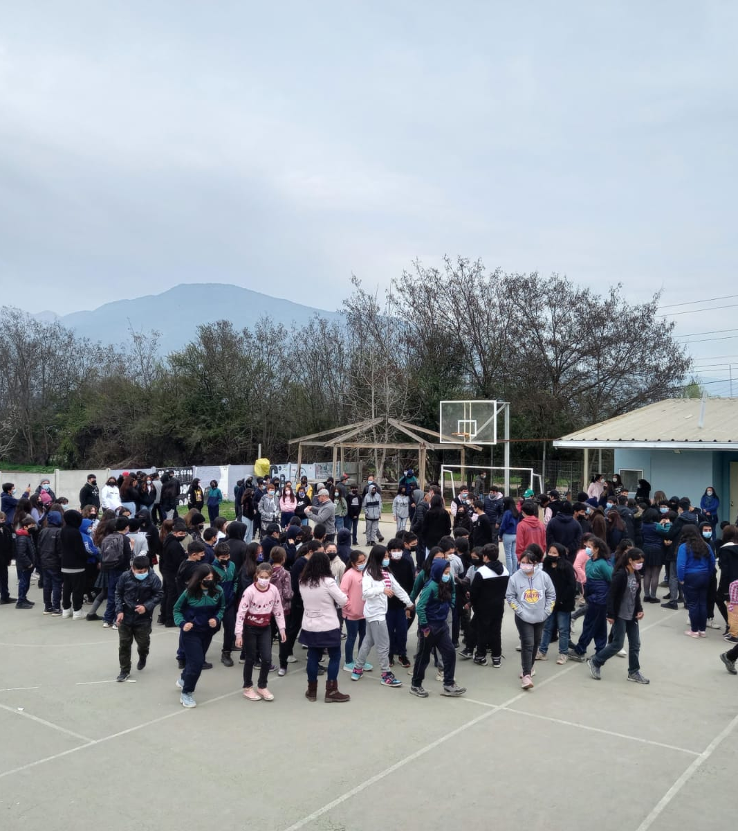
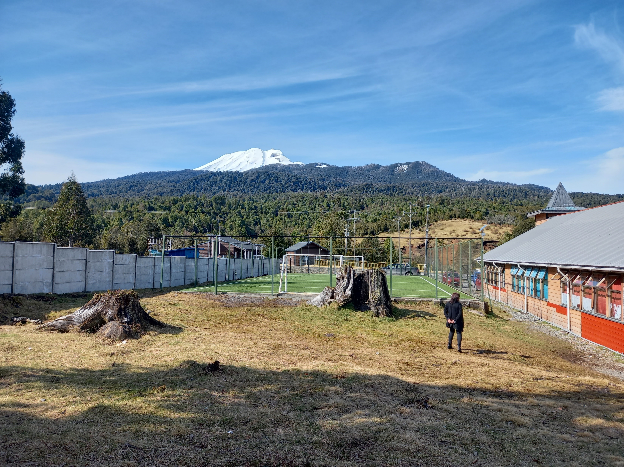
Use of immersive technologies to communicate school
preparedness plans among children and communities
exposed to natural hazards
Andrea Vásquez, 3rd year PhD student, School of Media and Communication, University of Leeds
Supervisors: Mr Simon Popple, Dr Rebecca Jarman

Slide 2
The problem
In countries such as Chile, there are public policies oriented to implement School Preparedness Plans to be prepared to face natural hazards…
However…
When an emergency occurs, parents arrive at the school, not as indicated in the School preparedness plan
How could immersive technologies mind this gap and impact preparedness to manage the aftermaths of a disaster?
* Parents are given a SPP once they enrol their
children

Slide 3
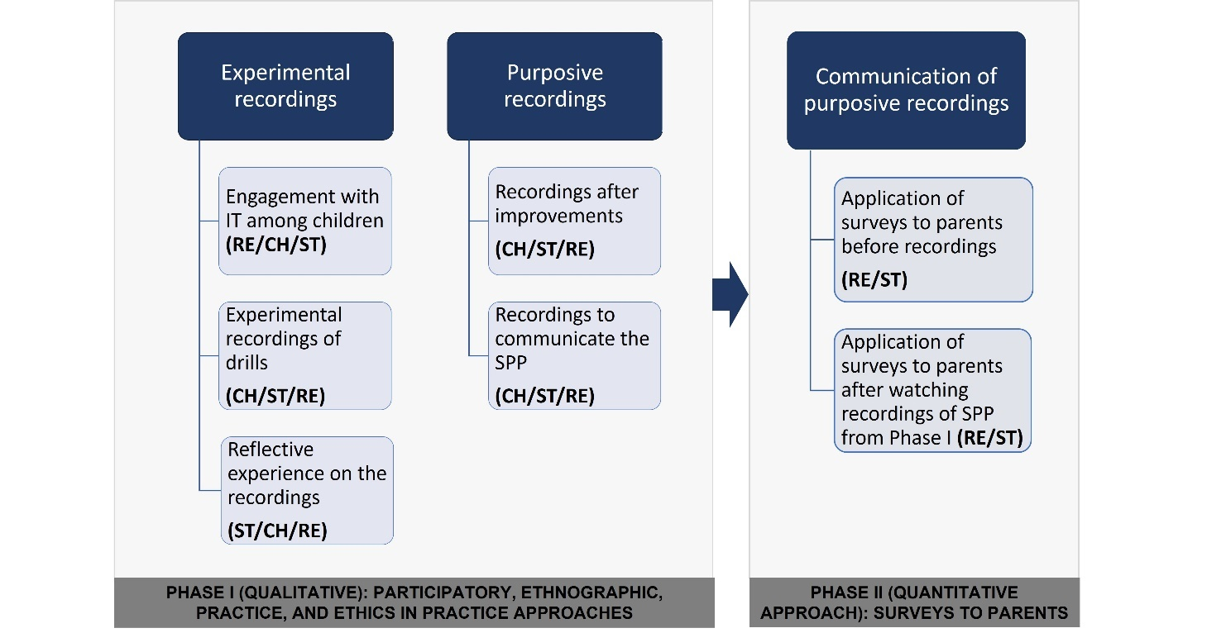
Methods applied in the 2 cases of study

Slide 4
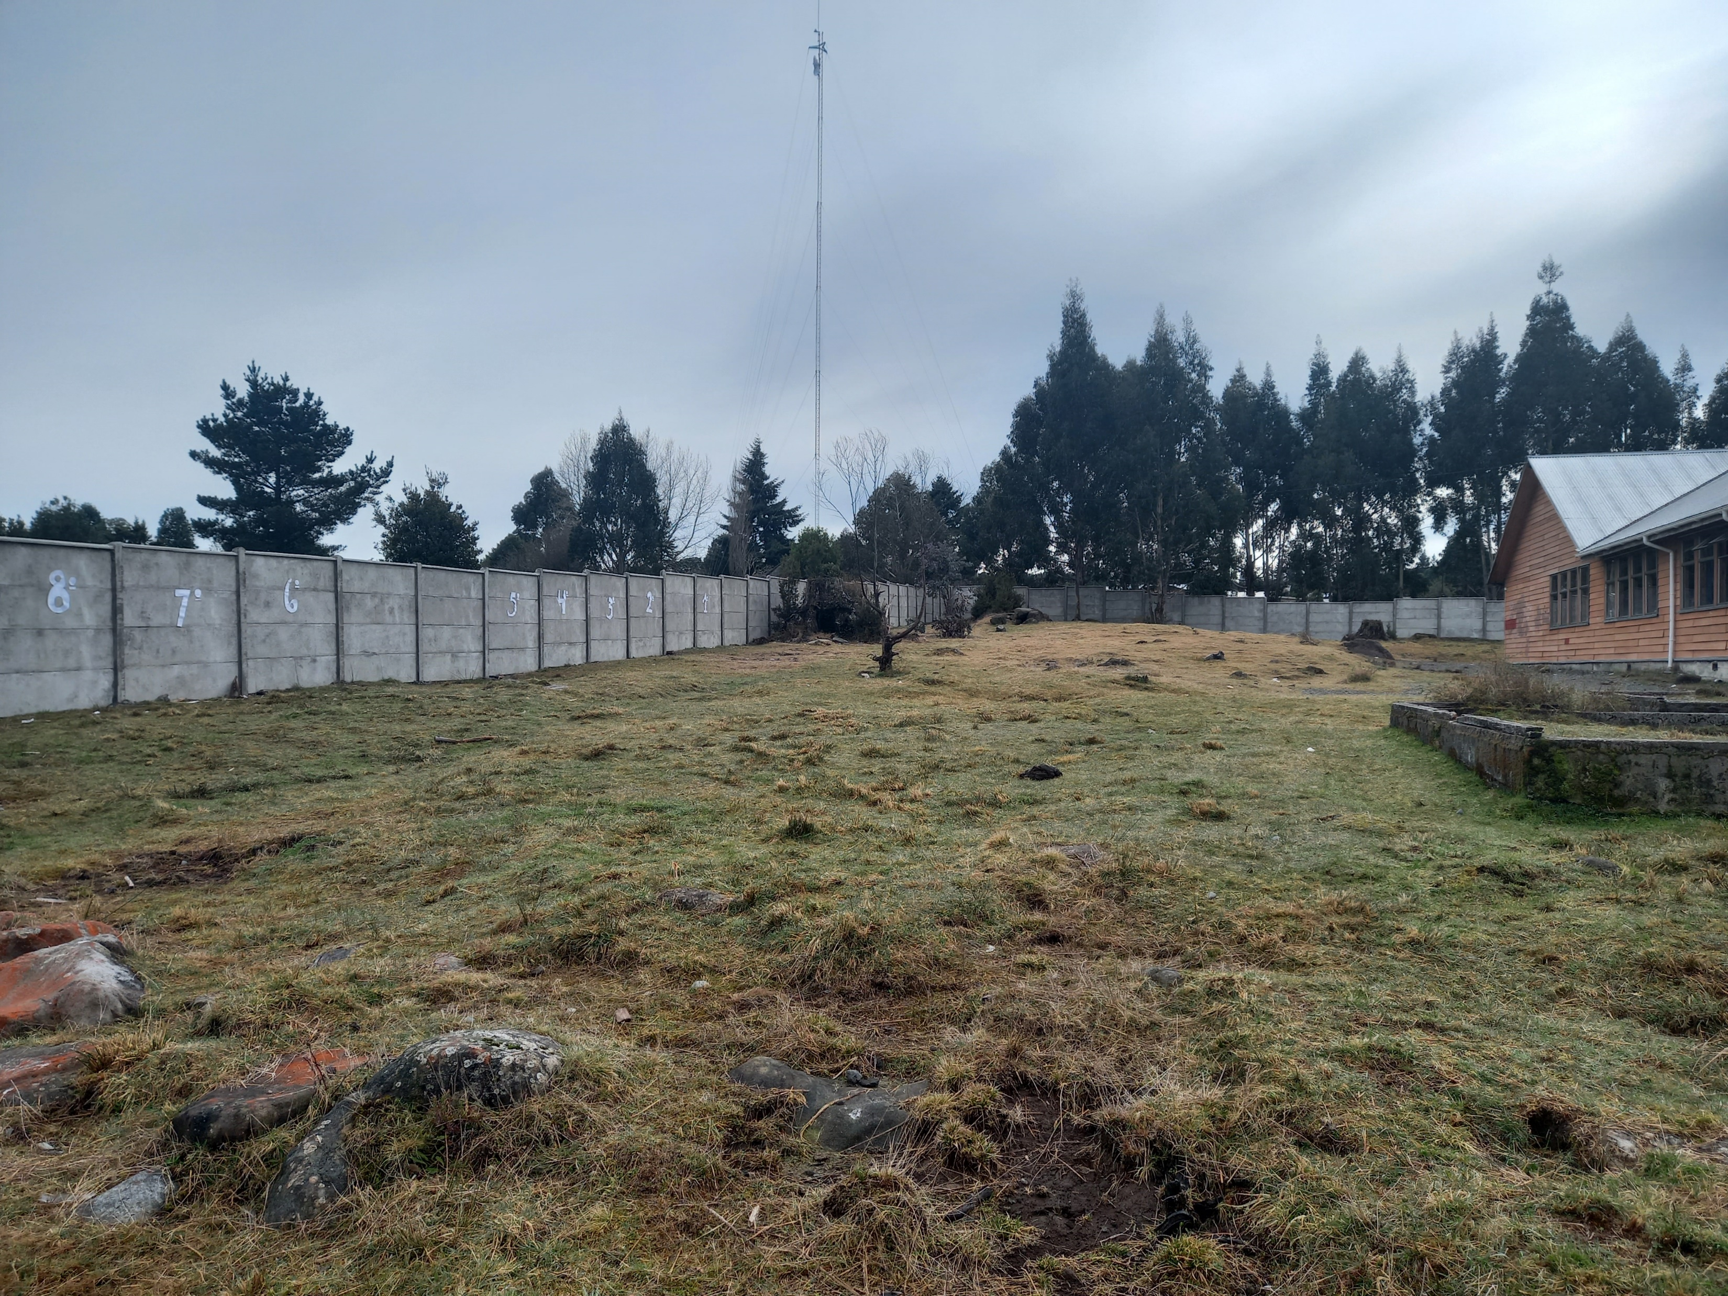
The journey: Escuela Rural Colonia Río Sur. Experimental recordings and purposive recording
Number of visits: 6
Total number of recorded drills: 4
Enroled students: 170
Previous experience with volcanic eruptions
First drill after COVID (August 2022)
360° camera used to record the drills
Final recording (November 2022)

Slide 5
Challenges of working with IT at Escuela Rural Colonia Rio Sur
Training to use 360° cameras
Experimental recordings
Reflection and management of the recordings
Development of skills on the use of technology
Management of social networks created by the school
2nd ethical challenge and technological gap:
Who will be trained to manage the software to manage the collected pictures and recordings? Under what rules (i.e. computer, training of technological skills, among others).
3rd ethical challenge:
As children become more advanced users of the technology, questions change and challenge the management of the recordings (which software to use to edit videos).
Concern about the consent to appear in videos.
4th ethical challenge and technological gap:
Who will be in charge of managing the social networks? Backup of recordings, and password to Access social networks.
Do these questions reveal a fragility in the use of technology among non-expert communities or reveal instead an opportunity for digital alphabetization?
1st ethical challenge:
Who owns the recordings?
What are the rules for managing those recordings for research purposes?
How this management is translated into a Benefit for the school community? (to position the Project within their language/culture)

Slide 6
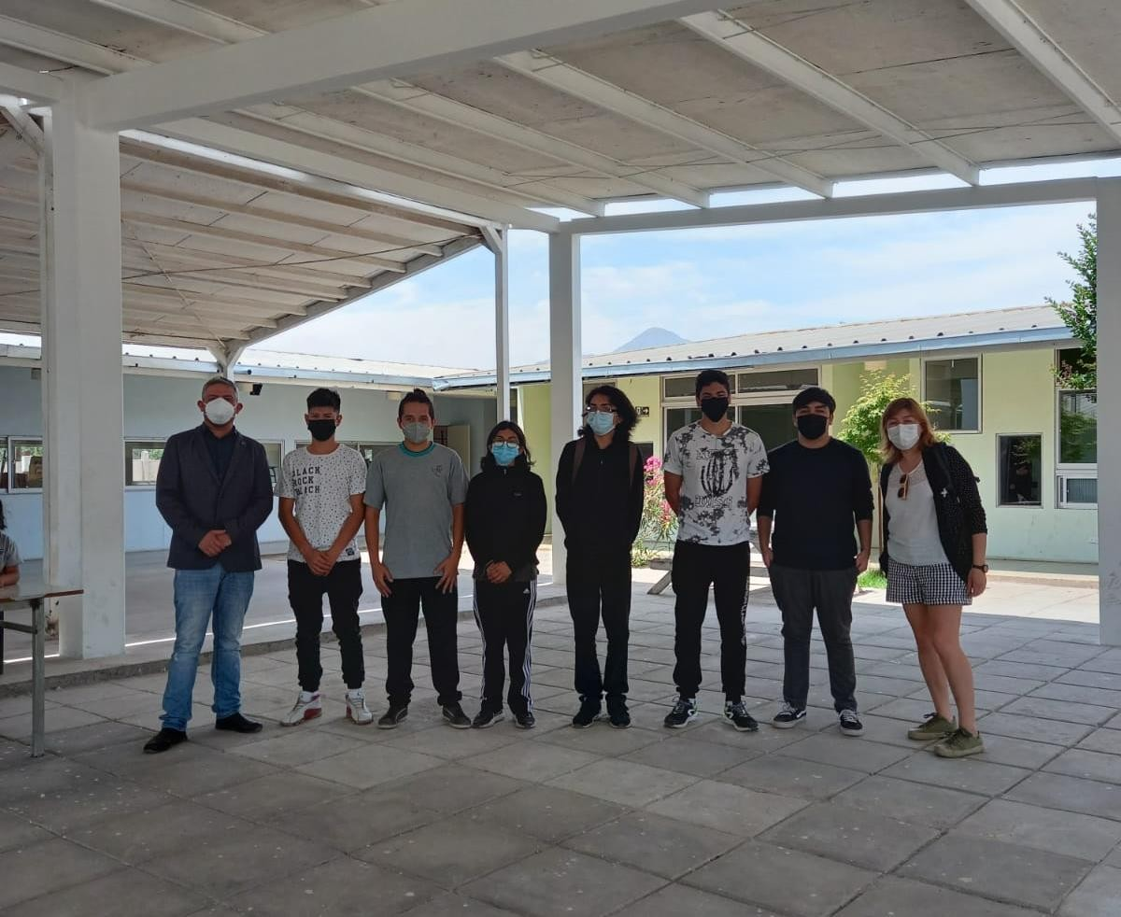
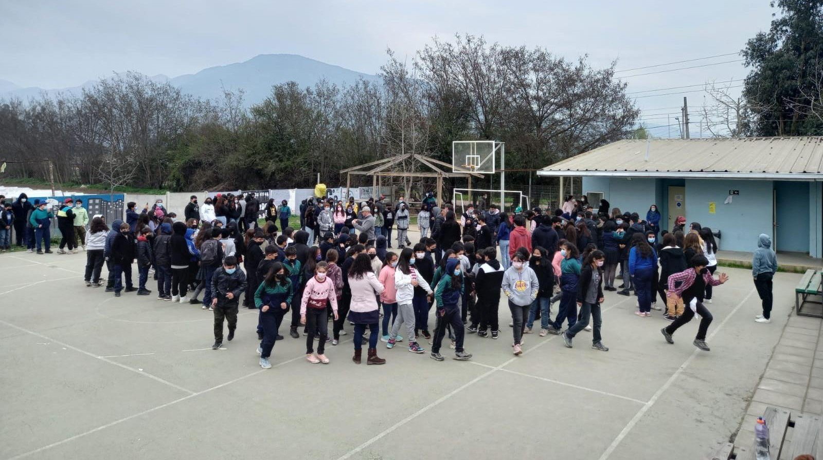
The journey: Colegio Altazol del Maipo

Slide 7
Challenges of working with IT at Colegio Altazol del Maipo
Training to use 360° cameras
Experimental recordings
Reflection and management of the recordings
Development of skills on the use of technology
Management of social networks created by the school
2nd ethical challenge and technological gap:
Who will be trained to manage the software to manage the collected pictures and recordings? Managed as a problem to be solved by informatics (external to the Project)
3rd ethical challenge:
As children become more advanced users of the technology, questions change and challenge the management of the recordings. They wanted to learn about the software.
4th ethical challenge and technological gap:
Who will be in charge of managing the social networks? External informatics (important gap).
Do these questions reveal a fragility in the use of technology among non-expert communities or reveal instead an opportunity for digital alphabetization?
1st ethical challenge:
Who owns the recordings?
How this management is translated into a Benefit for the school community? (to position the Project within their language/culture)

Slide 8
Impact of this research in the use of IT among school communities
IT challenge the school communities in different ways, even though the goal was the same, and drill recordings were obtained from both.
For the research, data collection has been successful. However, it revealed emergent but not less important outcomes: the use of technologies itself implies the knowledge of digital technologies (i.e. social networks).
Despite the immersive outcomes of this research, conducting the project on-site was critical to observe the interaction with the technology among children.

Slide 9
Impact of this research in the use of IT among school communities
“The doors of this school are open to your Project. However, if an eruption or earthquake happens there is nothing we can do” (School principal, May 2022)
Changes to the SPP (revising the safe zones, as well as the evacuation routes).
For the school in the South: they implemented for the first time the safety circle, in which students hold their hands and check if all of them are in the circle.
Preparedness appears like a topic they can work on and assess progress through technology.
360° recordings of the drill impacted positively the parents, as no one knew the SPP before watching the video, and those who watched the video could describe the SPP and felt more confident about the school in case of an emergency, as they could see the behaviour of their children and teachers.
“We need to continue working on preparedness, because the volcano is still there, and we are exposed to it” (School principal, May 2023).

Slide 10
References
Heidegger, M. (1977). Basic writings: from Being and time (1927) to The task of thinking (1964).
Kubicek, K., Ramirez, M., Limbos, M. A., & Iverson, E. (2008). Knowledge and behaviors of parents in planning for and dealing with emergencies. Journal of Community Health, 33(3), 158–168.
Johnson, V. A., Ronan, K. R., Johnston, D. M., & Peace, R. (2014). Evaluations of disaster education programs for children: A methodological review. International Journal of Disaster Risk Reduction, 9, 107–123.
Mitchell, T., Haynes, K., Hall, N., Choong, W., & Owen, K. (2008). The Roles of Children and Youth in Communicating Disaster Risk. Children, Youth and Environments, 18(1), 254–279.
Nations, U. (2015). Sendai framework for disaster risk reduction 2015-2030.
Tuan, Y. (1975). Place: An Existential Perspective. The Geographical Review, 65(2), 151–165.

Slide 11
Acknowledgments
Becas Chile scholarship for the development of advanced human capital.
Award to conduct fieldwork (2021-2022). School of Media and Communication, University of Leeds.
Supervision team: Mr Simon Popple, Dr Rebecca Jarman, ex supervisor Dr Tom Jackson).
Escuela Rural Colonia Río Sur
Colegio Altazol del Maipo

