Slide 1
Introduction to N8 CIR
Gillian Sinclair
N8 CIR Programme Manager

Slide 2
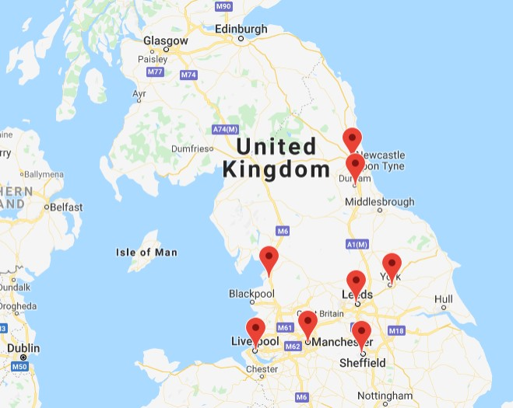
Who are we?
N8 Research Partnership is the 8 most research intensive universities in the North of England – Durham, Lancaster, Leeds, Liverpool, Manchester, Newcastle, Sheffield and York
N8 Centre of Excellence for Computationally Intensive Research (N8 CIR)
Derived from N8 HPC (2012 – 2018) which offered access to a shared compute platform for all 8 universities for 6 years.
Established to build on this partnership to expand the art of the possible within research themes by leveraging computational- and data-intensive practice.

Slide 3
N8 CIR Aims
Develop skills across the partner organisations
Develop shared software
Facilitate access to computational resources
Leverage funding for computationally intensive research
Help “non-traditional” users access computational resources
Accelerate research!

Slide 4
Practitioner-led approach
Important not to re-invent the wheel – leverage what is already out there.
Provide signposting & mechanism to share resources.
Inspire researchers to embrace new methods through practitioner-led activity
Provide forums for researchers to highlight their computational methods.
Online researcher case studies
Workshops and facilitated discussion
Capture domain-specific examples to enhance existing material.
Help bring training available outside of the region, into the region
Suggestions welcome!
Suggestions?

Slide 5
Our Themes
Themes
Digital Health
Digital Humanities
Research Software Engineers
Research Infrastructure Engineers
Machine Learning
Health and Humanities in place since Spring 2019; Machine
Learning launched Nov 2022
Wide variety of training / events for the Humanities including R, Python, web scraping, text analysis, visualisation, Machine Learning for Humanities and much more https://n8cir.org.uk/themes/digital-humanities/digital-humanities-resources/
Full details on our website and recordings on our YouTube channel - https://www.youtube.com/N8CIR

Slide 6
Bede – Tier 2 HPC
Tier 2 supercomputer delivered in early 2020
Comprised of 32 IBM Power 9 dual-CPU nodes, each with 4 NVIDIA V100 GPUs and high performance interconnect https://n8cir.org.uk/supporting-research/facilities/bede/hardware/
All N8 researchers can apply for access to Bede
Research Software Engineer support available at each institution to help you get started
For more information and to apply - https://n8cir.org.uk/supporting-research/facilities/bede/

Slide 7
Keep In Touch
Website – https://n8cir.org.uk/
Bede - https://n8cir.org.uk/bede/
Twitter - @N8CIR
Join our mailing list at https://n8cir.org.uk/contact/

