Slide 1

Animating Text Newcastle University
Jennifer Richards, Joseph Cowen Chair of English Literature, Newcastle University

Slide 2
The team (RSE, digital humanities, computing science, library services)
Kate Court, James Cummings, Fiona Galston, Kathryn Garside, Rachel Hammersley, Ian Johnson, Laura Kirkley, Jennifer Orr, Michael Rossington, Tiago Sousa Garcia, Mark Turner, Paul Watson, Magnus Williamson, and Nick Holliman (previously of NU, now Director of CUSP, London and Professor in Computer Science at King's College London.

Slide 3

What will the book of the future look like?
It will ‘be fluid [...] a richly networked portal, organized along lines of enquiry in which primary source material, secondary interpretations, witnesses and evidence, are all available, incorporated, made accessible for use’. Johanna Drucker, Graphesis: Visual Forms of Knowledge Production (Cambridge MA and London: Harvard University Press, 2014).

Slide 4
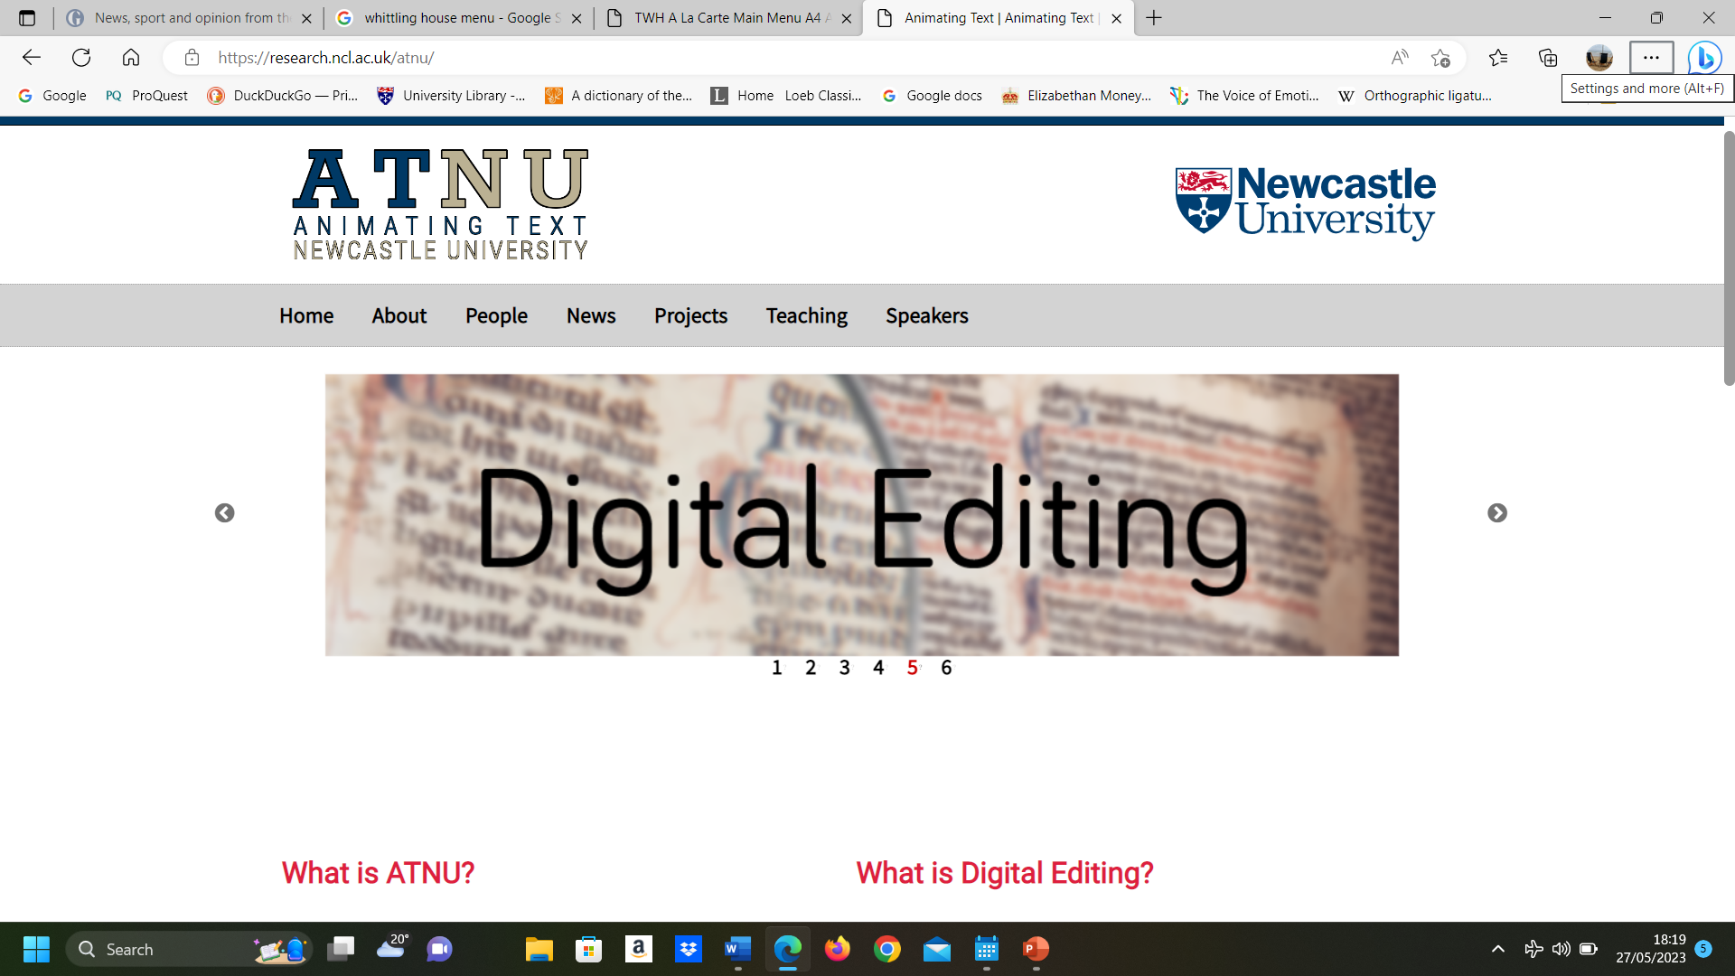

Slide 5
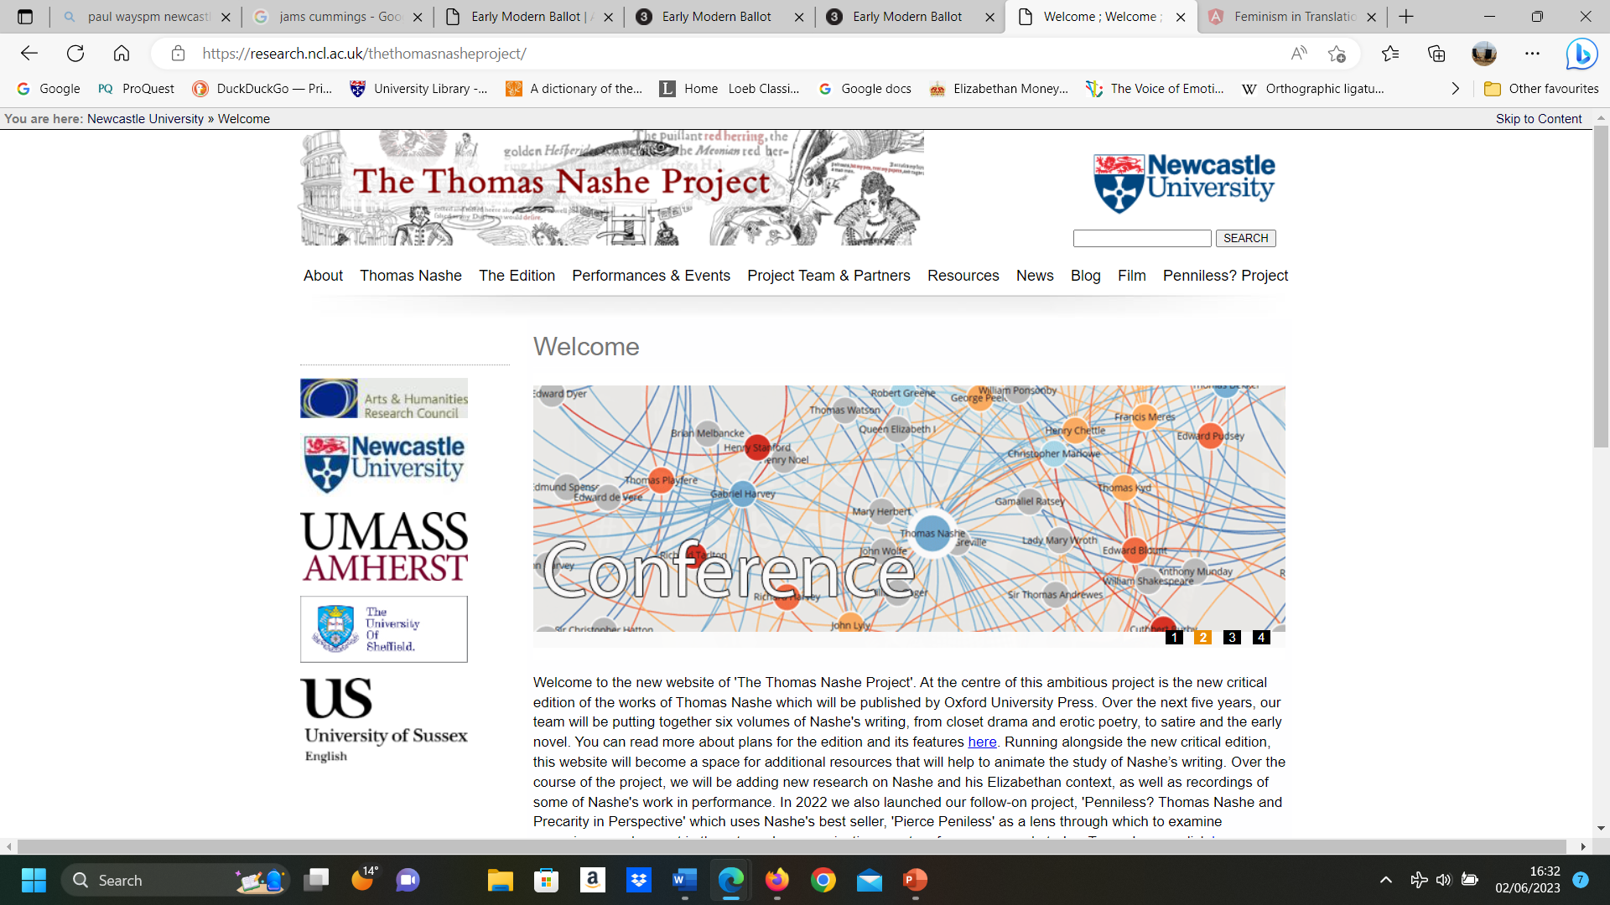

Slide 6
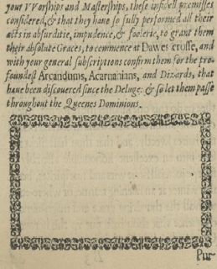
A page from Thomas Nashe, Have with you to Saffron Walden, 1596

Slide 7
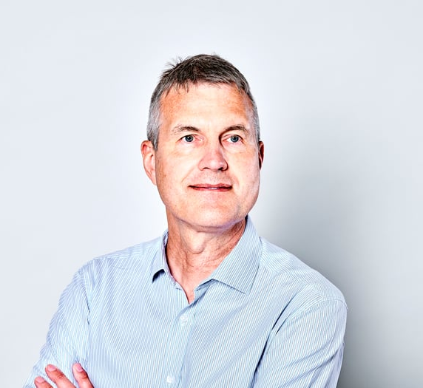
Paul Watson, Directior, National Innovation Centre for Data, Newcastle University

Slide 8
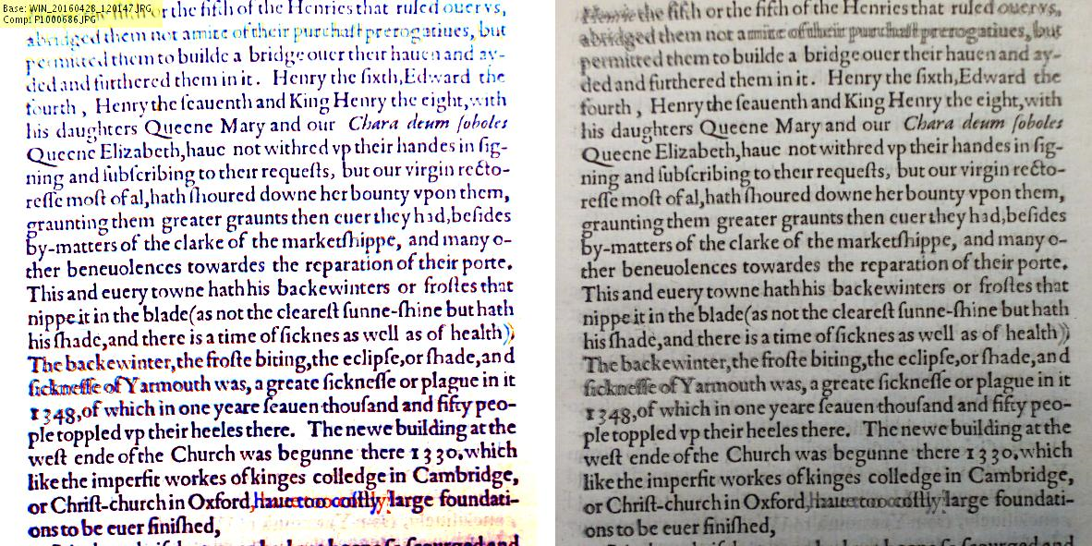

Slide 9
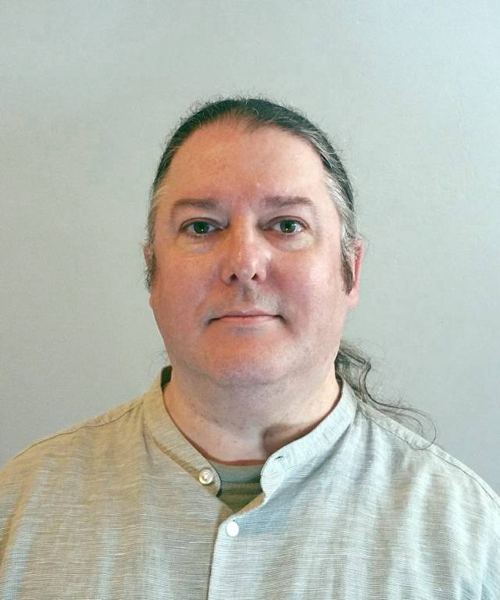
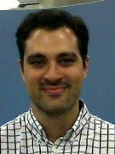
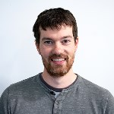
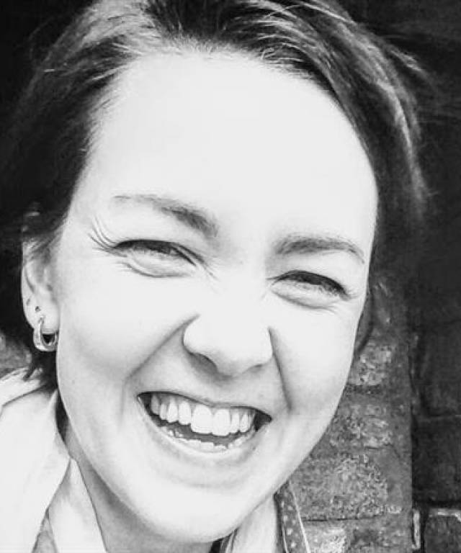
Some of the ATNU people

Slide 10
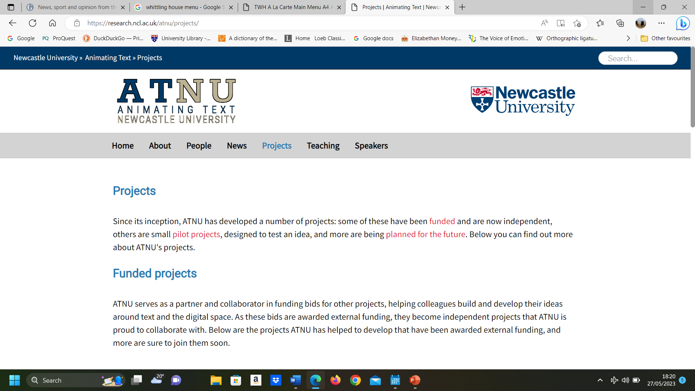

Slide 11
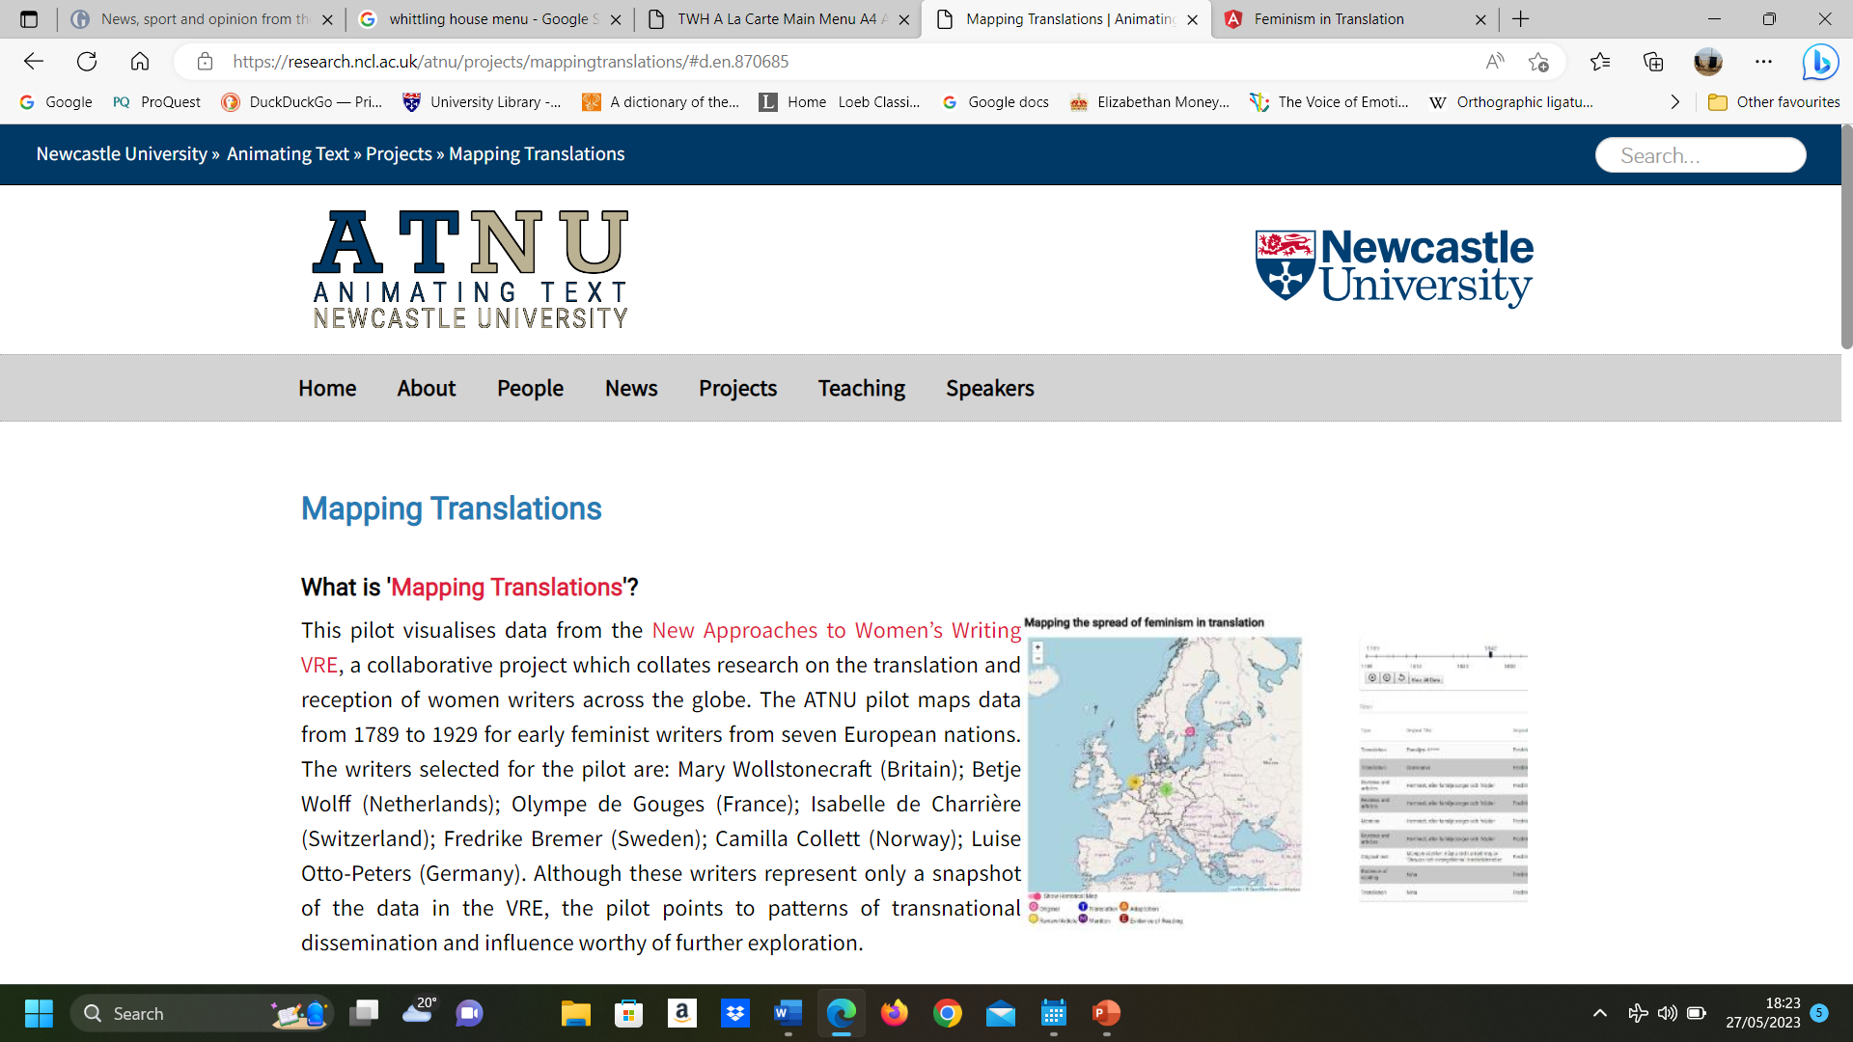

Slide 12
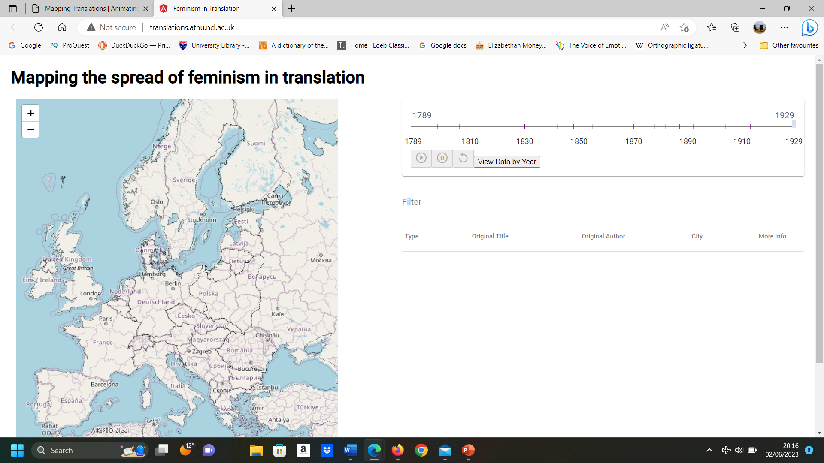
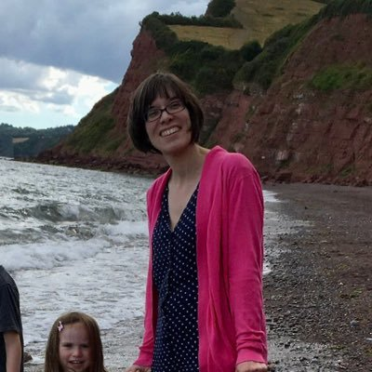

Slide 13
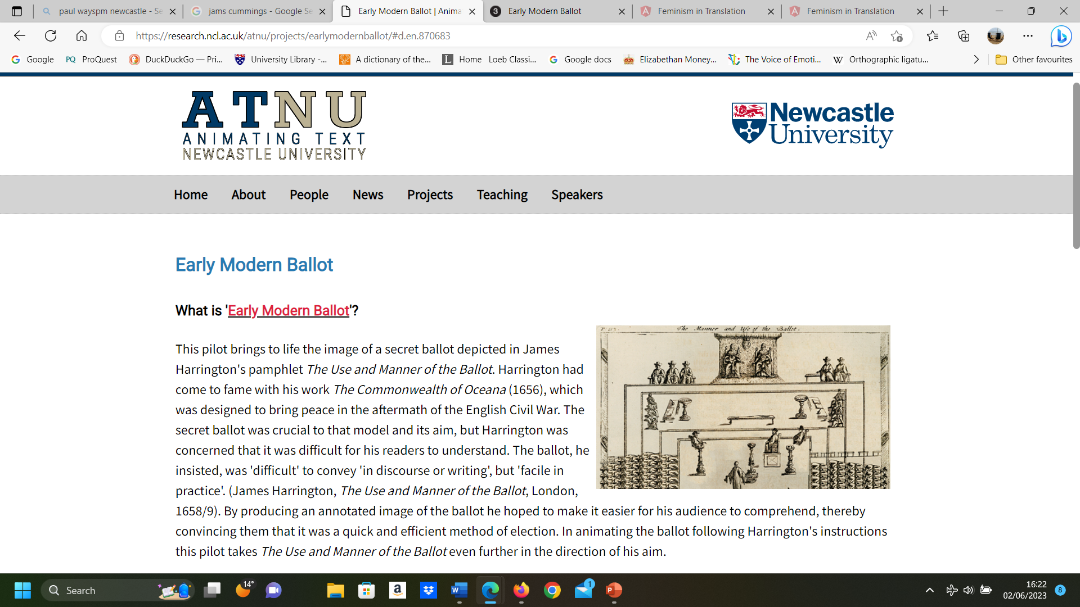
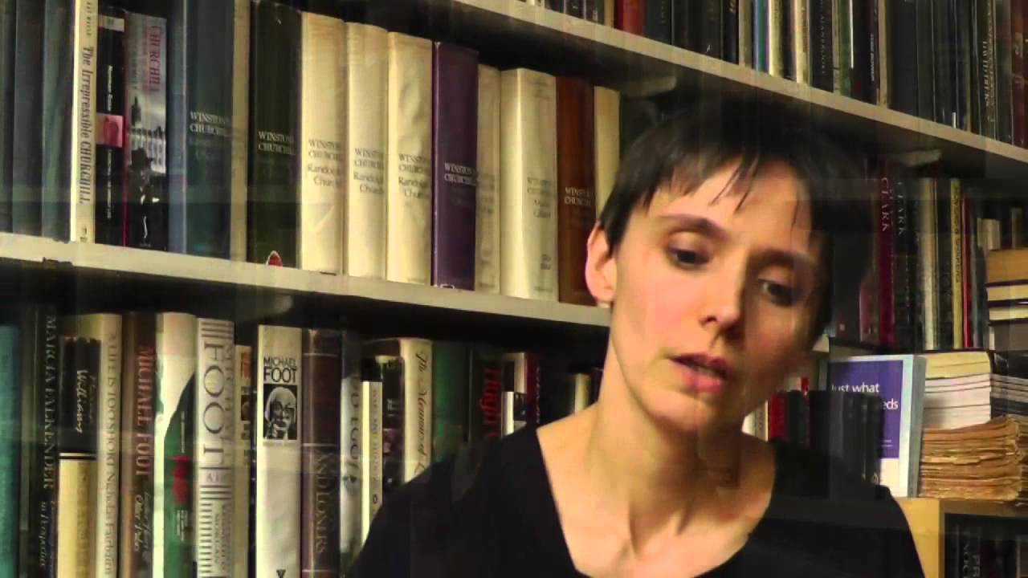

Slide 14
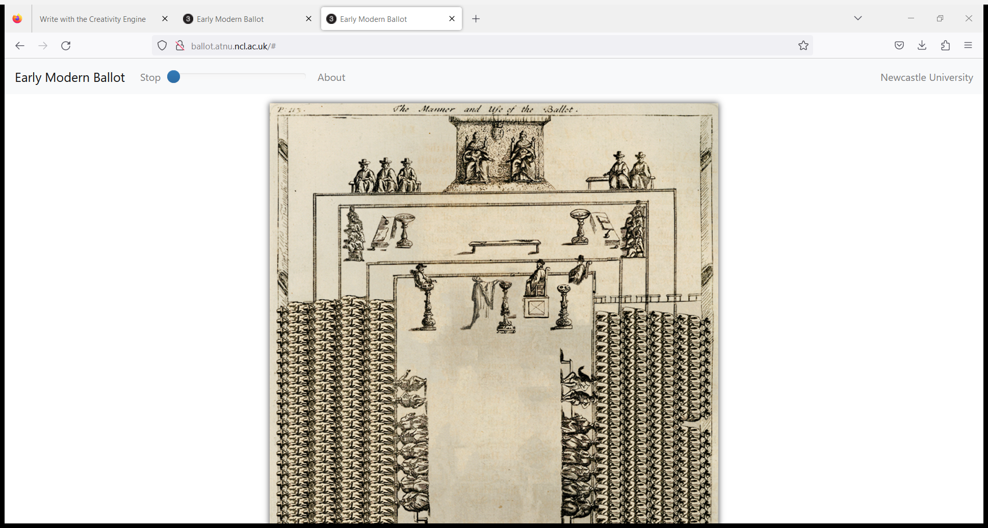

Slide 15
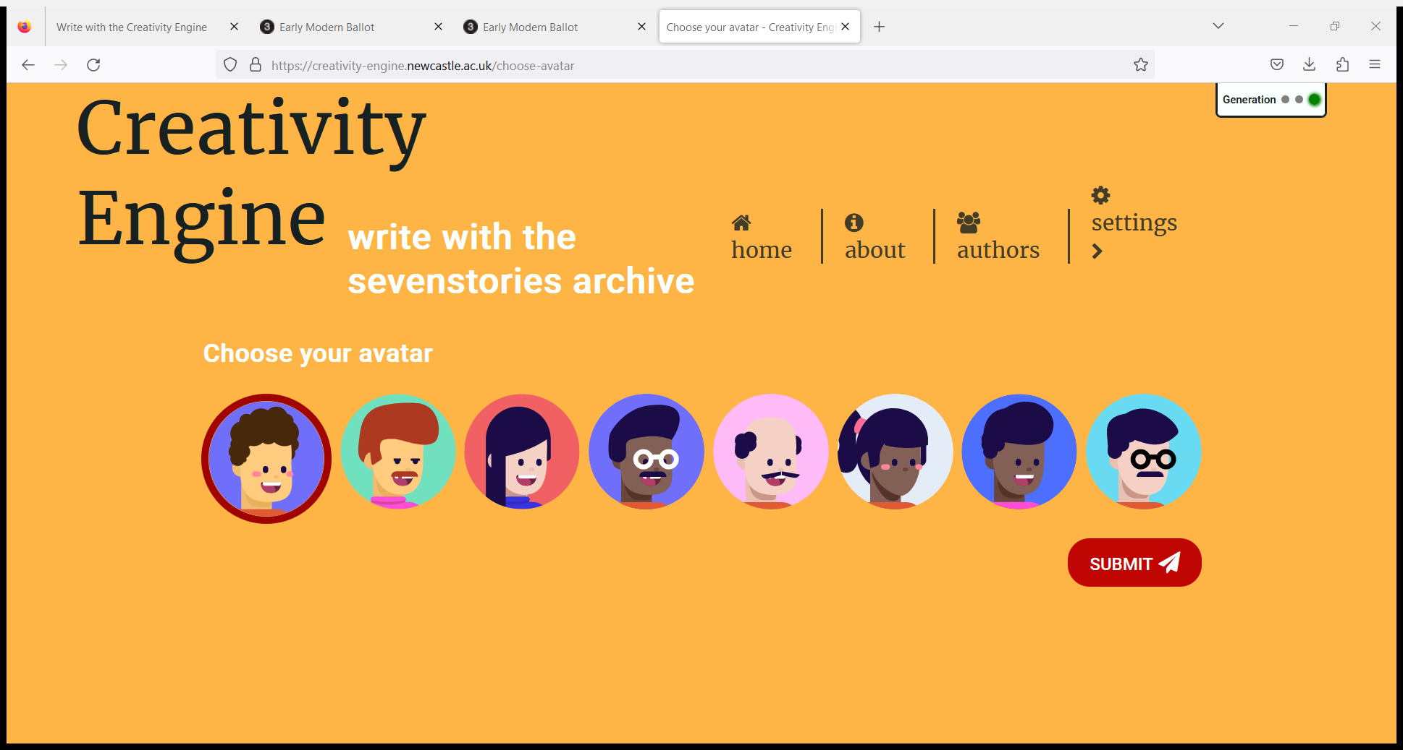
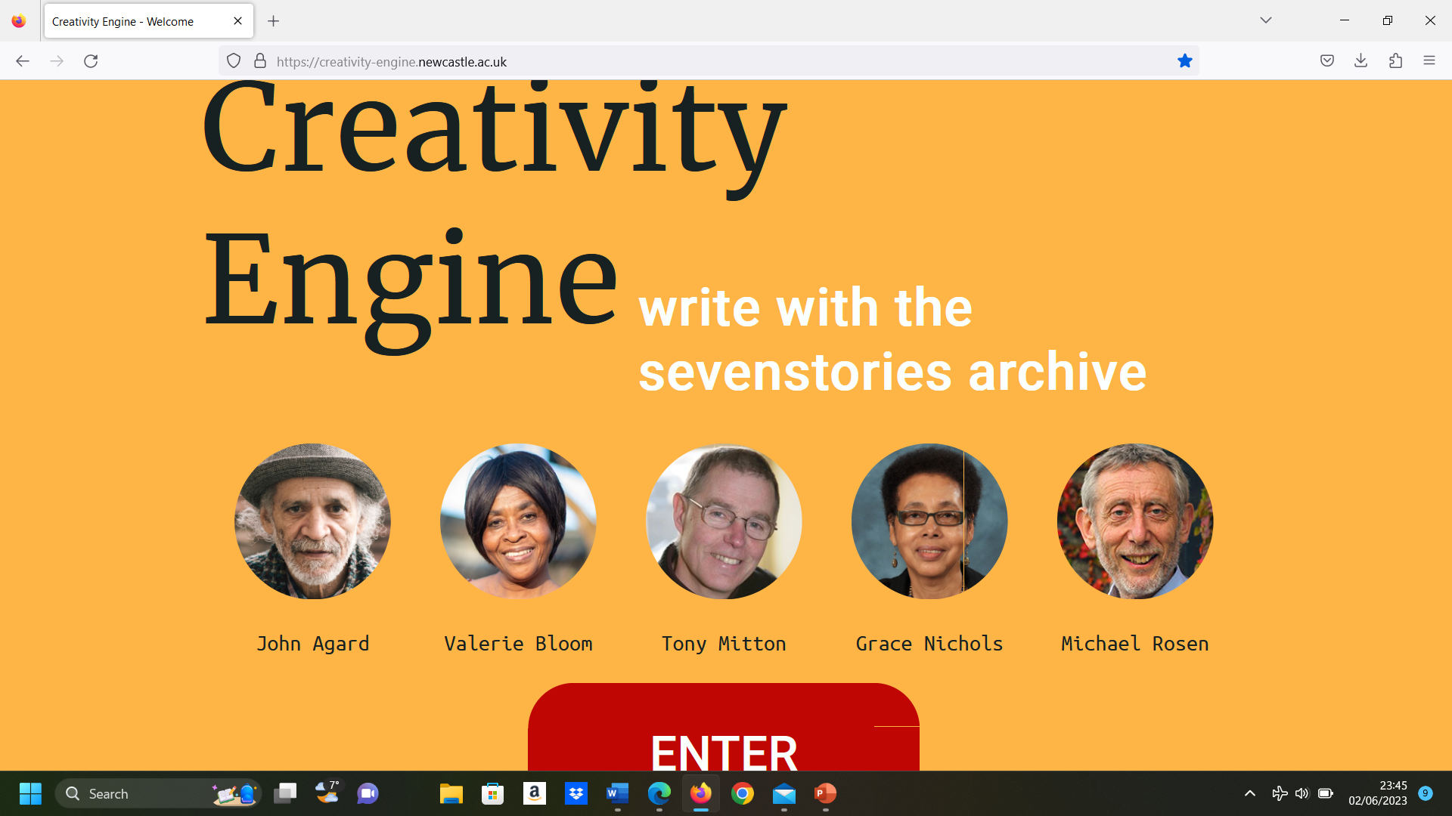

Slide 16
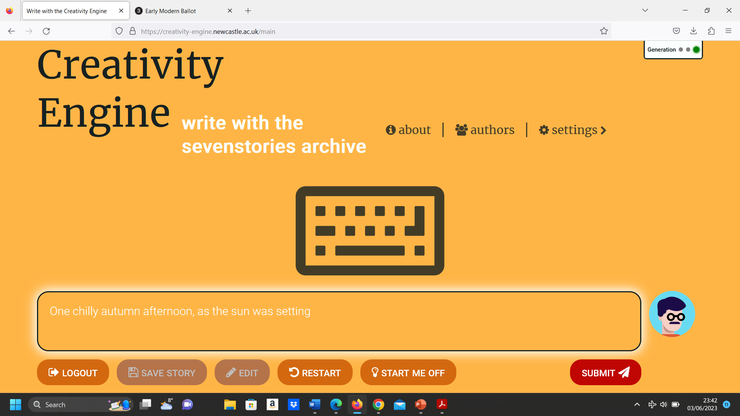

Slide 17
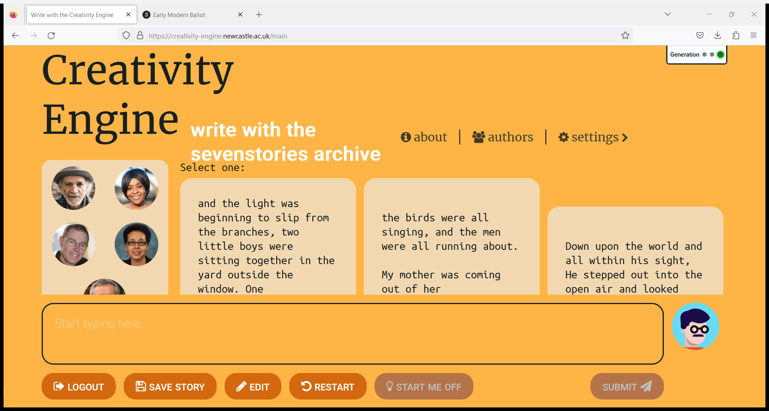

Slide 18
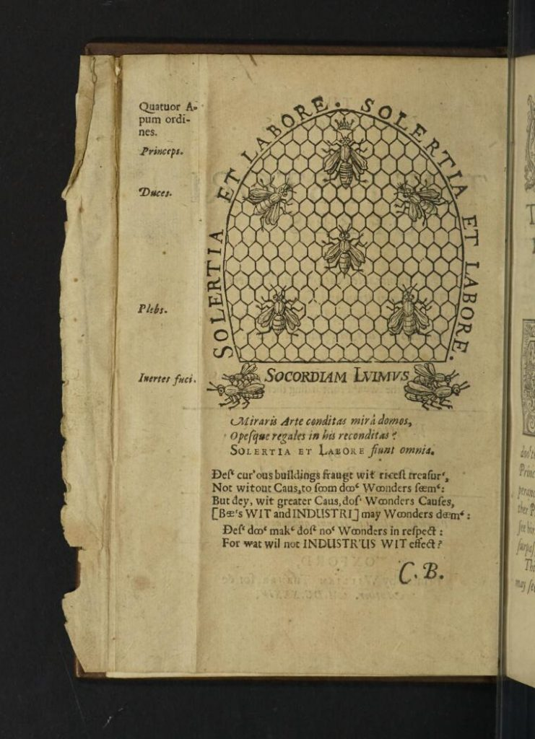
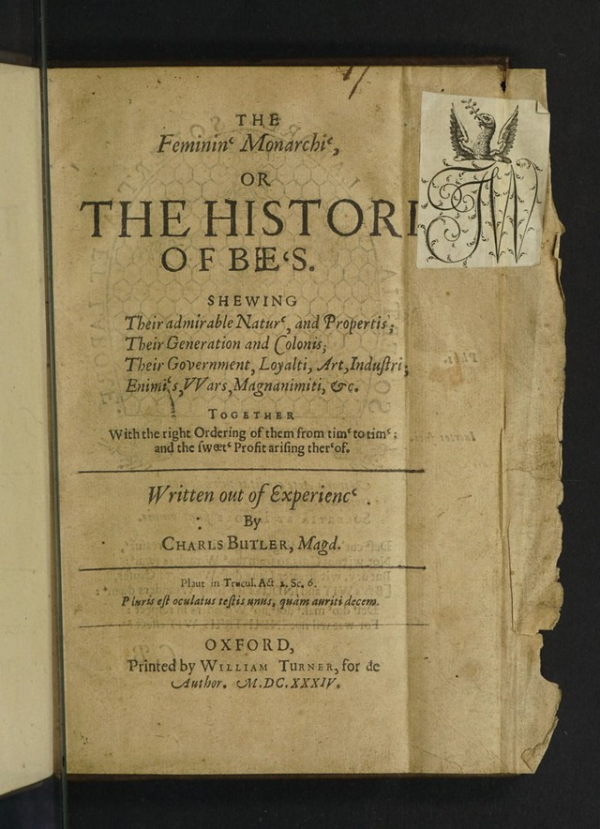

Slide 19
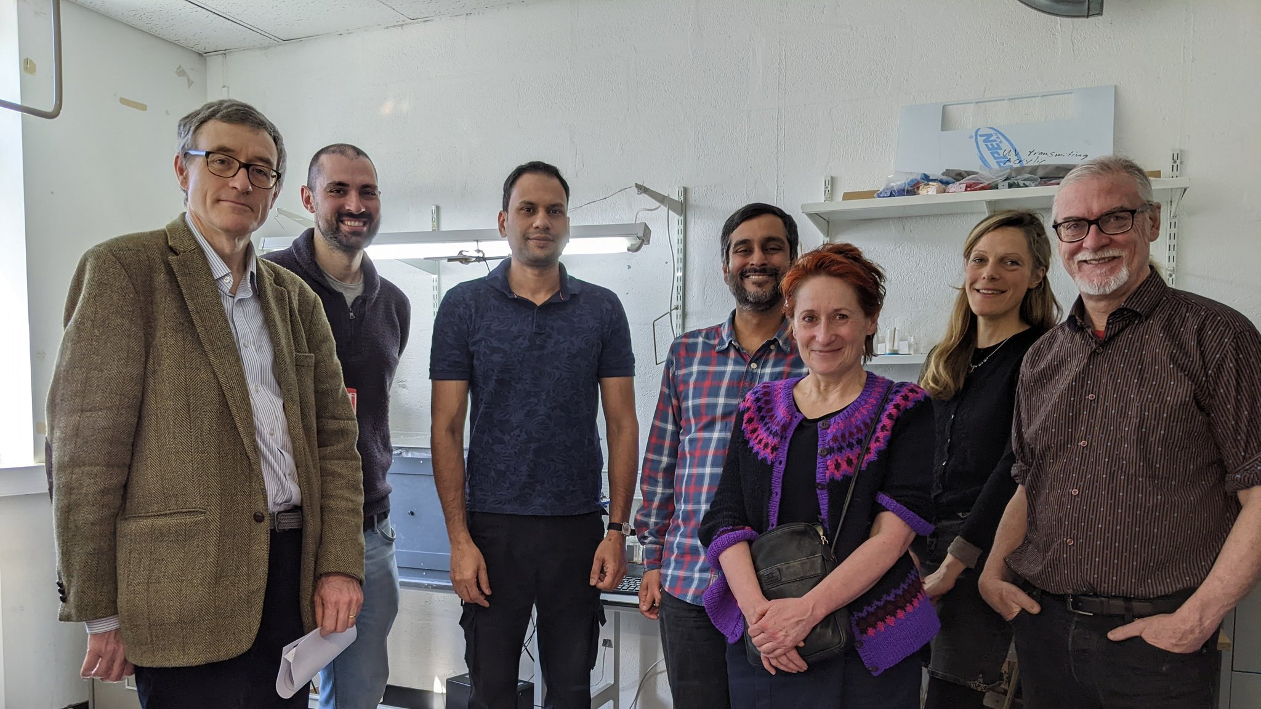
Bee-ing Human

Slide 20
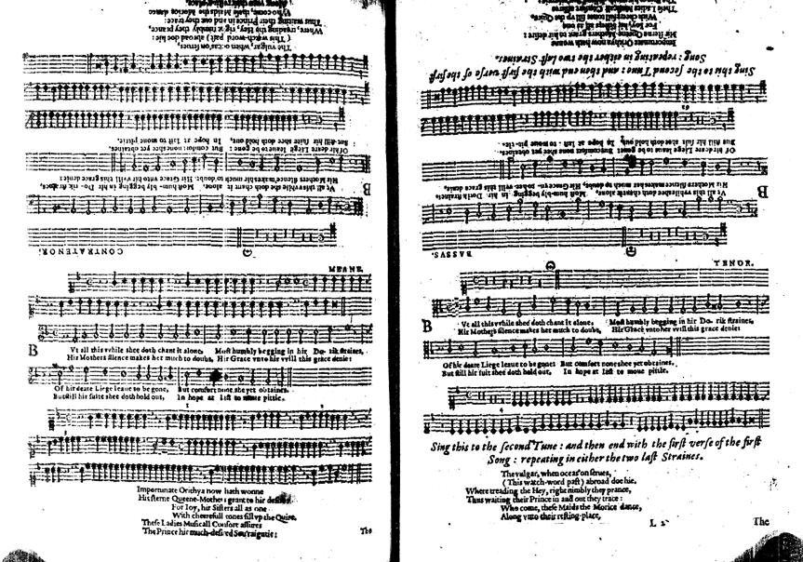

Slide 21
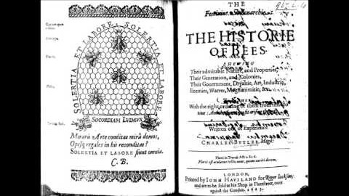
Notes:
From the 1623 score; play from 2.15)
Play from 3.36.

Slide 22

Thank you!

