Slide 1
Key Fundamentals of AI/ML including challenges and Opportunities for Health Data Community with a use case of DynAIRx for Optimising Prescriptions
Dr Asra Aslam
Research Fellow (University of Leeds, UK)
Contact: a.aslam2@leeds.ac.uk

Slide 2
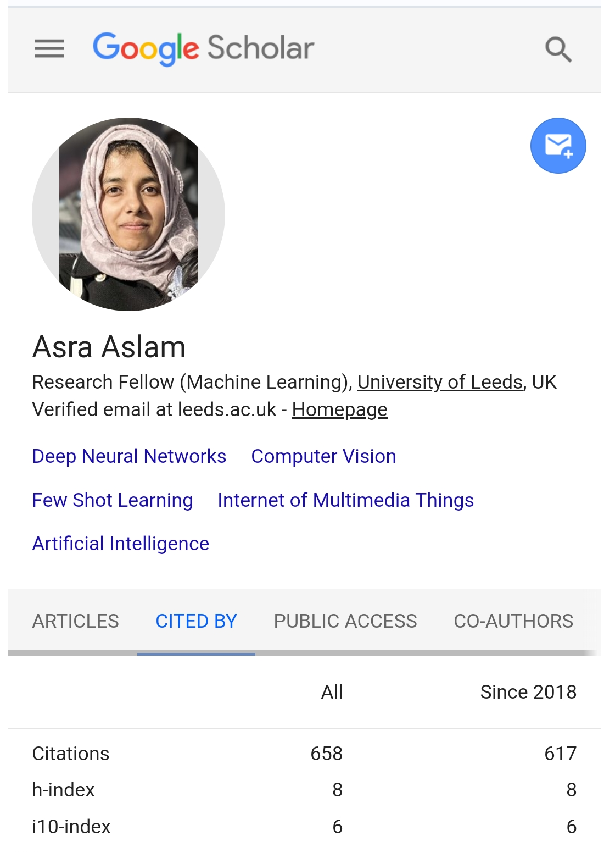
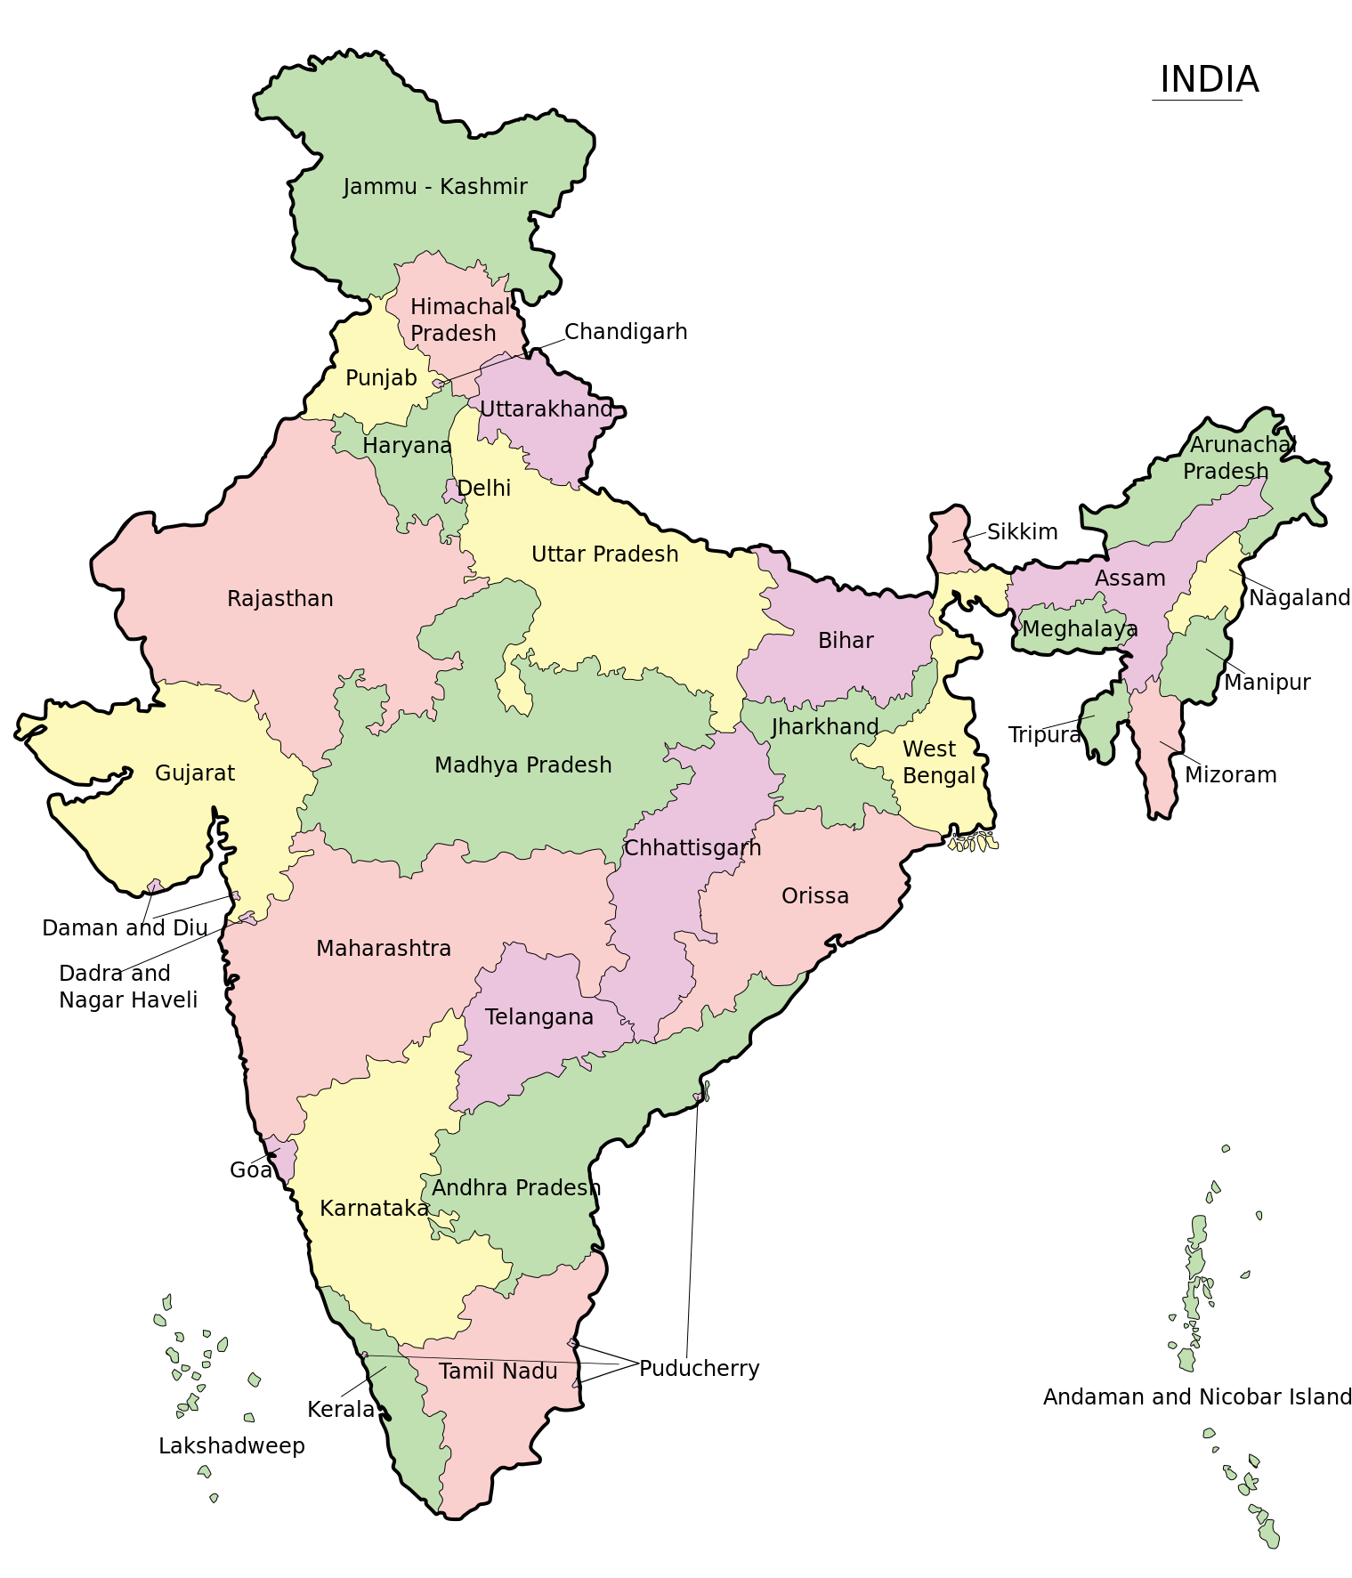
About Me!
Asra Aslam
From India
Research Fellow at Institute of Health and Data Science, University of Leeds, UK (Joined 21 March 2023)
Machine Learning Researcher at Industry (mindtrace.ai) in Manchester, UK (March 2021 to March 2023)
Ph.D. (2016 to 2021) from University of Galway, Ireland
Thesis Title “Detecting Seen/Unseen Objects with Reducing Response Time for Multimedia Event Processing”
Lecturer (from 2015 to 2016) at Computer Science and Engineering Dept, AMU, India
Chair at Women in Computer Vision (WiCV) community, which organize events at conferences like CVPR, ICCV, ECCV…
Masters and Undergraduate (M.Tech 2013-2015, B.Tech 2009-2013, Computer Science and Engineering), AMU, India

Slide 3
Outline
Basics of Machine Learning
State of the art of ML Techniques
Challenges and Opportunities of using AI in Health Data Sciences
TG-CNN for DynAIRx

Slide 4
Basics of Machine Learning
What is Machine Learning?
Machine learning algorithms can automatically learn and improve from data, without being explicitly programmed.
What is CNN?
A CNN is a neural network that are designed to recognize patterns in two or more-dimensional data.
We mostly use CNN for images and its layers performs an operation called ‘convolution’.
Convolution
?
Neural Network
?
Fully Connected
?
Cost
?

Slide 5
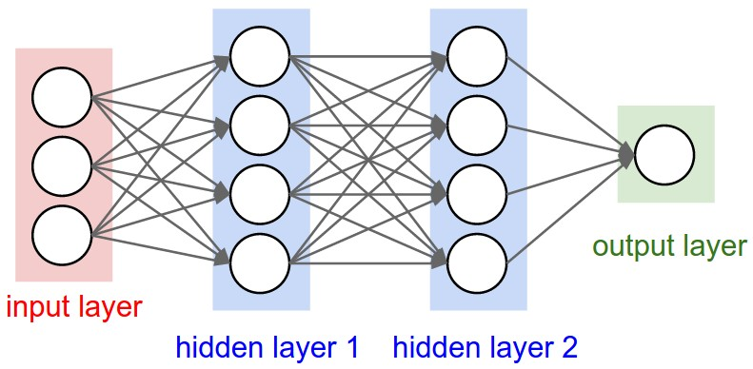
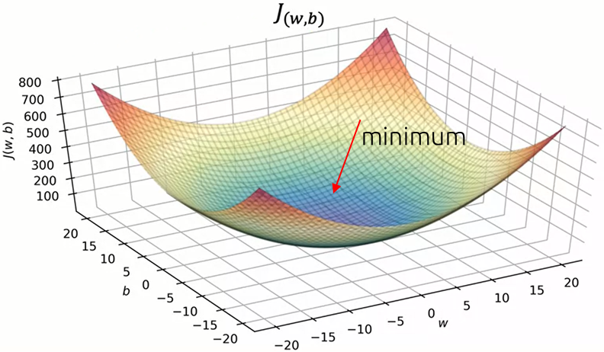
Building Blocks
What is neural network?
A neural network is a method in AI that teaches computers to process data in a way that is inspired by the human brain
Convolution?
Convolution is simply a type of linear operation used for feature extraction, where a small matrix, is applied to another matrix
Many Loss Types:
Mean Square Error Loss
Mean Absolute Error Loss
SVM Loss
Cross Entropy Loss
Cost Function
Cost function (also known as loss) measures the error between the output of neural network output with the actual output.
Gradient Descent algorithm is an optimisation method to find the minimum value of cost
Many Gradient Descent Method Types:
Batch Gradient Descent (BGD)
Stochastic Gradient Descent (SGD)
Mini-Batch Gradient Descent (mBGD)
Adam

Slide 6
Learnable Parameters vs Hyperparameters
Learnable Parameters:
Those parameters which can be learned by the machine
Examples: Weights and Biases
Hyperparameters
These are parameters which we supply to the model
Examples: Learning rate, regularization technique, batch size, Optimizer, number of epochs etc.
Hyperparameter Tuning! (which we always do)
Batch Size
Dropout
Epochs
Learning Rate
Freezing Layers

Slide 7
Machine Learning Cycle for any Use Case
Applying Machine Learning doesn’t end with model!
Pre-processing
Designing
Evaluation
Inference
- Acquire
- Explore
- Data Cleaning
- Feature Extraction
- Investigate Right Model
- Training
- Hyperparameter Tuning
- Domain Adaptation
- Formulate Evaluation Metrics
- Qualitative Analysis
- Quantitative Analysis
- Analyse Trade-offs
- Apply model to new data
- Analyse Domain Shift
- Improve Model
Update Approach
Deliverables: Cleaned Data Trained Models Metrics Hypothesis

Slide 8
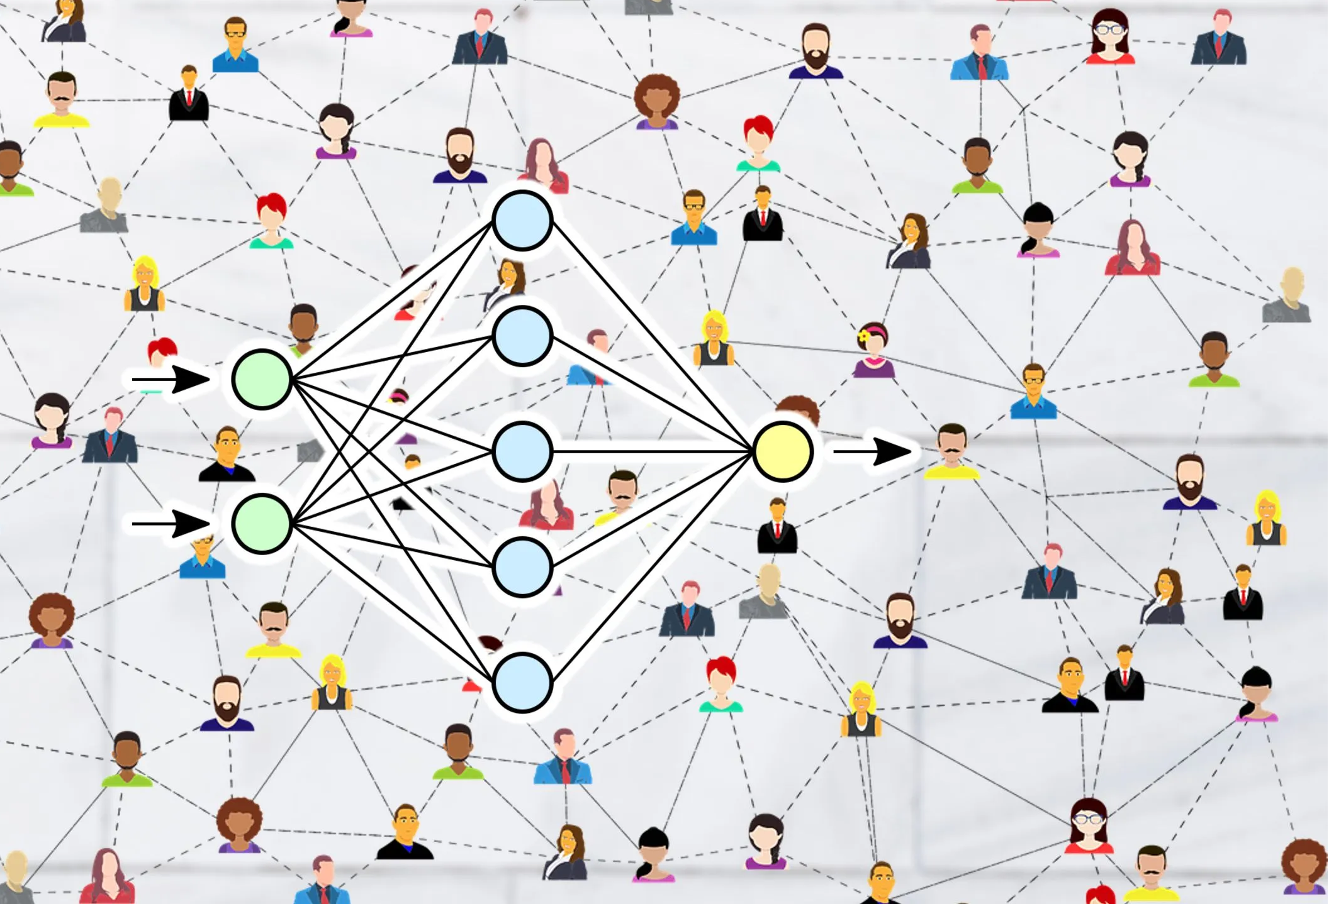
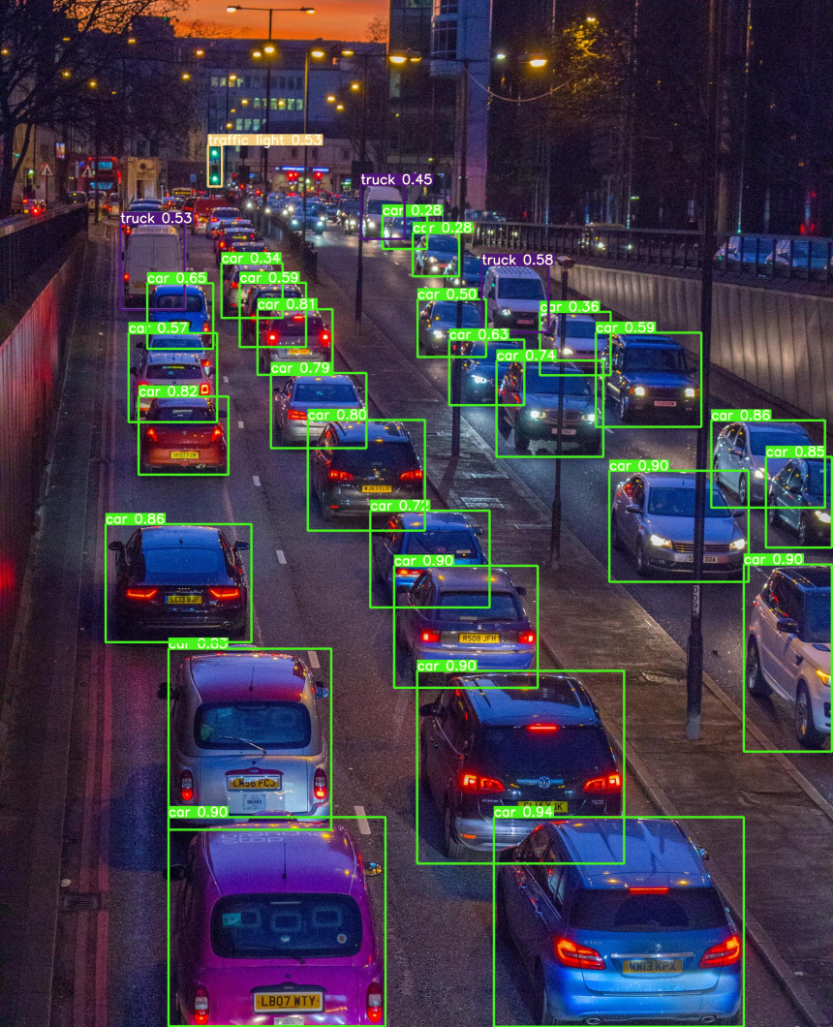
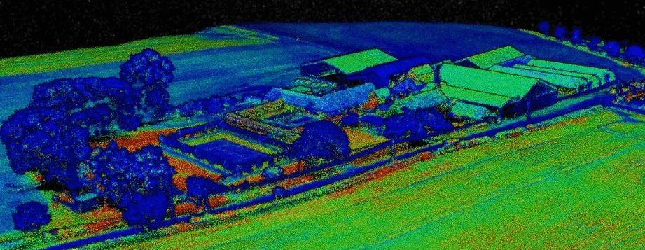
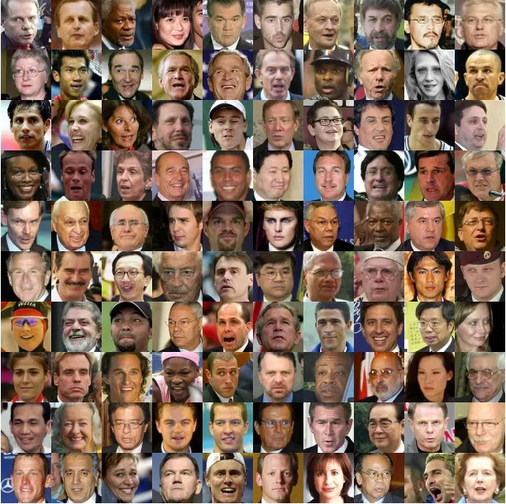
State of the art ML Techniques
Computer Vision
Natural Language Processing (NLP)
Graph Neural Networks
YOLOv7 for Object Detection
CLIP for Connecting text and Images
ResNet, EfficientNet, Inception, VGG for Image Classification
ChatGPT
Cohere
Codex
AI21
Voice Recognition
OpenAI Whisper
3D Point Clouds
Drug Discovery & Synthesizing Compounds
Social Influence Prediction
Recommender Systems
Scene Graph Generation
Pose estimation
PointNet++
SPVCNN
OpenAI Point-E
Generative Adversarial Networks (GAN)
Image Generation
Text Generation
Video Generation
Super Resolution

Slide 9
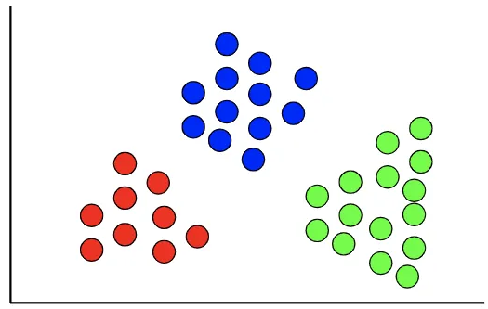
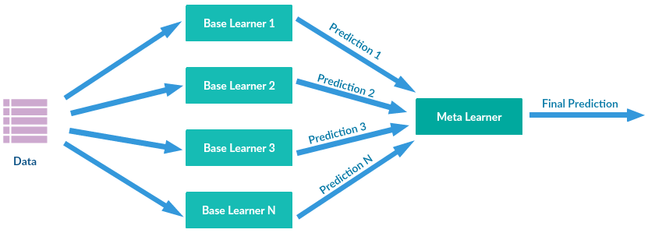
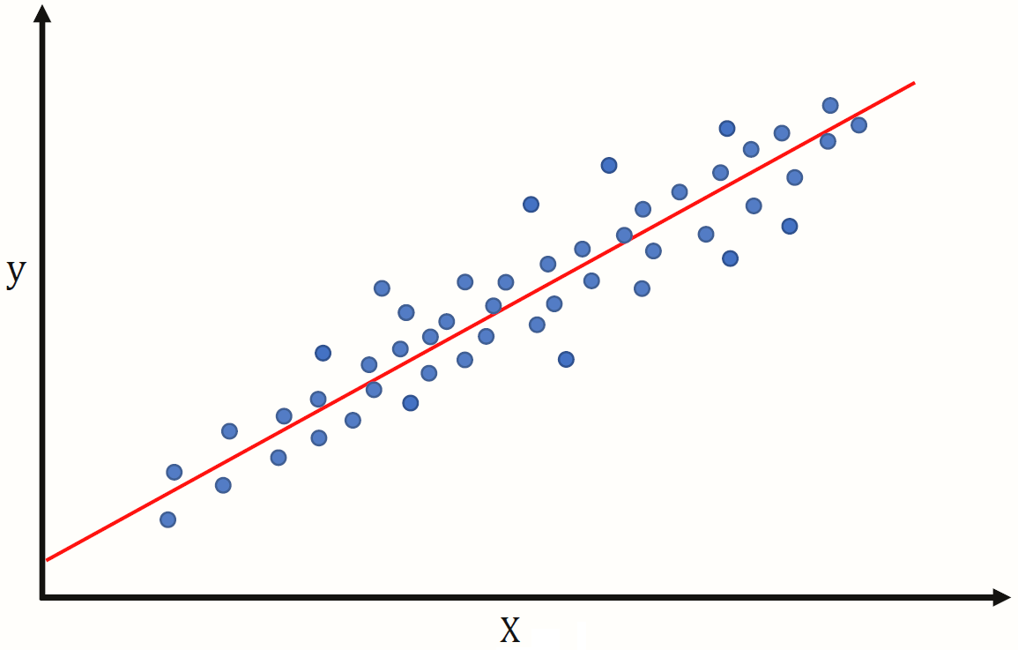
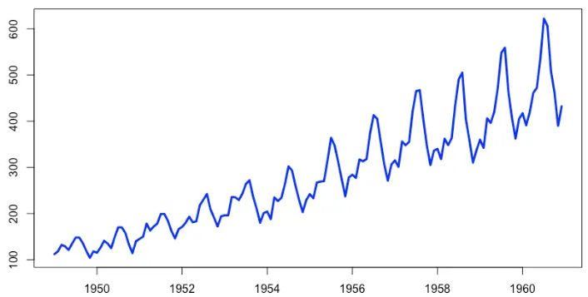
State of the art ML Techniques
Explanatory Algorithms
Ensemble Learning
Clustering
Linear/Logistic Regression
Decision Trees
Principal Component Analysis (PCA)
LIME
SHAPLEY
Random Forest
XGBoost
LightGBM
CatBoost
K-mode Clustering
DBSCAN
Spatial Clustering
Pattern Mining Algorithms
Time Series Algorithms
Apriori Algorithm
Recurrent Neural Network (RNN)
Long Short-Term Memory (LSTM)
SPADE
PrefixSpan
Prophet time series modelling
Autorgressive Integrated Moving Average
Exponential Smoothing

Slide 10
Challenges and Opportunities of using AI in Health Data Sciences
Lack of quality data
Expensive Data Collection, requires classification by experts of medical field
Privacy
Accountability and Responsibility
Trust
Bias and discrimination
Misuse and abuse of AI technologies could threaten patients’ safety and privacy
Public Health and Healthcare demand the highest standards of technical quality, ethics, transparency and fairness.
Risk for security breaches
Medical Imaging
Public Health Care
Retinal Disease Classification
Heart Disease
cancer detection[1]
tuberculosis detection[2]
covid detection[3]
privacy protection
social inequities
bias and discrimination
Examples of deep learning for health informatics [4]
heart disease diagnosis [8]
risk evaluation, procedural evaluation and planning [9]
ConvNet [5]
Transformer [6]
SVM [7]

Slide 11
TG-CNN for DynAIRx
Problem Statement:
Can AI be used to support structured medication reviews, optimising prescriptions for patients with multimorbidity?
Methodology:
Graph neural networks used for predicting mortality/hospitalisation
Temporal graph neural networks to incorporate elapsed time between health events
Use the model weights above to derive hypotheses on sequences of events that lead to poor patient outcomes
Causal modelling using both clinical and AI-based features
Visualise risk in GP-facing dashboards to help plan/run structured medication reviews
Dataset:
CPRD (presently)
Expected Deliverables:
Models to predict adverse events (e.g. falls, death)
Hypotheses regarding Causality

Slide 12
TG-CNN for DynAIRx
Temporal Graph
3D Tensor Form of Temporal Graph
$$e_{3}$$
3
8 days
0
0
9
0
1 day
6 days
SNOMED Code 4
0
0
0
0
SNOMED Code 1
SNOMED Code 2
0
0
0
0
$$e_{2}$$
2
0
0
0
$$Edge e_{1}$$
0
$$Node$$
$$e_{4}$$
0
0
0
0
9 days
SNOMED Code 3
0
0
0
0
0
0
0
0
1
8
0
0
0
0
0
0
0
0
0
0
6
$$G\left(e_{n},V_{s},V_{e}\right)=elasped time$$
0
0
0
0
0
0
0
0
0
Edge Index
$$e_{n}$$
$$G\left(0, 1, 2\right)=1$$
$$G\left(1, 2, 4\right)=6$$
1
2
3
4
0
1
0
0
Node Start
$$V_{s}$$
0
0
0
0
$G\left(2, 4, 1\right)=$8
0
0
0
0
$$G\left(3, 1, 3\right)=9$$
0
0
0
0
1 2 3 4
Node End
$$V_{e}$$

Slide 13
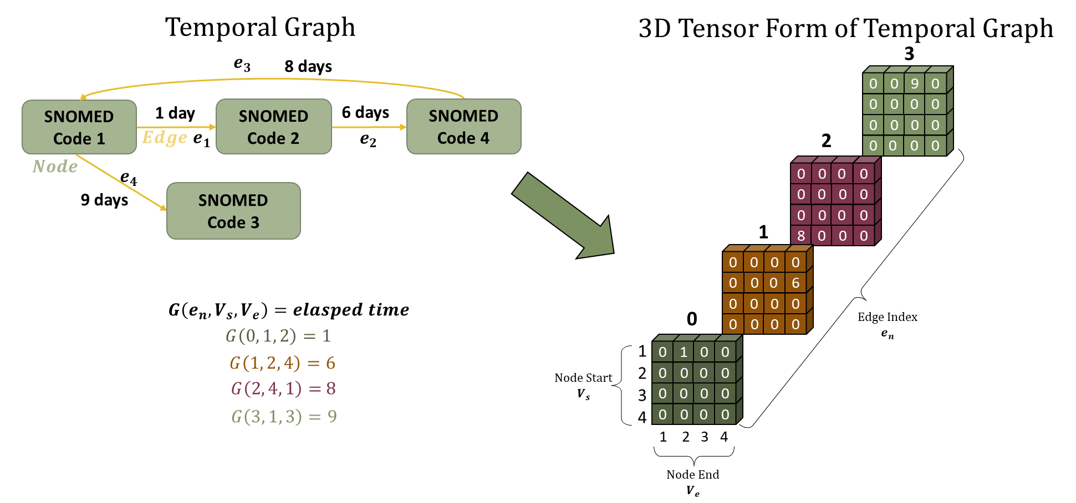
TG-CNN for DynAIRx
Prototype Temporal Graph Convolution Neural Network (TGCNN) on toy-dataset
Next Steps
Improvements to TGCNN using sparse linear algebra
Extract information from feature maps and construct hypotheses
Clustering to identify patterns and assist visualization of features

Slide 14
References
Hu, Z., Tang, J., Wang, Z., Zhang, K., Zhang, L., and Sun, Q. Deep learning for image-based cancer detection and diagnosis- a survey. Pattern Recognition, 83:134–149, 2018.
Lakhani, P. and Sundaram, B. Deep learning at chest radiography: automated classification of pulmonary tuberculosis by using convolutional neural networks. Radiology, 284(2):574–582, 2017.
Panwar, H., Gupta, P., Siddiqui, M. K., Morales-Menendez, R., and Singh, V. Application of deep learning for fast detection of covid-19 in x-rays using ncovnet. Chaos, Solitons & Fractals, 138:109944, 2020.
Rav`ı, D., Wong, C., Deligianni, F., Berthelot, M., Andreu- Perez, J., Lo, B., and Yang, G.-Z. Deep learning for health informatics. IEEE journal of biomedical and health informatics, 21(1):4–21, 2016.
Sunija, A., Kar, S., Gayathri, S., Gopi, V. P., and Palanisamy, P. Octnet: A lightweight cnn for retinal disease classification from optical coherence tomography images. Computer methods and programs in biomedicine, 200:105877, 2021.
He, J., Wang, J., Han, Z., Ma, J., Wang, C., and Qi, M. An interpretable transformer network for the retinal disease classification using optical coherence tomography. Scientific Reports, 13(1):3637, 2023.
Arunkumar, R. and Karthigaikumar, P. Multi-retinal disease classification by reduced deep learning features. Neural Computing and Applications, 28:329–334, 2017.
Nedadur, R.,Wang, B., and Tsang,W. Artificial intelligence for the echocardiographic assessment of valvular heart disease. Heart, 108(20):1592–1599, 2022.
Ribeiro, J. M., Astudillo, P., de Backer, O., Budde, R., Nuis, R. J., Goudzwaard, J., Van Mieghem, N. M., Lumens, J., Mortier, P., Mattace-Raso, F., et al. Artificial intelligence and transcatheter interventions for structural heart disease: a glance at the (near) future. Trends in cardiovascular medicine, 32(3):153–159, 2022.

Slide 15
Thank you!
Dr Asra Aslam (Leeds Institute of Health Sciences)
Contact: a.aslam2@leeds.ac.uk

