Slide 1
Enhancing the researcher health data discovery journey through research project feasibility analysis using the Gateway Cohort Discovery tool
N8CIR data and access virtual event
Dr. Isaac Odiase

Slide 2
Today’s talk
Access to health data is regularly ranked as a barrier by health data researchers.
The Gateway Cohort Discovery tool provides researchers with dataset population sizes from multiple data partners across the UK, based on specified query parameters.

Slide 3
Agenda
HDR UK mission and goal
The Innovation Gateway platform
Research project population size feasibility tool (Cohort Discovery)

Slide 4
Health Data Research (HDR) UK mission and goal

Slide 5
MISSION: to unite the UK’s health data to enable discoveries that improve people’s lives VISION: for large-scale data and advanced analytics to benefit every patient interaction, clinical trial and biomedical discovery, and to enhance public health

Slide 6
What we are about?
Improve health and boost UK science by making it easier for researchers to find, access and use diverse, high-quality data
Provide leadership to fix difficult technical problems, by creating innovative solutions needed for researchers to use large-scale data safely and securely
Accelerate & streamline health data science by developing open collaborations that connect data, people and organisations across the UK and internationally
Link Data
Curate Data
Analyse Data
Access Data
Create Insights
Find Data
Improve
Health
Accelerating the researcher journey towards trustworthy use of data for public benefit

Slide 7
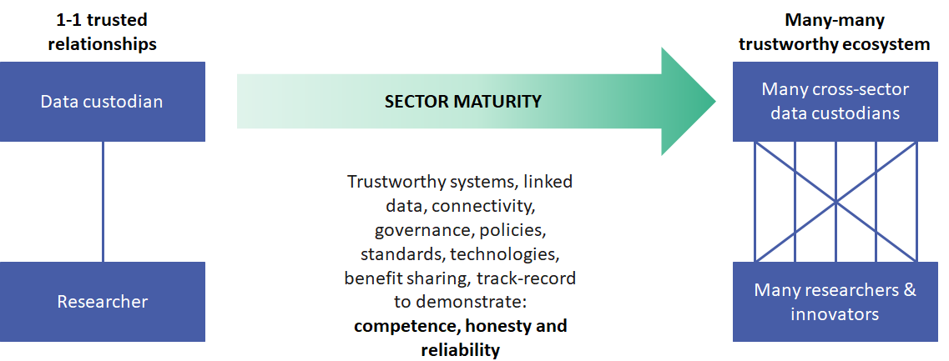
The problem we are trying to solve
Trustworthy data systems needed to link sensitive data, require consistency of information governance, policies, standards and interoperable technology
Establishing a trustworthy health data research ecosystem to accelerate use of data for public benefit

Slide 8
HDR UK enables studies on 67m people to accelerate research that improves lives
67 million people
20-year vision
For large-scale data and advanced analytics to benefit every patient interaction, clinical trial and biomedical discovery, and to enhance public health.
Across the lifespan
Diversity and detail

Slide 9
Innovation Gateway

Slide 10
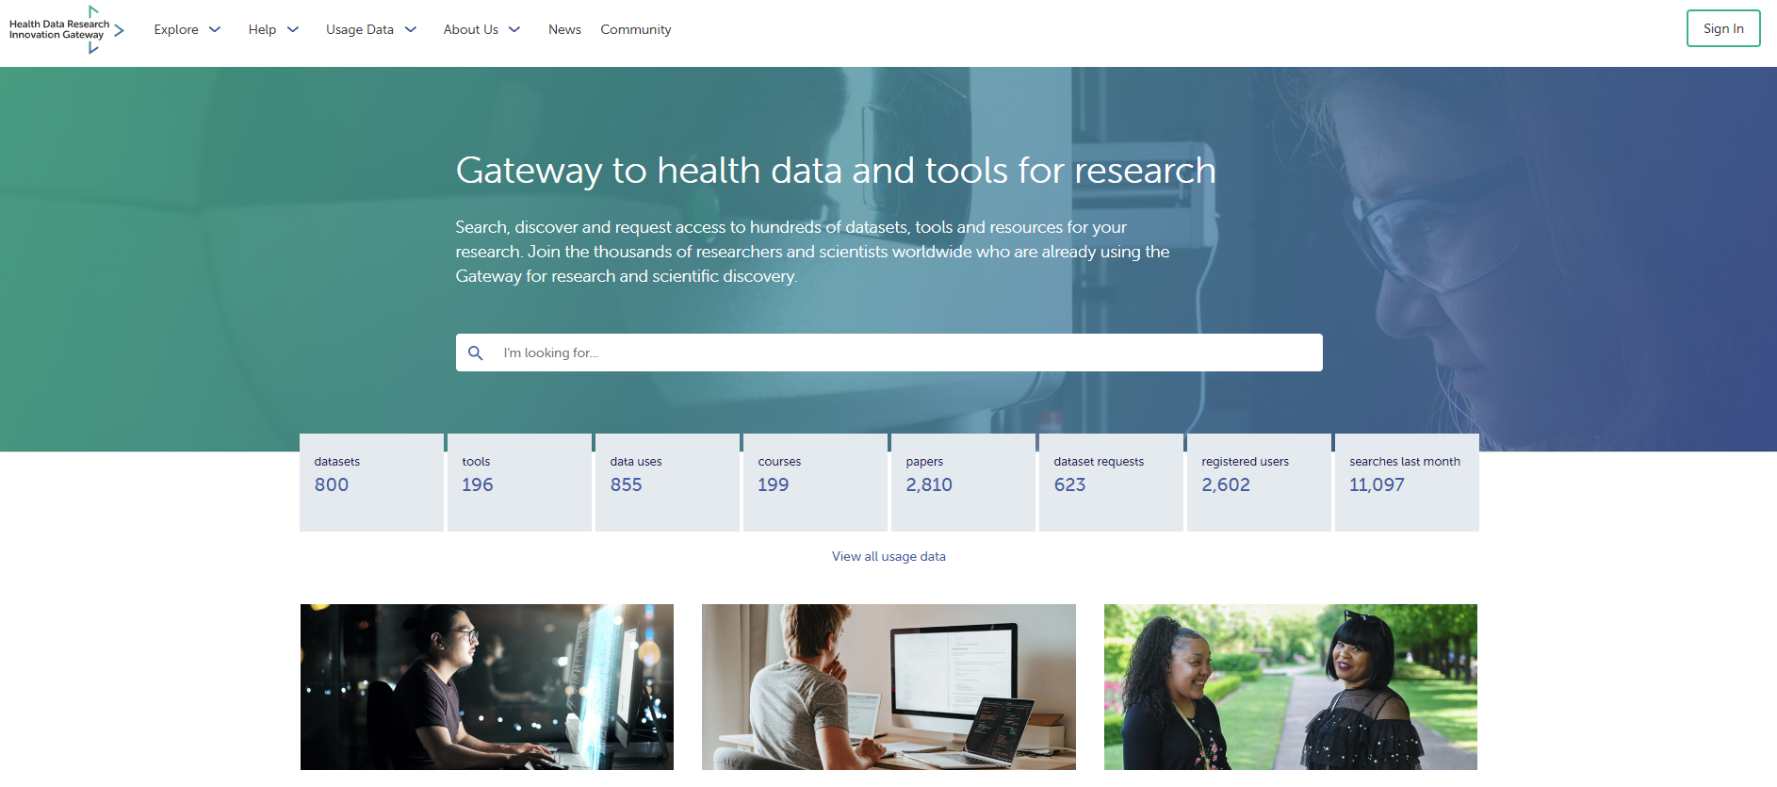
The Gateway
HDRUK Innovation Gateway | Homepage (healthdatagateway.org)

Slide 11
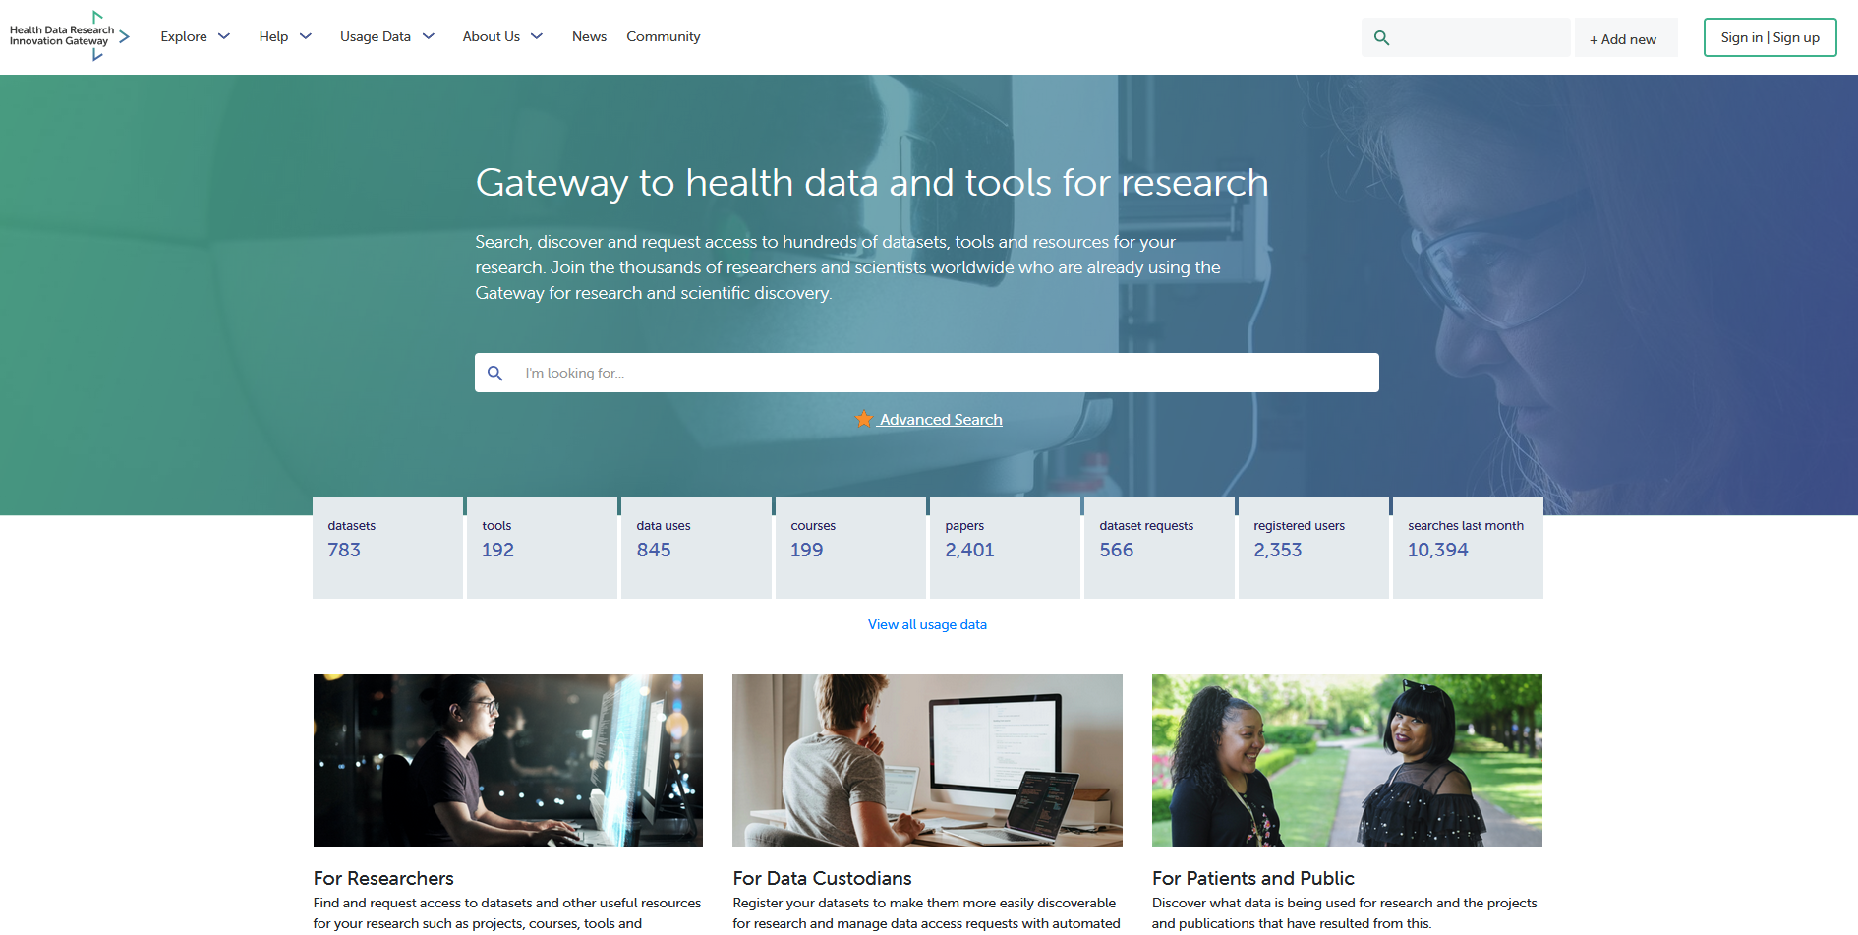
The current Gateway (Mk1)
Data Access Requests (DAR): Enquiries, Application & Approvals
Data Discovery: Metadata
Data Use Register: Transparency on use of data:
Data Discovery: Collections, Tools, Publications
Data Discovery: Cohort Discovery Tool

Slide 12
Gateway Mk2 – enhanced features
Use Gateway tech in your website and brand your entries on the Gateway
Point people at other solutions
Using NLP and Elastic Search
Advanced Search
Brandable
Sign-posting
Analysis scripts, detailed metadata, federated analytics
Multiomic, imaging, open, non-health
End to End Researcher Journey
Additional Data Types
DCAT, Schema.org, DDI
Share with Gateway- we share with other networks
Multiple metadata standards
International exposure

Slide 13
Gateway as the ‘single front door’ for the NHS research SDE network
“The Gateway will evolve to provide users with a clear and consistent user journey for data discovery and cohort finding; reducing complexity and confusion for those wanting to securely access data to improve care and reduce burden on the NHS.”
https://www.linkedin.com/pulse/transforming-data-enabled-research-landscape-england-bloomfield/

Slide 14
Cohort Discovery tool

Slide 15
What are the current barriers to discovering, identifying and accessing health data for research?
Option | Ranking
Lack of standard data access request processes and policies | 1
Lack of transparency around data access request processes and policies | 2
Complexity of data access request process | 3
Length of time to get data access approvals | 4
Lack of training materials/awareness on how to find and access datasets | 5
Length of time to get ethical approval | 6
Complexity of ethical approval process | 7
Lack of common data standards within multiple Trusted Research Environments (TREs) | 8
Skills to use analytic tools available in Trusted Research Environments (TREs) | 9
Trusted Research Environment (TRE) Disclosure control processes for extracting analytical output | 10

Slide 16
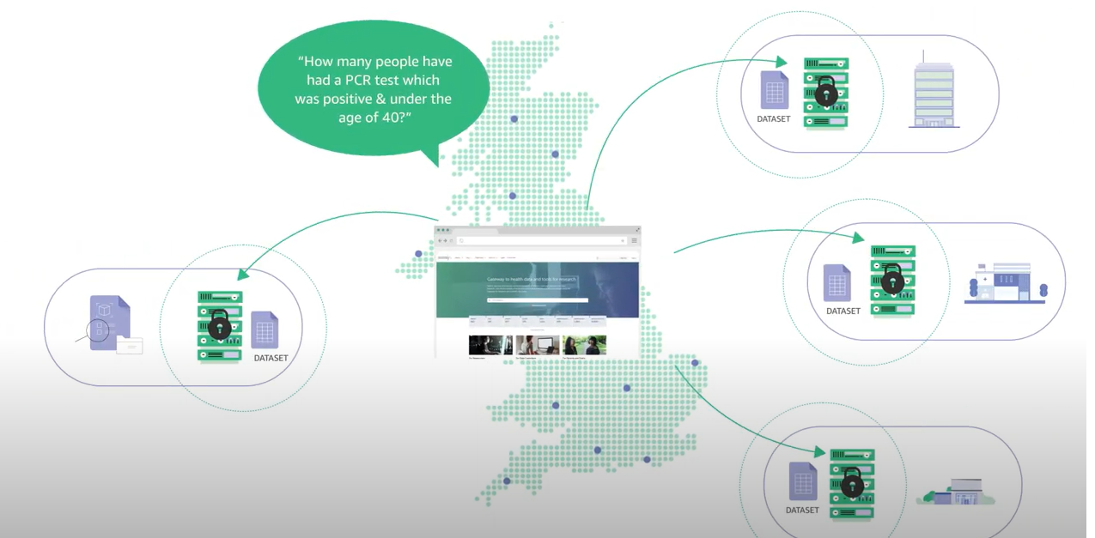
Cohort Discovery tool

Slide 17
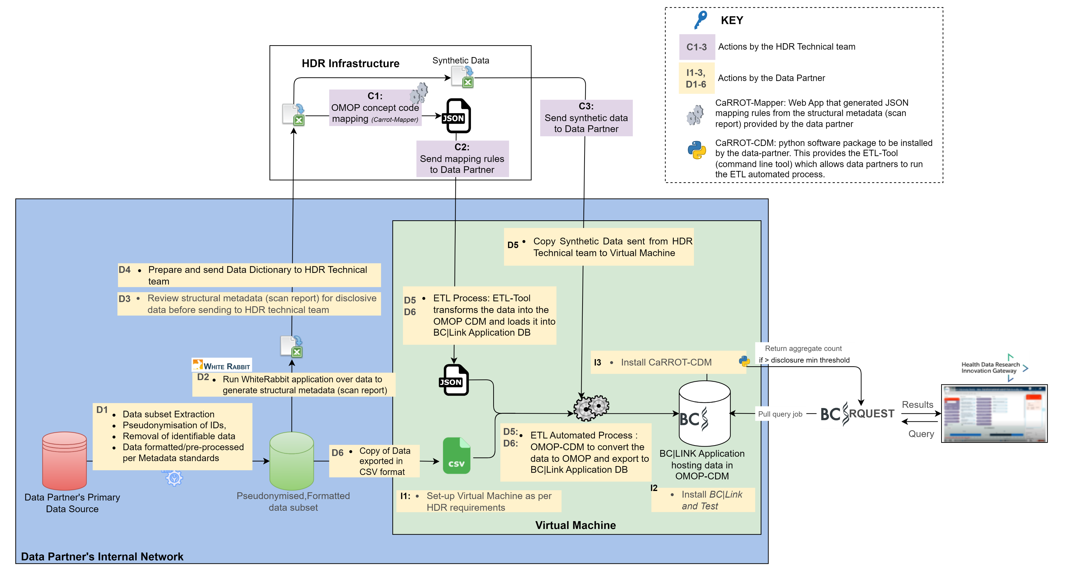
Process overview

Slide 18
Cohort Discovery explainer
https://www.youtube.com/watch?v=yvFrnbXlqRk&embeds_referring_euri=https%3A%2F%2Fwww.healthdatagateway.org%2F&feature=emb_imp_woyt

Slide 19
Benefits
Save researchers time in finding datasets that are most suitable for their research
Researchers can understand whether a dataset contains the population of their interest
Assist researchers to submit data access request(s) to the appropriate data custodians
Save data custodians time by minimising enquiries to them about the content of the datasets they hold

Slide 20
Thank you
Dr. Isaac Odiase

