Slide 1



The Technical Development of WardSonar.
Mysha Zaman
University of Leeds
Email: fy22mz@leeds.ac.uk
Notes:
Hello everyone, my name is Mysha Zaman, and I’m an undergraduate Computer Science student at the University of Leeds. This summer, I worked on the WardSonar project, where I focused on developing both the front-end and back-end of the system. Today, I’ll share my experience, the problem we aimed to address, and what I learned through the process.

Slide 2

The Challenge of Patient Safety in Mental Health Wards
Inpatient mental health wards can be high-pressure environments where safety incidents, like violence and self-harm, are a significant concern.
Traditional incident reporting is often reactive—it happens after an incident. We need a way to be more proactive and prevent these events.
The key question is: Can we use real-time patient feedback to predict and prevent safety incidents before they happen?
Answering this question is crucial because it can help staff intervene earlier, improve patient care, and create safer environments for everyone.
Notes:
Let's start with the problem we aimed to solve. Inpatient mental health wards, while providing essential care, can be complex environments. Unfortunately, they sometimes face high levels of safety incidents, such as violence or self-harm. The current system for reporting these incidents is often reactive, meaning we report what happened after the fact. This is a bit like driving a car and only looking in the rear-view mirror."
"The core question of the WardSonar project was this: Can we use a digital tool to get real-time feedback from patients and use that information to predict and prevent safety issues? If we could, we would be moving from a reactive to a proactive approach to safety. This is a very important goal because it has the potential to help staff make timely interventions, ultimately creating a safer and more positive environment for patients and staff alike.

Slide 3
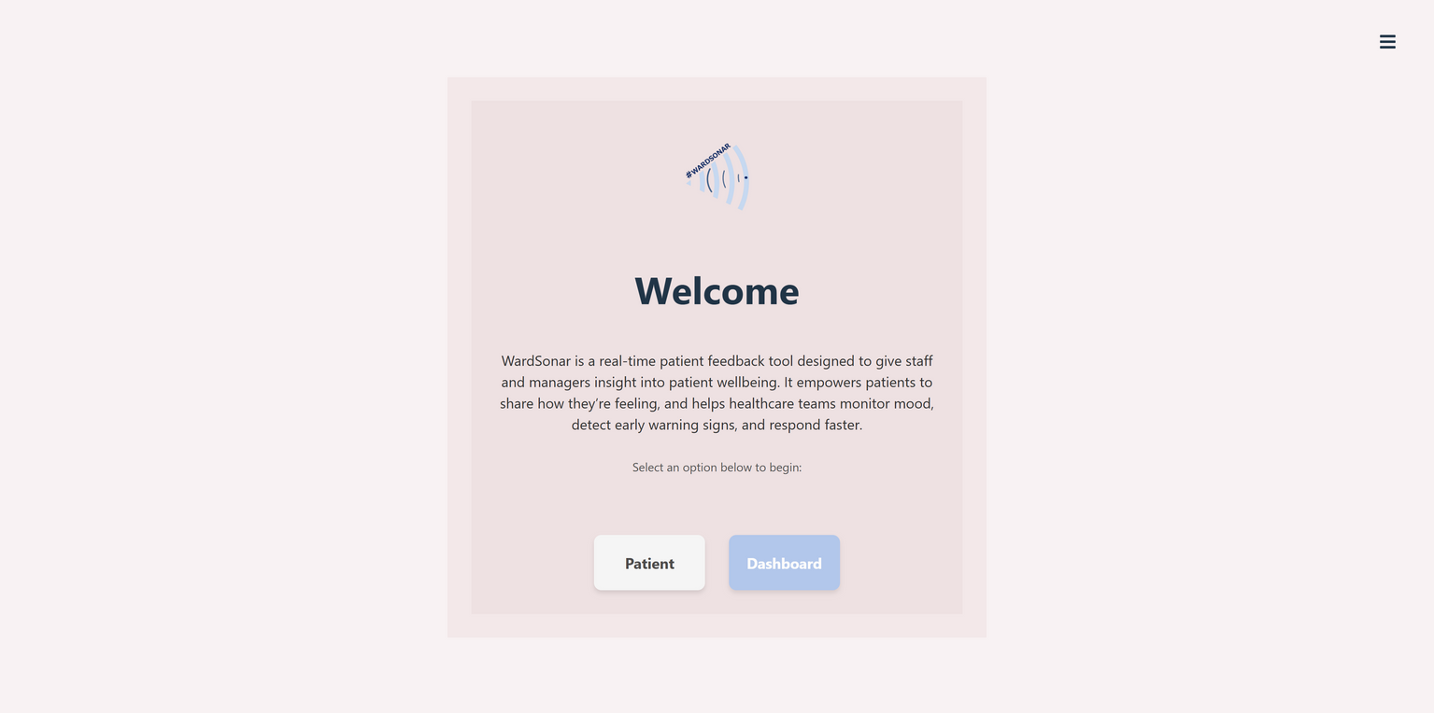
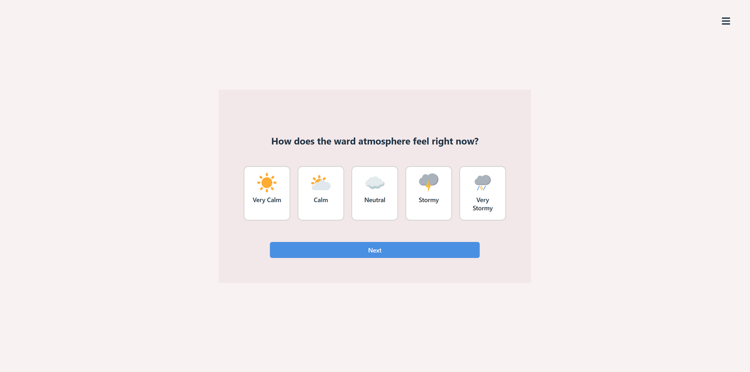
My Role: Developing the WardSonar Tool
Data: Patient feedback collected in real-time through the WardSonar tool.
Methodology:
Front-End Development: Built a user-friendly web application for patients to log their feelings of safety. This had to be simple and intuitive.
Back-End Development: Created the system that takes this real-time data, processes it, and stores it in a database.
Key Challenge: Ensuring the data was anonymous and secure to protect patient privacy. This was a critical ethical and technical challenge.
Notes:
My specific role in this larger project was to build the WardSonar tool itself. My work was divided into two main parts: the front-end and the back-end. On the front-end, my goal was to create a simple, easy-to-use web application that patients could access on a tablet or mobile device. As you can see from this image, it's designed to be straightforward. Patients can log how they're feeling about their safety at any given moment with just a few taps."
"On the back-end, my job was to build the infrastructure that takes that feedback and securely stores it. A major challenge was ensuring the data was completely anonymous. Patients needed to feel confident that their feedback couldn't be traced back to them. We had to implement robust security measures to protect their privacy, which was a top priority.

Slide 4
Key Findings: The Power of Real-Time Data
The original WardSonar study showed the potential of a patient-led tool for safety monitoring (Baker et al., 2024).
Key findings from the previous study included:
Early Signal: The frequency of tool usage provided a stronger signal about potential incidents than specific patient reports.
Contagion Effect: "An incident significantly increases the odds of another one for up to 4 hours afterward—a 'contagion effect.'" (Bojke et al., 2024; Baker et al., 2024)
My Project's Goal: To re-develop the technology to be more robust, accessible, and user-friendly, ensuring this valuable research can be built upon.
Notes:
Now, before I talk about my specific results, it's important to understand the findings from the original WardSonar study that motivated my project. I didn't conduct the research that led to these findings; my role was to create a new and improved version of the tool."
"The original research, led by Dr. Baker and his team, demonstrated the incredible potential of a tool like WardSonar. They found that the frequency of use was a powerful signal for potential safety issues on the ward. And even more compellingly, their data confirmed the existence of a 'contagion effect,' showing that after a safety incident, the odds of another one increase significantly for up to four hours."
"These are the findings that justified my project. My goal was to take this proven concept and re-engineer the technology, making it more robust and accessible. My work focused on building a new version that can stand the test of time, is easier for patients and staff to use, and is ready for future research and implementation."

Slide 5


Discussion & Next Steps
I successfully re-developed the WardSonar web application to be more robust and accessible for future research.
This work was based on a prior study that demonstrated the tool's potential to provide an early warning signal for safety incidents.
Key Achievement: I took a decommissioned prototype and created a functional web application with enhanced user experience and security.
Future Work:
Conduct usability testing with patients and staff to gather feedback on the new web application.
Explore how to integrate the tool with existing hospital IT systems for seamless data utilization.
Notes:
To conclude, my project was about taking the valuable research from the original WardSonar study and giving it a new life. My core contribution was developing a new version of the WardSonar web application, making it more robust and accessible for future use."
"The key takeaway is that I successfully re-engineered the technology from a basic, decommissioned prototype into a functional web application with enhanced user experience and security. This means the research foundation is now ready to be built upon with a reliable and scalable tool."
"Looking ahead, the next steps are crucial. We need to conduct thorough usability testing with patients and staff to ensure the new application meets their needs. We also need to work on integrating it directly with other hospital systems so the data can be used to inform real-time decisions on the wards."

Slide 6

Thank You
Notes:
Finally, I want to express my sincere gratitude to my project leader, John Baker, and my supervisor Sorrel for their invaluable guidance throughout this internship. Thank you all for listening!

