Slide 1
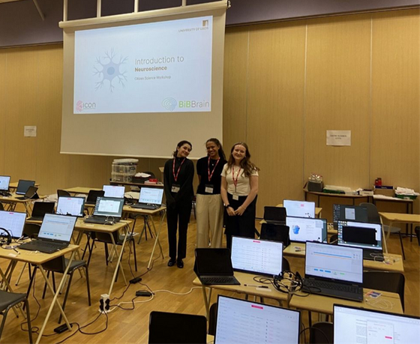

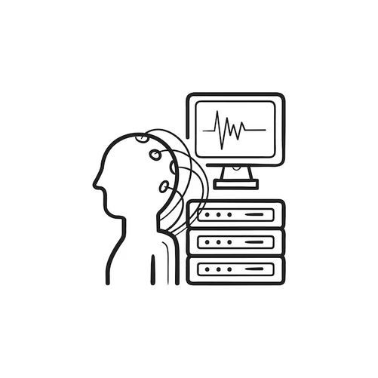
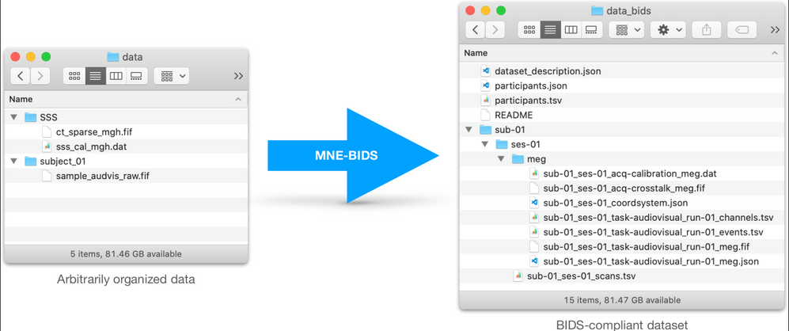

Who am I?
arianawilliams033@gmail.com
Ariana Williams
2nd year undergraduate psychology student
University of Leeds, working with University of Sheffield
Minimal coding experience
Love for technology and neuroscience
Experience with EEGs
EEGs
BIDS
My Project
Standardisation
Create a document guiding a novice through transforming their EEG data into BIDS formatting, using MNE-BIDS.
MNE-BIDS
Open, accessible data
Collaboration
Notes:
- hello
- thanks for listening/ joining
- today I'll be presenting the process and results of my N8 internship
-wonderful experience, share a snippet of that with you today
- introduction (name, 2nd-3rd year, psych, leeds, work w/sheffield on eegML)
-Project
BIDS?
brain imaging data structure - hierarchical file format for neuroimaging data -> standardisation of data organisation and storage
MNE-BIDS?
A processing pipeline that uses MNE-python tools (for working with EEG and MEG data)to generate BIDS-compliant datasets
Relevant facts abt me
- minimal coding (gcses)
-love tech, especially relating to neuropsych
- Volunteer RA (experience using EEGs but not data)
- How are they relevant?
- project requires me to create doc explaining converting EEG data to BIDS, for novice
- experience = context, new experiences w data = explaining to inexperienced audience
- personal goals at start of project (learn coding, use and management of EEG data, integration into lab env (how they function), tech underpinning psych studies )

Slide 2
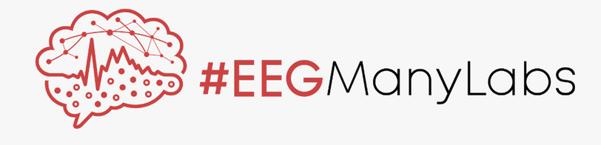
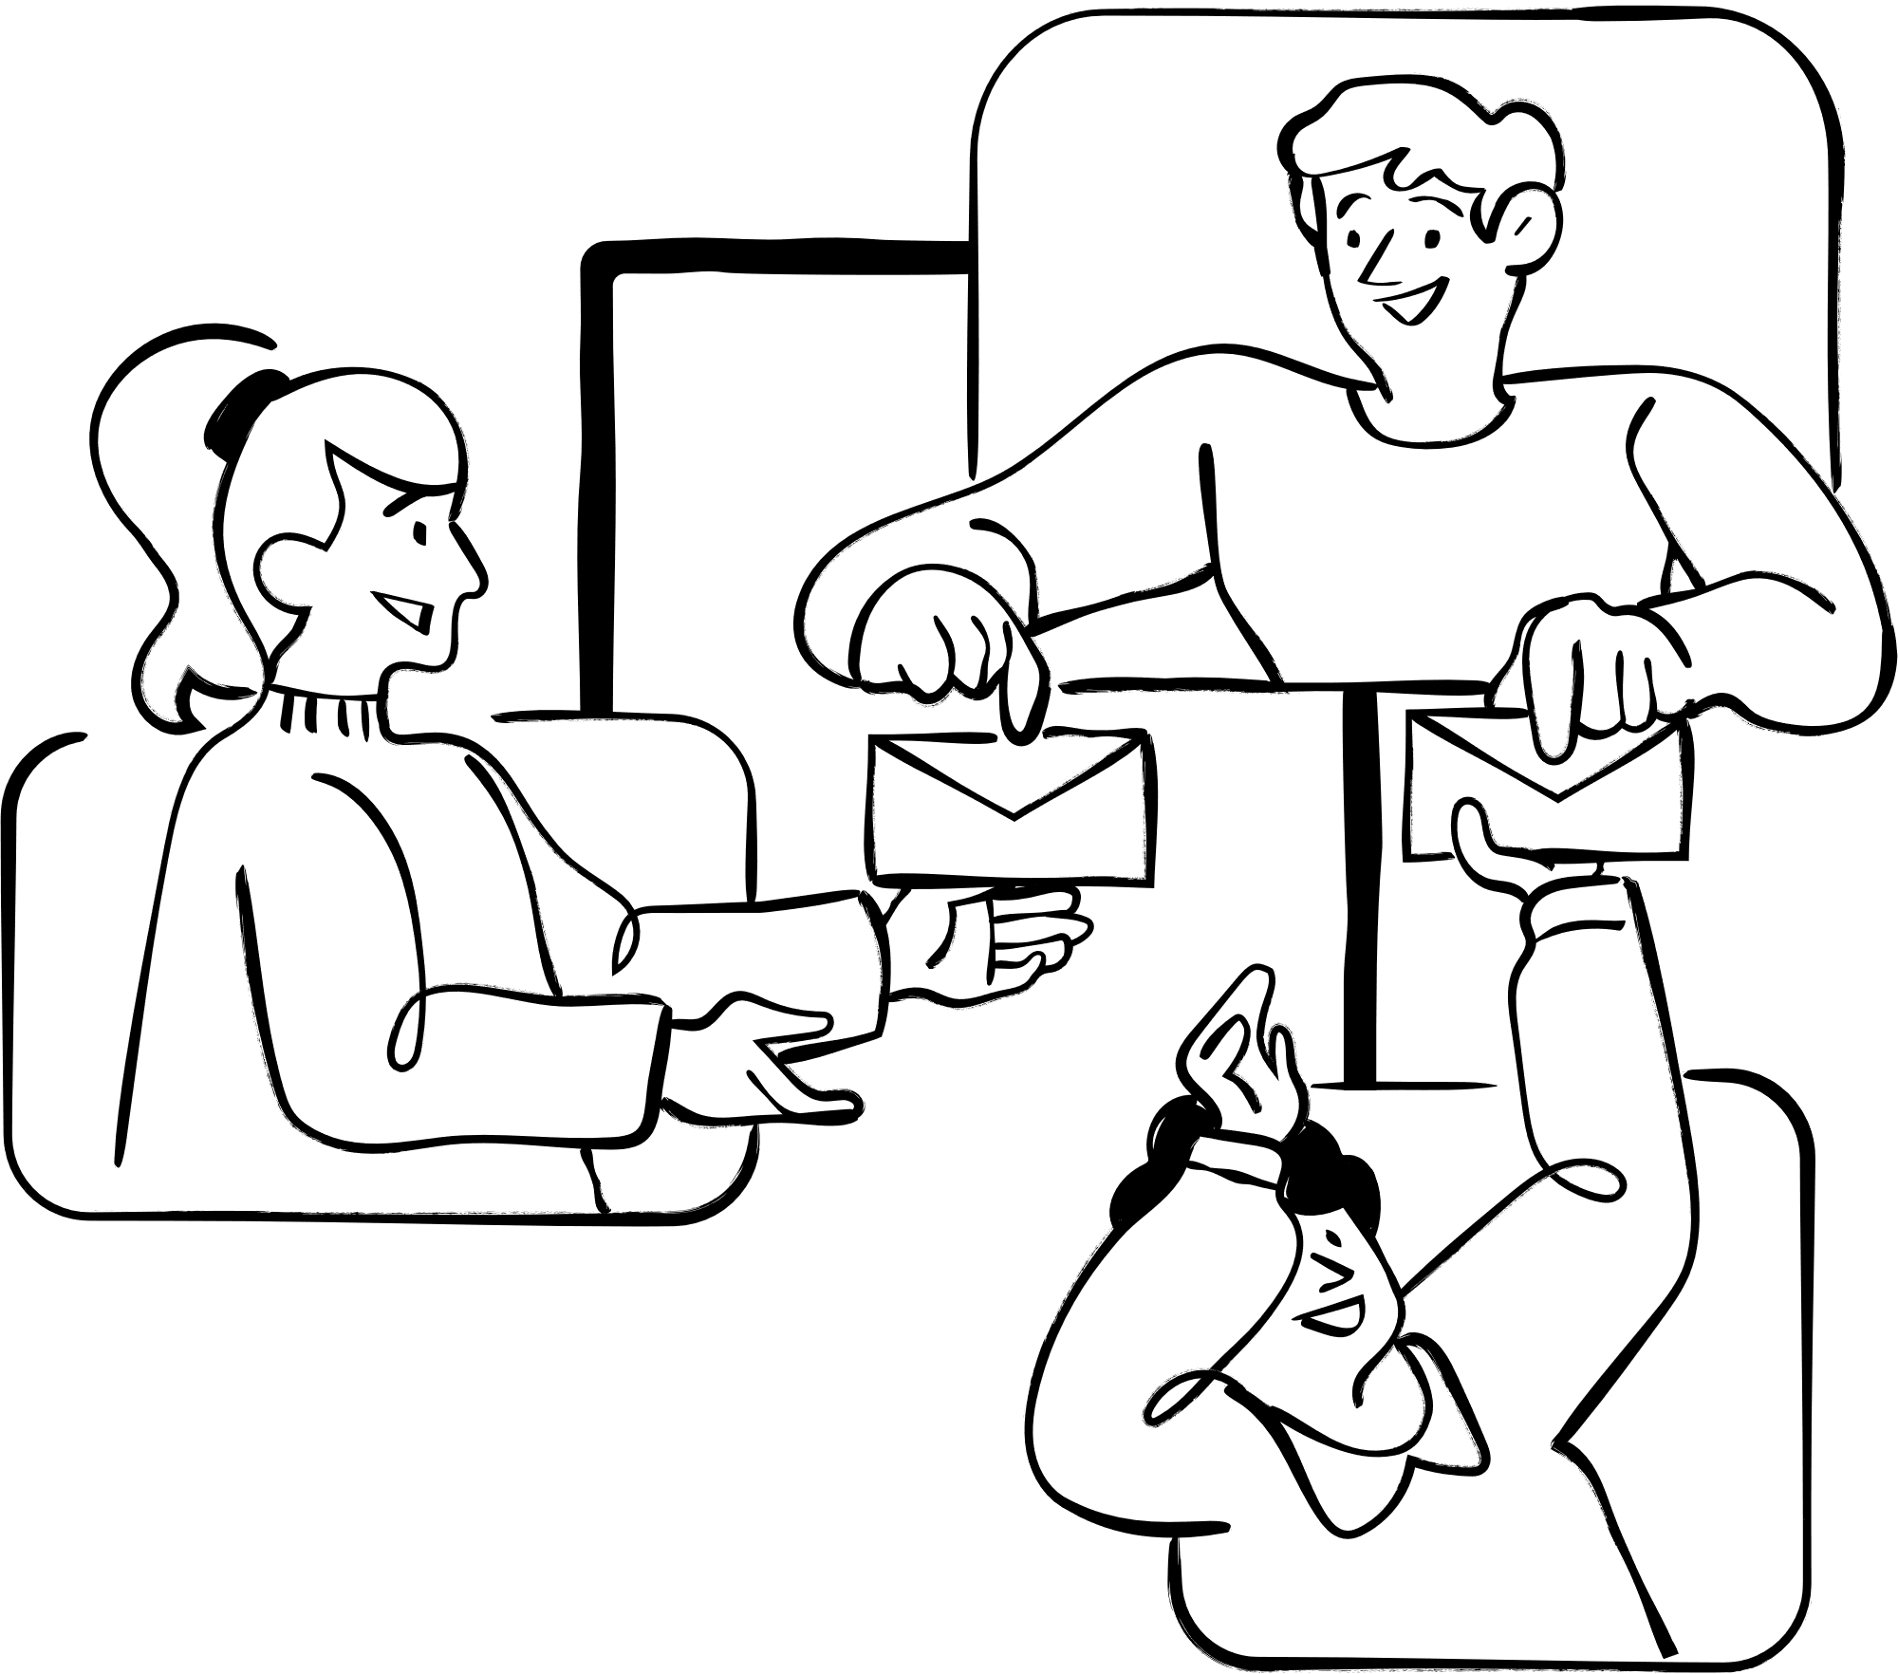

International
20 influential studies
BIDS-valid, but missing metadata.
→ Semi-automatic metadata inclusion
High-level writing
→ More detailed, low-level writing
Large Scale
Collaborative
Reducing barriers to access for BIDS formatting
⟶ more BIDS formatted datasets
Higher replicability standards
Open, transparent replication data
High-powered, large-scale multi-site collaborations
Why is my project important?
Notes:
-Project conducted as a part of the EEGManyLabs team
- international, large scale and collaborative effort to conduct replications of 20 influential psychology studies
lead to
- higher standards for replications (meaningful and generalisable results)
- open science culture of high powered large scale multi site collaborations
- important that replication data and materials are accessible and transparent --> re-analyses --> BIDS formatting
--> my project
- current documents lacking (depth, clarity, valid but not all metadata)
high level writing = barriers to entry entry, may not use due to skill requirements, no BIDS
benefits
- Standardisation -> open, accessible data -> FAIR -> collaboration
(findable, accessible, interoperable, reusable)

Slide 3
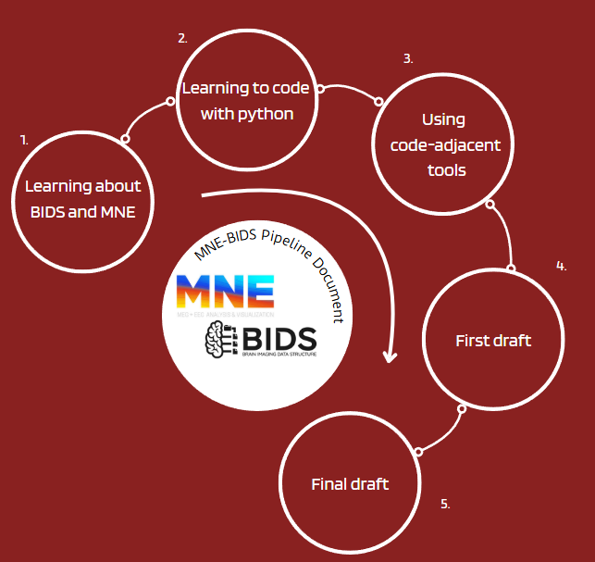
The process
Learning about BIDS and MNE
2. Learning to code with Python
3. Using code-adjacent tools
4. First draft
5. Final draft
Notes:
- as said before- BIDS/mne docs
- Goal = more comprehensive pipeline, had to learn to code it (python recommended by dan, limited coding knowledge)
- learnt to code (w/excercism), learnt to use coding tools (makrdown- write up doc, github, vs code(host doc and push edits to github repo), uv (manage packages and venv))
- given raw and formatted eeg data, aided me in generating my code (check against pre-formatted)
- multiple drafts, guided by feedback from lab and supervisor

Slide 4





The challenges
Learning about BIDS and MNE
2. Learning to code with Python
Logical thinking
Generating concise, readable code
→ Repetition
→ Understanding and fixing mistakes
Large quantities of complex information
→ Practice and thorough exploration
3. Using code-adjacent tools
4. First draft
Missing data
→ Mid/Post- pipeline additions
Editing TSV files
→ Learnt ‘pandas’
Understanding uv and virtual environments
→ Exploration of documents and explanation of concepts
5. Final draft
Code only converts one participant
→ Created looping pipeline
Notes:
- as project progressed, relish challenges
- rewarding to find solution after working hard
- beneficial to self and project progression
- fixing problems = better work, growth
- So, sharing main challenges that helped me/project develop
1.
Large quantities of complex information
→ Read through thoroughly before beginning work, to give me context, then solidified knowledge by explaining and implementing them within my work, while using the original documents to support
2.
Struggled with adapting way of thinking to match the highly logical requirements for writing code (less binary thinking)
struggled with making concise and readable code
→ repetition, fixed mistakes, thoroughly understood what I did wrong, and read others’ code to see better versions
3.
Struggled to find most effective tools for comprehensively writing docs and pushing changes to repo
-> trial and error, before settling on vscode- most effective and comprehensive
Struggled to fully understand uses of UV and creating virtual environments, even after using them in my work
→ spoke to supervisor and worked through more in depth documentation, practised creating venvs, used uv in docs
4.
Too much was data missing from final BIDS dataset
→used mne tool ‘info’ to allow users to input data within the pipeline, added explanations for editing sections with missing information
Didn't know how to edit TSV files
→ learnt ‘pandas’, a tool that has a lot of functionality within python code, that I used frequently in later pieces of code
5.
Too much repetition, leading to a lengthy document with many unnecessary steps
-> changed the structure of the document to remove repetition and just have more general sections
inability to easily iterate over multiple participants
→ coded a way to loop through multiple participants, using excel sheets to input data, allowing the pipeline to run with minimal manual input

Slide 5
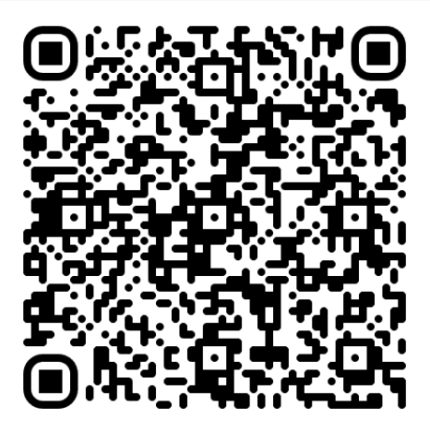

My Final Project
Main components:
→ General information
→ Downloading/formatting your dataset
→ Setting up your coding environment
→ Transforming your EEG data to BIDS
→ Adapting your BIDS dataset to include relevant metadata
→ Validating your BIDS dataset
→ Citing MNE-BIDS
→ Adapting the code to iterate through all participants
Scan Me!
https://github.com/ubdbra001/RosettaState/blob/MNE-BIDS-pipeline-post-feedback/MNE-BIDS%20pipeline.ipynb
Notes:
- talked a lot about project, here is a snippet from it (too long to present whole)
- utilises jupyter markdown notebook, hosted in vscode
- displays sections of code, broken down and explained in beginner terms
- expected proficiencies (knowledge of python, BIDS and their EEG dataset), but document should be accessible for all who need it
- runs through:
General information
- info on BIDS, MNE, MNE-BIDS, versions for each
Downloading/formatting your dataset
- Downloading example data if needed and ensuring EEG data follows correct format (EDF) for doc
Setting up your coding environment
- setting up virtual env, downloading dependencies (coding packages for running current code), importing tools
Transforming your EEG data to BIDS
-steps for converting the EEG data into bids formatting, using code and explanations
Adapting your BIDS dataset to include relevant metadata
- editing the TSV and JSON files to include any extra metadata needed
Validating your BIDS dataset
- guidance to a tool for checking if your dataset is valid by BIDS standards
Citing MNE-BIDS
- Guidance on how to ensure their dataset properly cites the tools used to generate it
Adapting the code to iterate through all participants
- Loop that runs through the above section of code, outlined in red, but for all participants, using excel sheets

Slide 6


What have I learnt?
Skills
Reflections
Managing personal development goals
Working to meet deadlines
Finding and solving complex problems
Responding to feedback
Managing neuroimaging data and metadata
Proud of the progress I’ve made and the technical skills and knowledge I have gained
More knowledge → less beginner-friendly
Difficulties in generating inclusivity
Notes:
Professional interactions
Managing personal development goals
Thinking in a more logical/binary manner (coding skills)
Finding and solving complex problems (and presenting results)
Responding to feedback
Working to meet deadlines
Managing neuroimaging data and its metadata
Upon reflection on this project,
- Proud of the progress I’ve made and the technical skills and knowledge I have gained
- Gained skills and experiences that will benefit me in future endeavours (coding important but undertaught in psych)
- Enjoyed the challenges that came with coding
- More knowledge → less beginner-friendly
== Difficulties in generating inclusivity, the widespread issues make sense
- could go back, I'd be more aware of the issue and be more intentional with my explanations

Slide 7

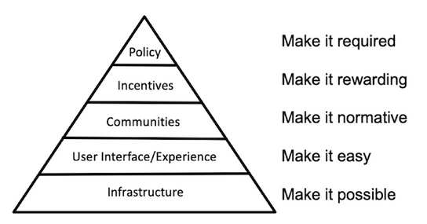
Discussion
Aim: To create an entry-level document that explains the process of transforming an EEG dataset into BIDS-compliancy, using MNE BIDS.
Overview
How did I approach my project?
Top-down
Feedback-focused
Solution-oriented
Key outcomes
Lowered barriers to entry for data transformation
Promoting data standardisation and sharing
Learn as they go
Makes tools accessible across disciplines
Acknowledgements
Daniel Brady
EEGManyLabs team
https://www.cos.io/blog/strategy-for-culture-change
Notes:
While completing my project,
- top-down approach, with gathering broader information, drafting a basic pipeline and slowly making doc more specific, gathering more tailored information
- feedback focused, weekly feedback from lab and supervisor meetings- pointed towards areas of improvement and working on generating solutions
- cyclical, natural progression between problems and solutions- fed into each other
-lots to learn, did so by implementing them in document then explaining in detail
Aim and outcome
avoid ppl not using due to knowledge gaps- data sharing and standardisation practices used
- greater movement to make research more open and accessible,
- encompasses both replications and open data sharing practices.
-One important aspect, thats underdeveloped is this accessibility for less experienced individuals
my doc's outcomes are:
- Lowered barriers to entry for data transformation
- Promoting data standardisation and sharing
- Learn as they go
- Makes tools accessible across disciplines
Big thank you to Dan, my supervisor, who gave me a lot of amazing advice and supported my development through the project,
and
the EEGManyLabs team, who provided me with tonnes of feedback and guidance and gave me the chance to experience a real lab environment.

