Slide 1
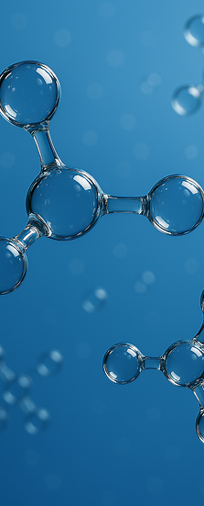


Transformer-based Molecular Classification Models for Blood Brain Barrier Penetration Prediction
Hamzah Patel
September 12, 2025

Slide 2
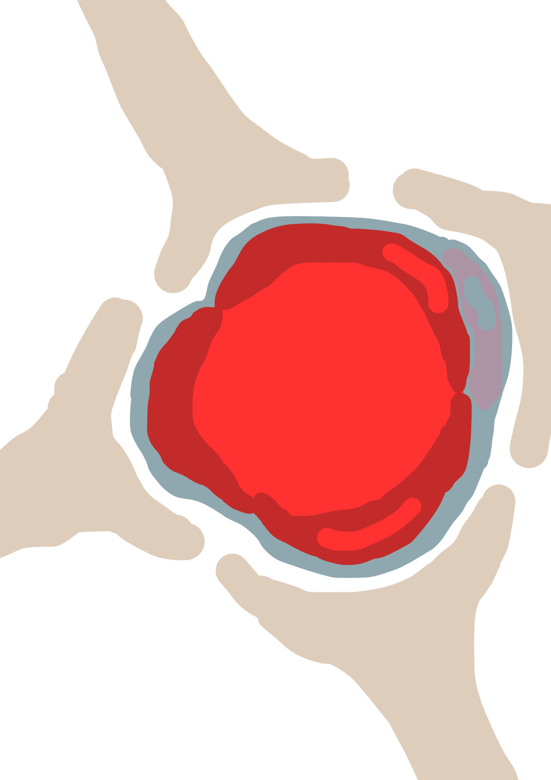
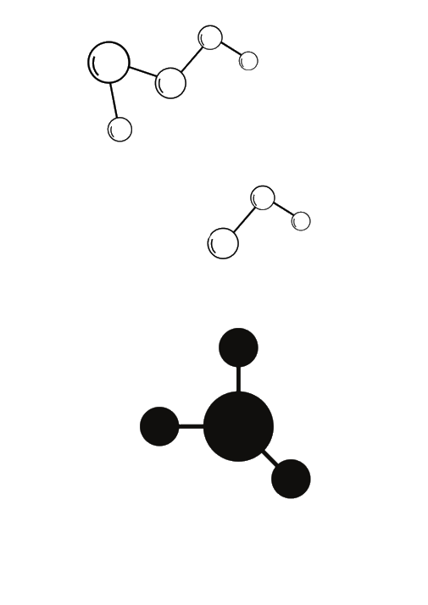
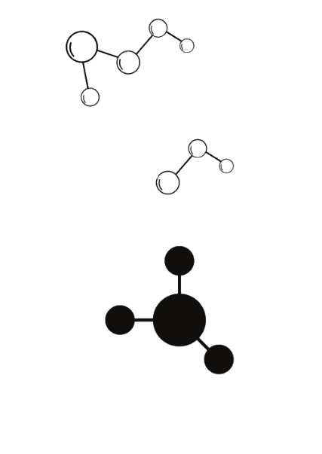
What is the Blood Brain Barrier (BBB)?
Late 19th century discovery: dyes injected into the blood stained all organs except the brain.
A physical and biochemical shield formed by tightly packed endothelial cells.
It keeps out over 98% of small molecules and 100% of large molecules!
Only a few molecules (e.g. oxygen, CO₂, some nutrients via transporters) can cross the cell membrane.
Endothelial cells

Slide 3
Why model BBB permeability?
Most potential drugs fail because they cannot cross the BBB.
Predicting permeability early can save time and billions in medicine development.
The project:
Objective: Evaluate how accurately different computational models can classify BBB permeability.
Approach:
Classical ML baselines (Logical Regression, Random Forest)
Transformer-based architectures (SMILES-to-BERT)
Large Language Models (Zero-shot & Few-Shot)
Aim:
Compare performance, strengths and limitations across models.
Identify how far AI can push BBB prediction beyond traditional methods

Slide 4
What is SMILES?
SMILES: Simplified Molecular Input Line Entry System
A standardised way to represent molecules as linear strings of characters for machine learning where:
Atoms = letters (C, O, N)
Bonds = symbols (=, #, $)
Rings = numbers (1, 2, etc.)
NOTE hydrogens are not always specified.
Example:
H
H
H
C
C
O
H
H
H
Ethanol becomes:
CCO
SMILES-TO-BERT
A BERT based Transformer model
Designed to understand and extract feature vector from SMILES
Where hydrogens are implied on the carbon and oxygen atoms to satisfy their valencies.

Slide 5
Datasets
Name of Dataset | No. of Molecules | Notes
DeepChem BBBP | 2039 | Well-balanced, pre-weighted
PubChem | 7807 | Highly imbalanced (required data manipulation), ~12.1% non-permeable
MaskAtom | 4095 | External validation, diverse scaffold split used.
Evaluation Metrics
ROC-AUC: How well the model separates BBB+ from BBB- (the closer to 1.0, the less random and closer to perfect the separation.
Recall: Measures the fraction of positives which were correct.
F1 Score: The harmonic mean of precision and recall (important for imbalanced sets). The higher the F1 Score, the better the performance of the model.

Slide 6
Results
SMILES-to-BERT models consistently achieved higher ROC-AUC, F1 and recall values, particularly on DeepChem and MaskAtom.
Random Forest was selected as the best classifier for PubChem because of suitability compared to classifiers like SMOTE.
Dataset | Best Classifier | ROC-AUC | F1 (Permeable) | Recall (Permeable) | Notes
DeepChem | LR | 0.986 | 0.94 | 0.96 | High separability + SMILE-TO-BERT already very effective
PubChem | RF w/ Threshold of 0.730 | 0.808 | 0.847 | 0.77 | Non-linear model handled data better
MaskAtom | Weighted LR | 0.836 | 0.837 | 0.88 | Best recall among approaches- shows linear models can still compete

Slide 7
Takeaways and Next Steps
Classical ML: strong baselines and can even achieve a strong ROC-AUC and F1 when paired with transformer-based feature representation but struggle with imbalance. Falls short on analysing longer SMILES strings.
More Complex Models: Random Forest improves performance on noisier datasets. Weighted models excel at recall and reducing false negatives.
LLMs: Exciting frontier and has few-shot has potential for SMILES reasoning but failed to outperform other models.
What does this mean?
BBBP can reduce costly late-stage failures.
Combine with multi-task learning and further LLM development for more accurate predictions.

Slide 8
Thank you!
Acknowledgements:
N8 CIR
My supervisors, Procheta Sen and Manhui Wang
The Research IT department at the University of Liverpool

