Slide 1


AI Quantum Entangled PET
By Kiran Pooni, University of York
kp1215@york.ac.uk
zz

Slide 2
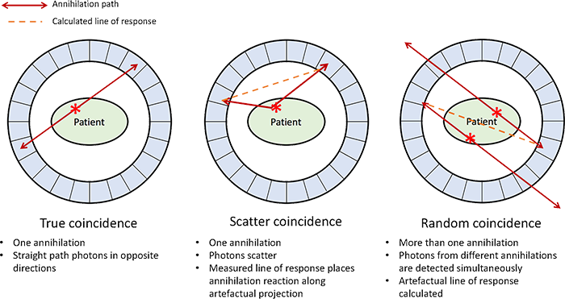
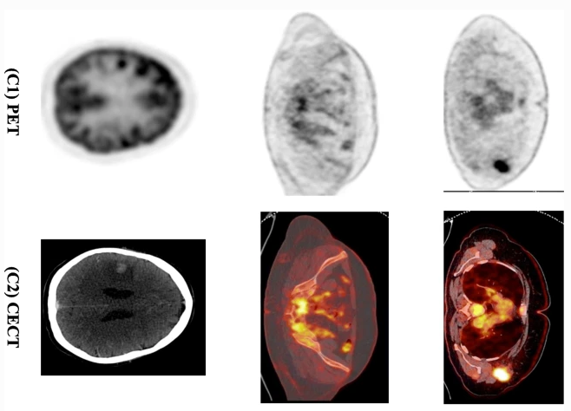
Positron Emission Tomography (PET)
Positron (e⁺) emitted from a 𝞫+ source in the patient anhilates with an electron producing a photon pair emitted back to back. The photons are then detected and the annihilation site can be pinpointed. But the photons can be photo-absorbed or compton scattered in the patient learning to the different coincidence in figure 1.
In actual PET the scattering of photon limits the structural data , degrading the image. Therefore PET is primarily used for functional data. But if the photon path could be obtained containing scatter and annihilation PET could be used to gain structural and functional data
Figure 1 : Diagram of different PET coincidences [1].
Figure 2: Images of PET and CT scans [2].

Slide 3
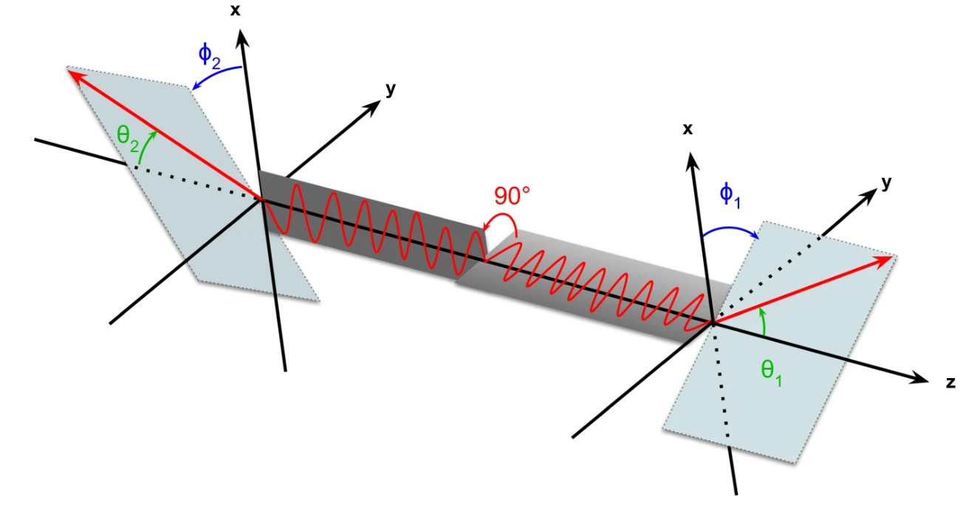
Quantum Entanglement
The two annihilation photons are created in a quantum entangled state and it has been discovered that the quantum entanglement is maintained even after one photon compton scatters in the patient [3].
The difference between the photon scattering angle in the detector Δɸ shows a cosine distribution therefore the background noise can be removed by finding LOR’s with Δɸ that do not match the distribution.
Scattered event which is usually discarded can be recycled using machine learning to correct the line of response identifying the true annihilation site and additionally the scatter site.
Figure 3: Schematic figure showing the definition of the scattering angles θ and ϕ for the double Compton scattering of the two entangled γ photons.

Slide 4
Line of Response (LOR) Model
Data was simulated in Geant4 using a random setup of sources in a water phantom to simulate the patient using a detector set up used in real PET. The data is stored in .root files which I created a custom data loader to extract on scale the desired directories and append the to an input array. Normalising energies and coordinates.
Many photon event types were simulated one of the most common events where gamma 2 scatters in the phantom and both scanner in the detector was used to train the model.
Two different model were trained one for predicting annihilation sites and the other for scatter sites due to the differences in distributions. Huber loss was sued for model one and MSE + diversity penalty.
The input features for the models are physical detector measurements usually taken during PET scans and additionally quantum information.
Model one will predict annihilation sites then using the site calculate the correct LOR, model two predicts the scatter map which is used to perform attenuation correction on the predicted LOR’s.

Slide 5
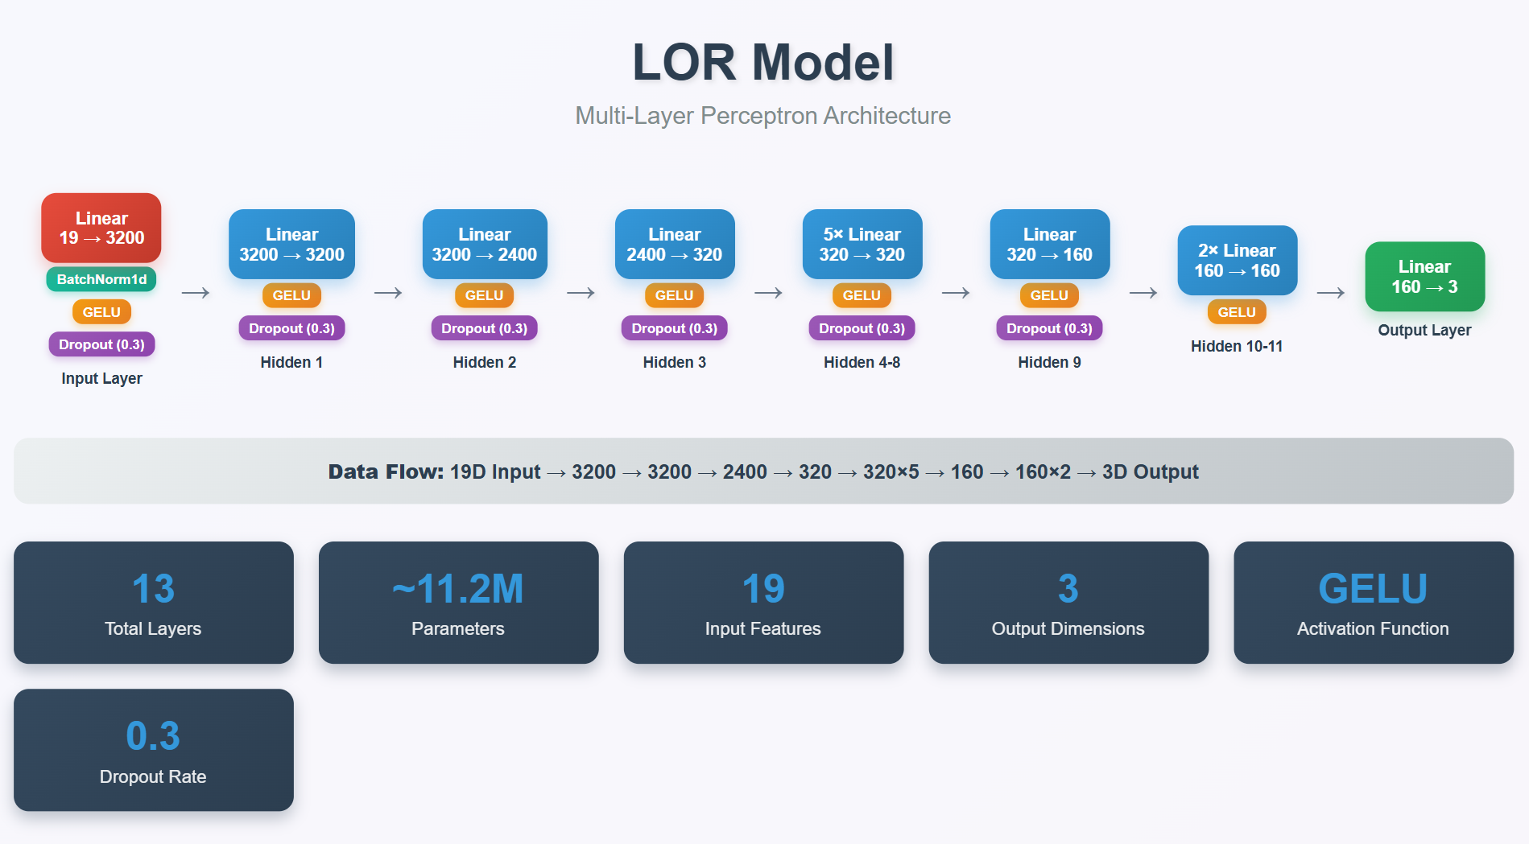

Slide 6
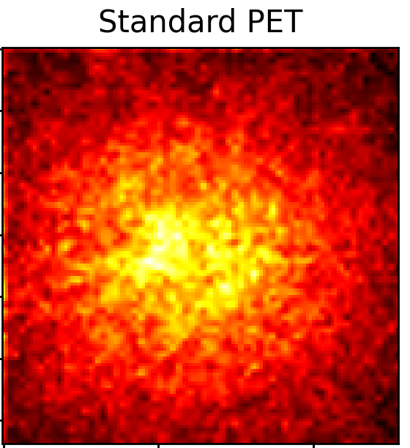
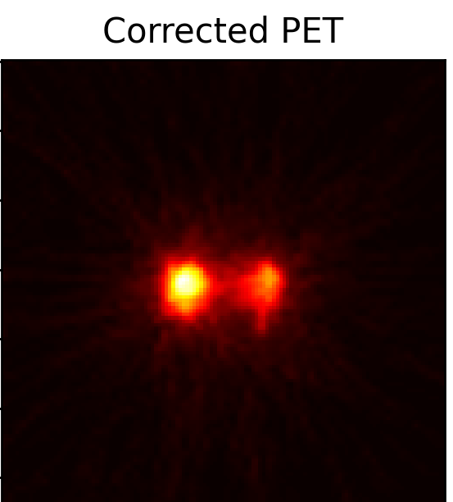
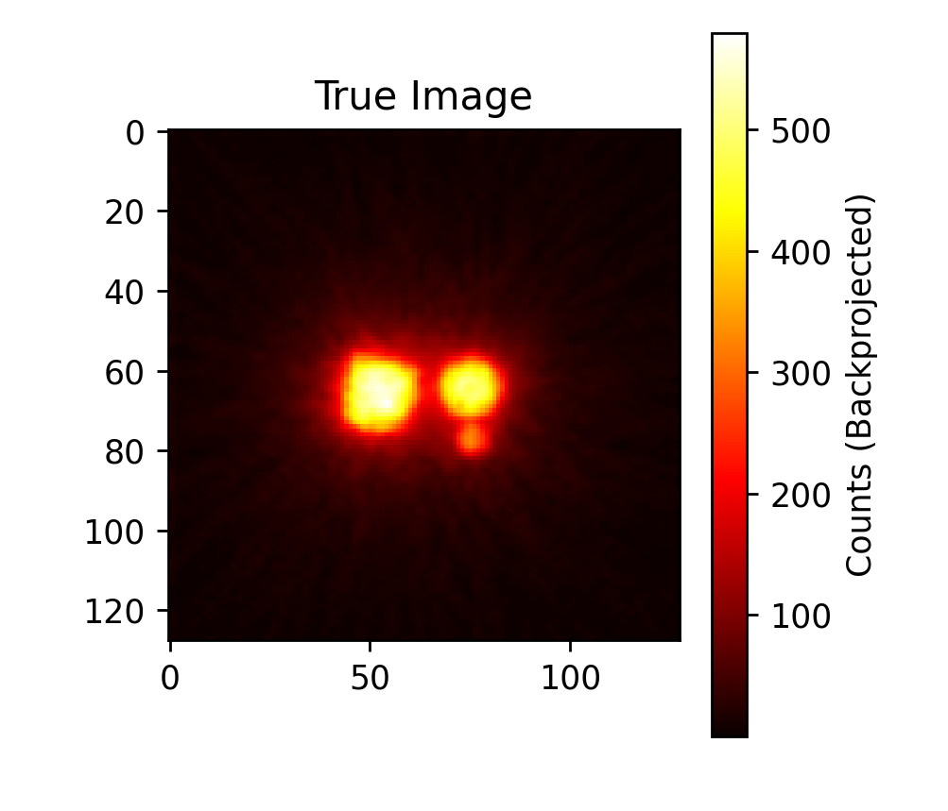
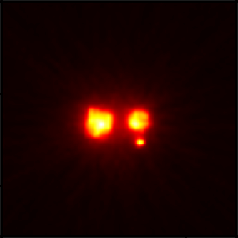
10⁵ Lines of responses
10⁶ Lines of responses
Mean SSIM across slices: 0.02

Slide 7
Discussion
In summary I have made two models to predicted annihilation and scatter maps. Then created a function to calculate LOR’s, preform attenttution correction on the LOR’s then using a backprojection algorithm to create an image. This provides proof of concept for the potential of AI corrected PET can work to some extent, providing structural data corrected for attenuation.
I've found the LOR approach using MLP to be resource expensive when trying custom loss functions therefore in the future the use of a supercomputer is required to further refine the model.
To perform a full attenuation correction the photo-absorption sites need to be predicted asswell, so an additional model needs training.
Use the model on real PET data to measure performance, train on more simulated data with many different topologies to ensure the model is learning the physics and not just the shape of the source.

Slide 8
Thank you ,Prof Dan Watts , Julien Bordes and Cameron Kyle-Davidson for you help.

