Slide 1



A DASHBOARD FOR FITTING MOSQUITO RESPONSES TO TEMPERATURE
Teleri Stone
t.stone@lancaster.ac.uk
Supervised by Dr Marta Shocket and Dr John Fozard

Slide 2

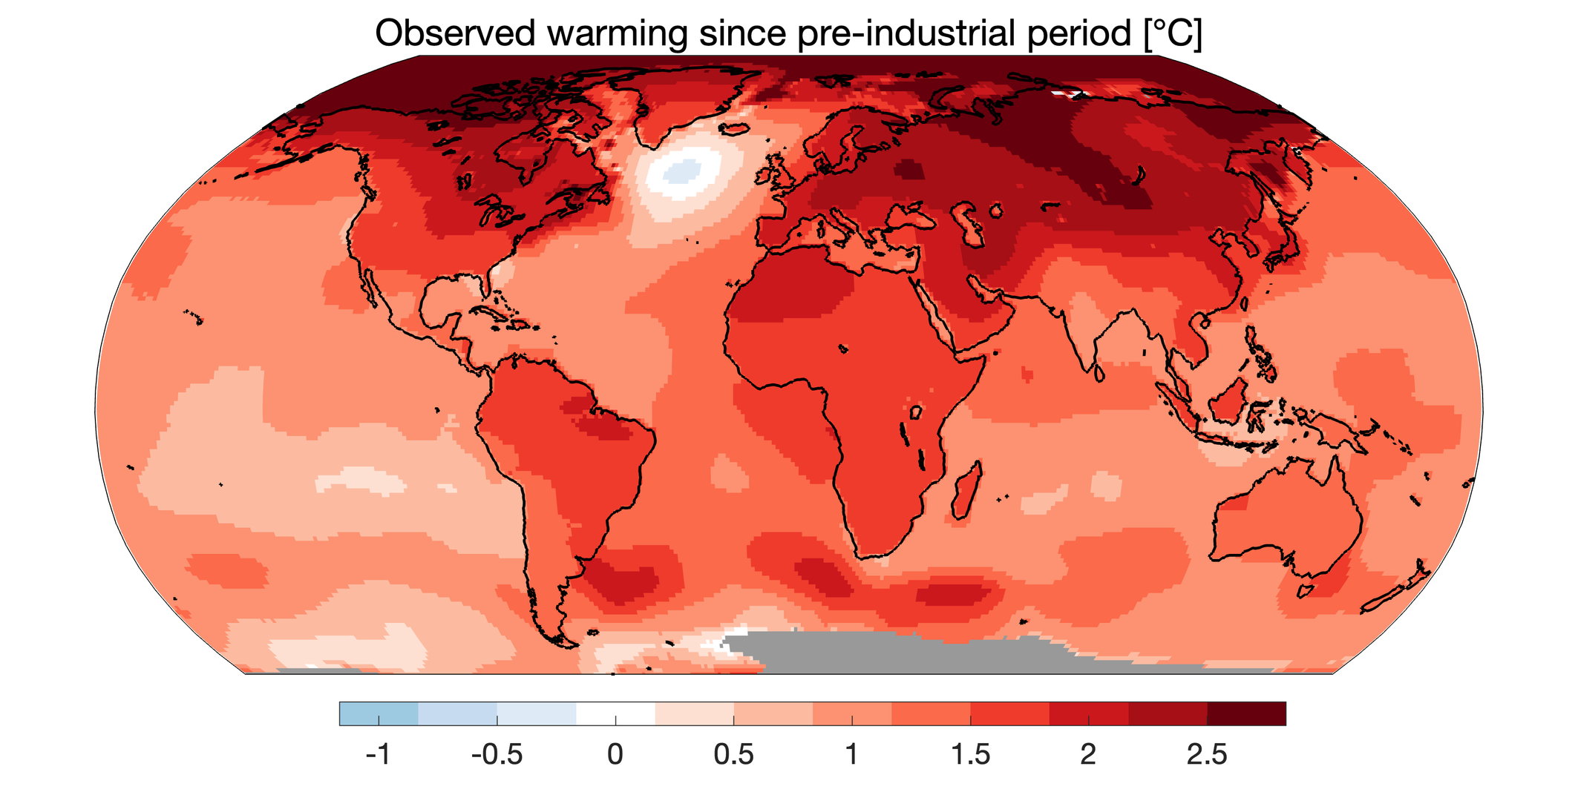
Context: Climate Change and Disease
Prof Ed Hawkins
Notes:
intdoduce disease
numbers of deals and cases
names of diseases
who factsheet vector bourne disease

Slide 3


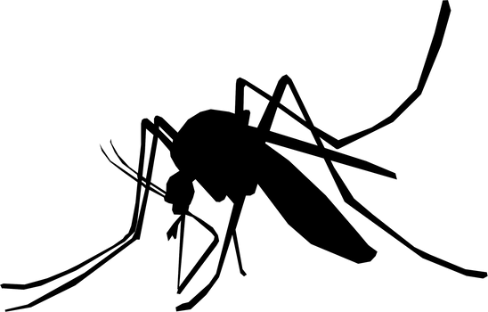
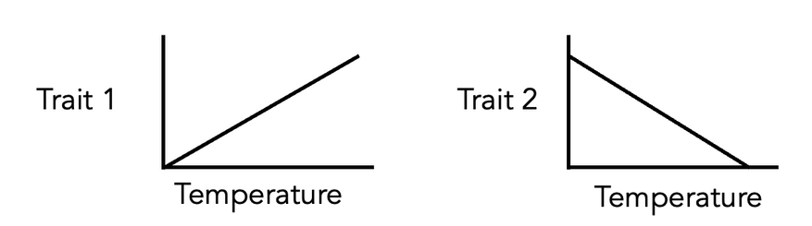
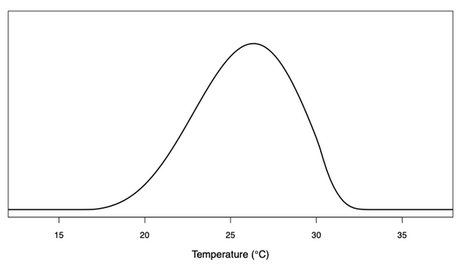
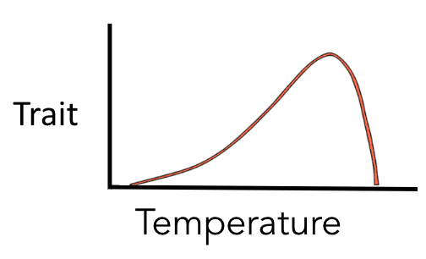
MOSQUITOS
Lab Experiments
e.g.
bite rate
survival
reproductive rate
Field observations of disease
Temperature
Host & parasite traits
Mathematical Models
Disease
Transmission
Thermal performance curve (TPC)
Notes:
why use lab experiements
traits can have opposing relationships
models used to -
Fit temperature trait relationships
Model disease transmission
Predict future disease burdens

Slide 4





R, rTPC and Shiny
Notes:
expalain that r is programming used for stats
intoduce my experience

Slide 5

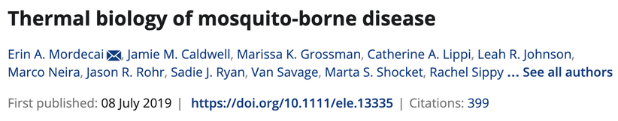
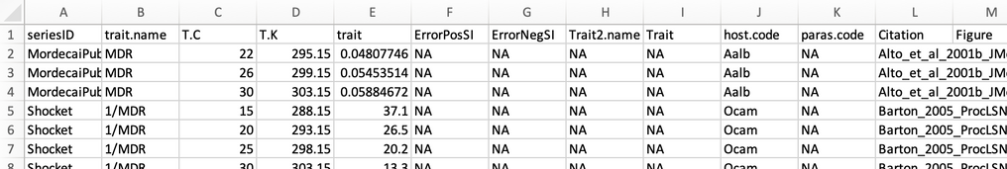


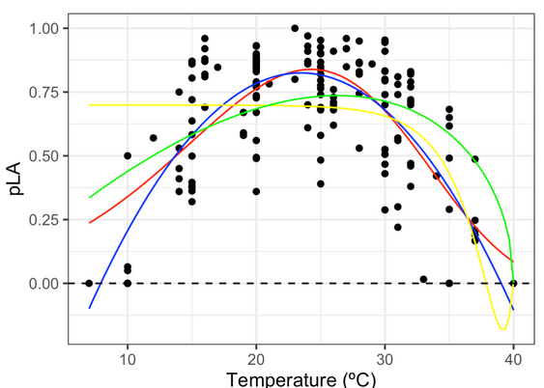
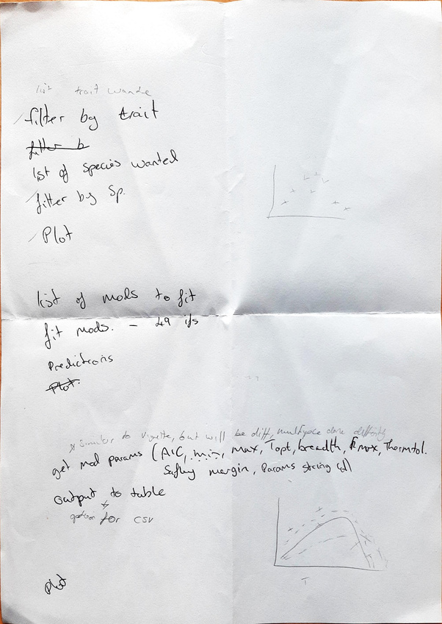
THE DATA AND THE PROCESS

Slide 6

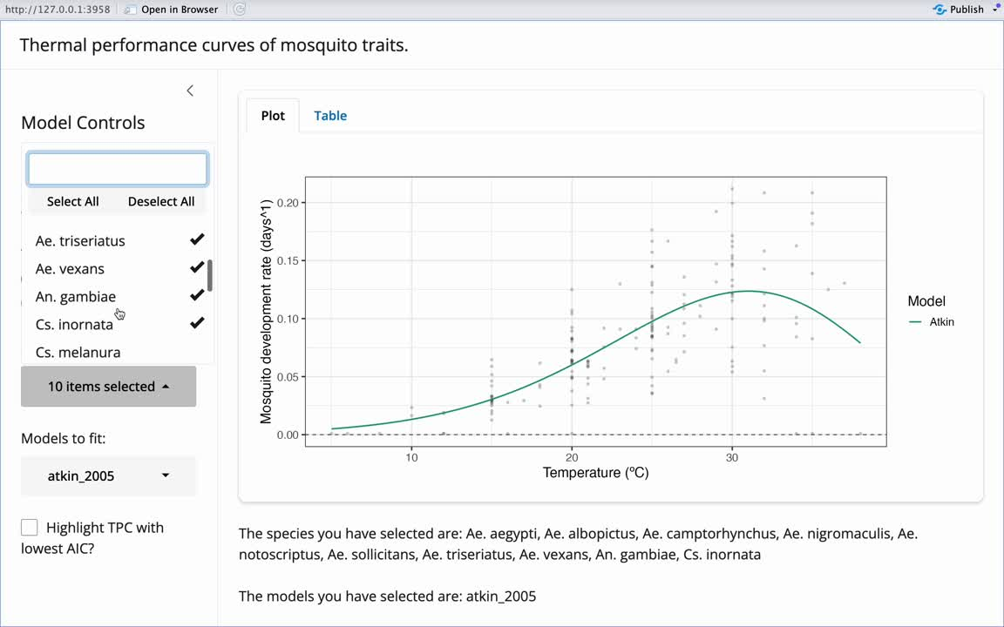
DEMO OF RESULTS

Slide 7

CONCLUSION
It works!
Version control
Reactive programming
What I’ve learnt
Designing a user interface
Thermal biology
Debugging code
Future
progress
Programming skills
Notes:
talked to francis and changes to package

Slide 8
THANK YOU FOR LISTENING

