Slide 1

Introduction
Trigger Warning
This presentation includes discussion of maternal mental health, including experiences of emotional distress during or after pregnancy. Some viewers may have lived experience of these issues. Please take care while watching, and feel free to step away or speak to someone for support if needed. If you are affected by any of the topics raised, support is available through organisations such as:
  Samaritans, call 116 123 (free, 24/7);
  Mind, call 0300 123 3393, www.mind.org.uk;
  Birth Trauma Association, www.birthtraumaassociation.org.uk.
N8 CIR Internship Presentation
12 September 2025

Slide 2

Advancing Statistical and Mathematical Validation for Maternal Mental Health Recovery Pathway: Deep Learning, Evaluation, and Evidence-Based Insights
Zain Safdar, Newcastle University
z.z.safdar2@newcastle.ac.uk
N8 CIR Internship Presentation
12 September 2025

Slide 3
Introduction
Background
Why machine learning for maternal mental health?
  Early detection of postnatal depression
  Traditional screening methods often miss at-risk individuals
Goals of my Research
  Investigation of Coastal Influence
  Prediction of Postnatal Depression
N8 CIR Internship Presentation
12 September 2025

Slide 4
Methodology
Data
  Structured synthetic patient maternal mental health data
  Additional data sources:
    UK Government
  Data Preprocessing
    Handling Missing Values, Encoding, Scaling, Feature Engineering
  Exploratory Data Analysis
N8 CIR Internship Presentation
12 September 2025

Slide 5
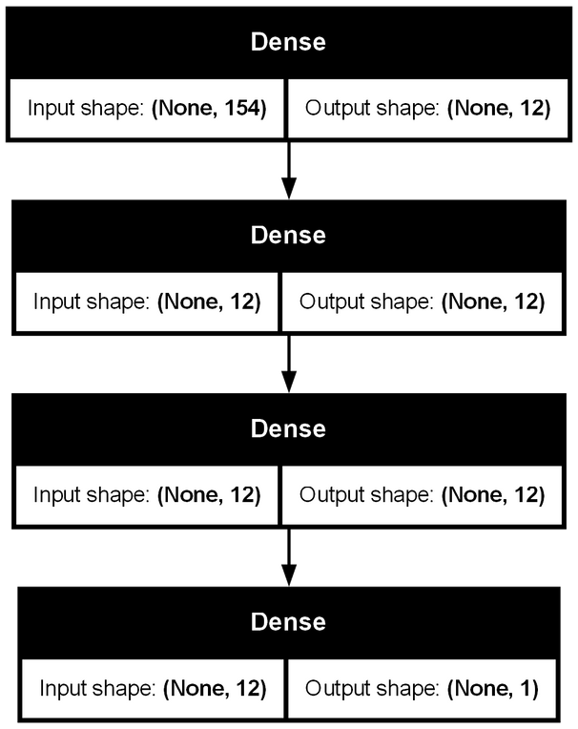
Methodology
Analysis, Modelling and Evaluation
  Spatial Analysis
    Choropleth maps of the NENC region
  4 Neural Networks
    1 - 4 layers.
    Optimiser → Adam, Batch size → 32, Epochs → 50
  Evaluation
    SHAP Feature Importance
    ANOVA, T-tests, Bonferroni Correlation
Neural Network 3 (layers)
N8 CIR Internship Presentation
12 September 2025

Slide 6
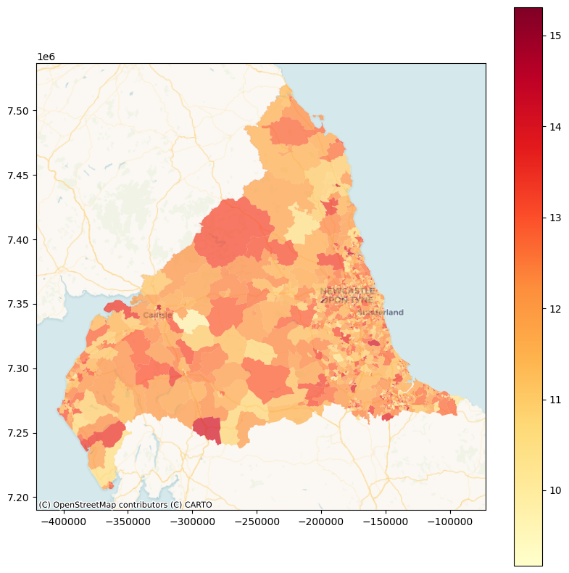
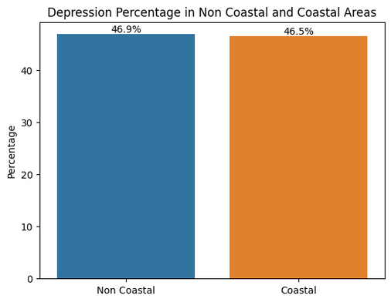
Results
Investigation of Coastal Influence
Average EPDS in the NENC Region
  Negligible difference in Postnatal Depression rates between the Non-coastal and Coastal Regions
  Regression modelling shows coastal access has:
    Very little/no influence on
depression scores
N8 CIR Internship Presentation
12 September 2025

Slide 7
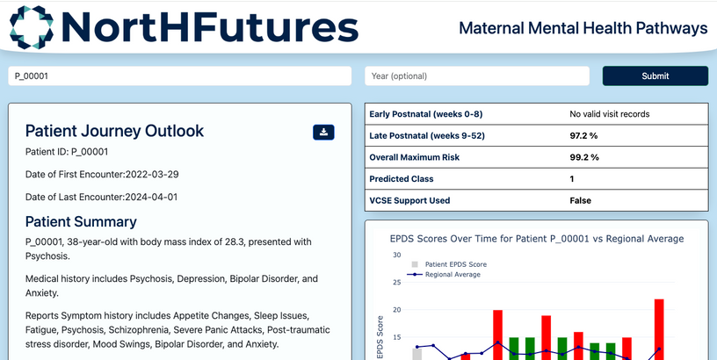
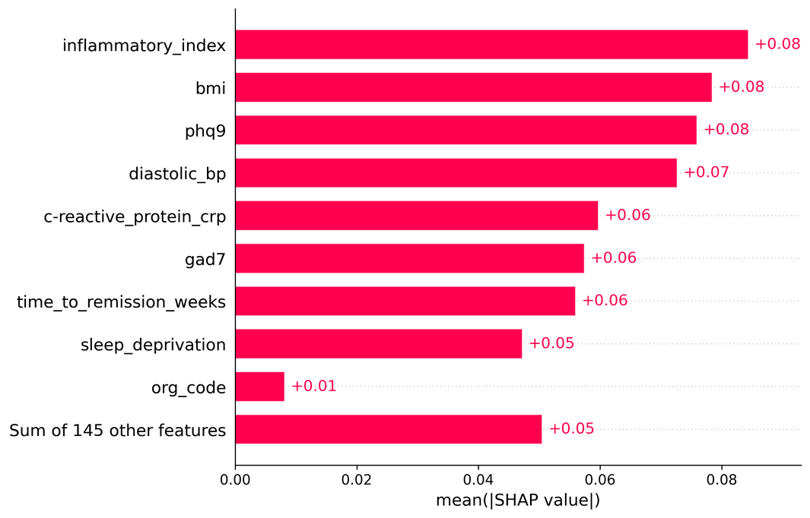
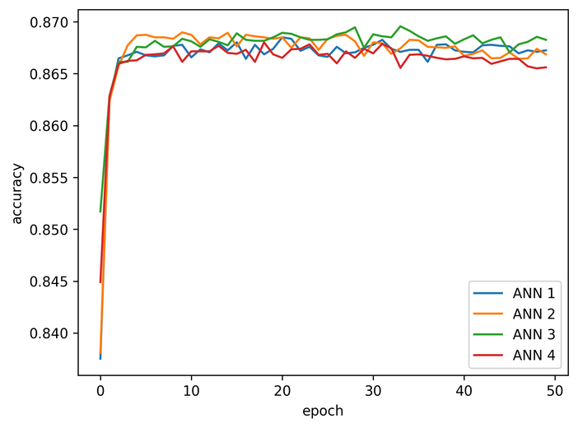
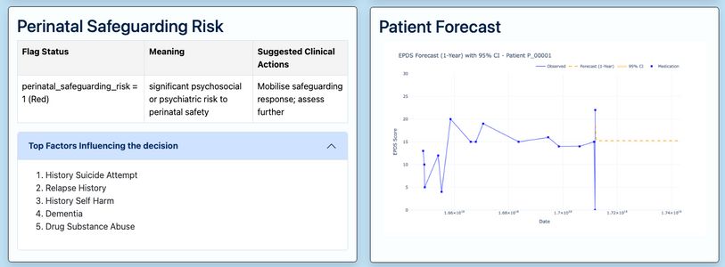
Results
Prediction of Postnatal Depression
N8 CIR Internship Presentation
12 September 2025

Slide 8
Conclusion
Broader Context
  NHS 10 Year Plan 2025: “set up a national independent investigation into maternity and neonatal services.”
  Women of the North Report: “Women living in deprivation, disproportionately in the North, are at increased risk of death and depression.”
N8 CIR Internship Presentation
12 September 2025
Notes:
from the Transparency of Care section of the Fit for the future
set up a national independent investigation into maternity and neonatal services. We will also establish a national maternity and neonatal taskforce, chaired by the Secretary of State for Health and Social Care, to inform a new national maternity and neonatal action plan, co-produced with bereaved families
An NHS Workforce fit for the future: "make AI every nurse’s and doctor’s trusted assistant, saving them time and supporting them in decision making."

