Slide 1

Music.Me: A Personalised Music Recommendation System for Everyday Life and Wellbeing
Presented by: Al Aiham Ahmed
University of Liverpool
sgaalmaa@liverpool.ac.uk

Slide 2
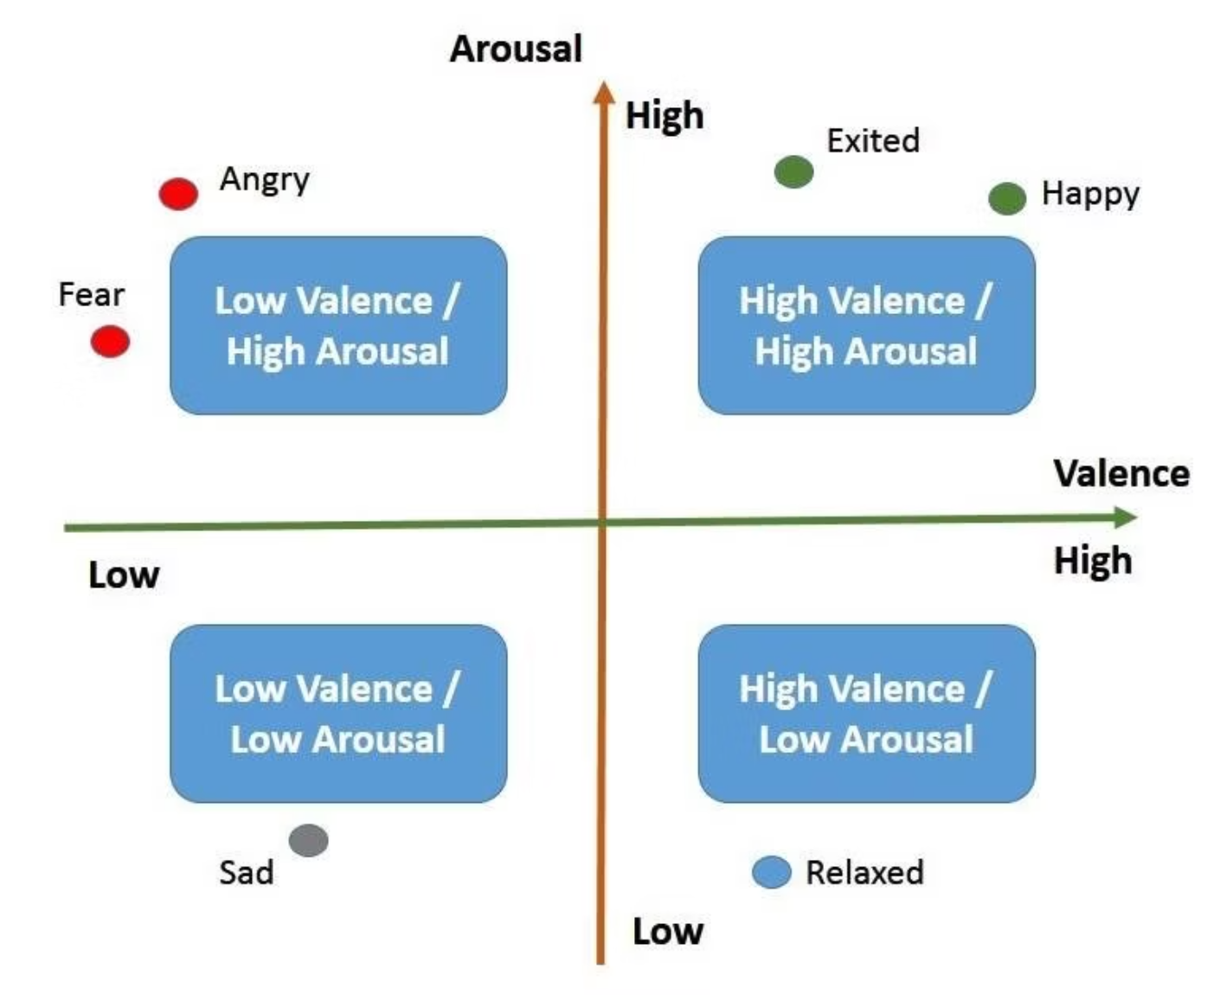
Project Overview
Connecting Music to Wellbeing
Most systems rely only on listening history
Music.Me: Integrate emotion recognition into the recommendation process.
Generate playlists for specific goals e.g. study, exercise
Valence: Positivity (Happiness)
Arousal: Intensity (Energy)
Goal: Predict arousal and valence

Slide 3



Our Approach
Our methodology was built upon the latest academic insights, aiming to adapt and enhance existing research for our specific application.
Foundational Research
Replication & Refinement
Expanded Datasets and Features
Inspired by the 2025 paper: "Towards Unified Music Emotion Recognition across Dimensional and Categorical Models."
Attempted to replicate the paper's model and fine-tune it to predict arousal and valence from song features.
Integrated additional datasets and features to enrich the model's training and improve its generalisability.

Slide 4




Music2Emotion Framework
Our Music2Emotion framework integrates advanced machine learning techniques to accurately predict emotional responses.
Data Augmentation
Introduced noise injection to increase dataset diversity, helping the model generalize better.
Multi-task Learning
Simultaneously predicts valence/arousal and mood categories for comprehensive insight.
Knowledge Distillation
Enhances model performance and generalization through efficient knowledge transfer.

Slide 5


Technical Implementation
Our Machine Learning Pipeline
We employed a machine learning model to predict arousal and valence, leveraging various technical approaches.
Feature Engineering
Data Pre-processing
Extracting relevant musical characteristics (e.g., MERT, chords).
Cleaning, normalising, and structuring raw audio data for model input.
Evaluation & Validation
Model Training
Assessing model performance and generalisability to ensure accurate predictions on new music.
Training our chosen machine learning algorithm on the prepared datasets to recognise emotional patterns.

Slide 6
Navigating the Complexity of Music Data
Dataset
Type
Size
DEAM
Valence/Arousal
1802
PMEmo
Valence/Arousal
794
EmoMusic
Valence/Arousal
-
Jamendo
Mood Classification
18,486
MuSe
Valence/Arousal
58,042
Music4All
Valence/Arousal
66,335
LionBridge
Valence/Arousal
99

Slide 7
Preparing MuSe and Music4All Datasets
This pre-processing pipeline was specifically designed and applied to the large-scale MuSe and Music4All datasets to prepare them for our model training.
Data Cleaning
Audio Download
Implemented robust error checking to identify and remove failed downloads or incorrectly matched audio, maintaining data quality.
Developed a custom pipeline to efficiently download relevant audio files from YouTube, ensuring compatibility with dataset IDs.
Dataset Splits
Annotation Files
Carefully created distinct train, validation, and test splits to facilitate rigorous model evaluation and prevent overfitting.
Generated consistent annotation files, structuring them to seamlessly integrate with our multi-dataset training approach.

Slide 8




Feature Extraction
We developed a robust feature extraction pipeline, leveraging both state-of-the-art embeddings and classical audio descriptors.
MERT Embeddings
Chord Progressions
Key Signatures
Utilized pre-trained audio transformers for deep, context-rich feature representations, capturing intricate musical patterns.
Analyzed harmonic structures to capture the emotional nuances embedded within the sequence and movement of chords.
Incorporated tonal information to understand its significant role in shaping the emotional expression of a piece.
Essentia Features
OpenSmile Features
Low-level audio descriptors and high-level features using Essentia.
Acoustic and paralinguistic feature sets, further enriching our comprehensive dataset.

Slide 9
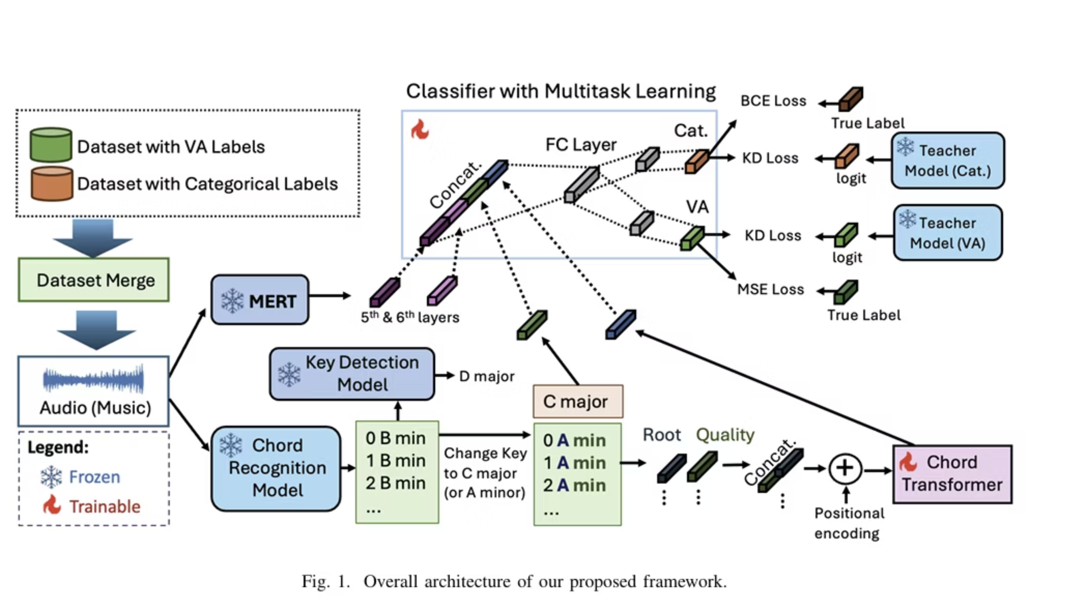

Slide 10
Model Performance Results
LionBridge
Jamendo
Training datasets
Notes
RMSE(A)
RMSE(V)
PRAUC
ROCAUC
J+D+P
Base
1.025
1.586
0.132
0.757
J+D+P+M
Muse original
0.975
1.423
0.134
0.765
J+D+P+M
Muse Spotify
1.007
1.354
0.144
0.769
J+D+P+M+Music4All
All datasets
1.274
1.752
0.135
0.762

Slide 11
Outperforming State-of-the-Art Models
Model
PR-AUC
ROC-AUC
MERT-95M
0.1340
0.7640
MERT-330M
0.1400
0.7650
SELAH-HCMUS
0.1435
0.7599
Greeretal.
0.1082
0.7354
Our Model
0.1440
0.7690
Our proposed model achieved the highest scores in both PR-AUC and ROC-AUC on the MTG-Jamendo dataset, clearly showcasing its superior performance over existing state-of-the-art models.

Slide 12
Discussion & Next Steps
The Future of Music.Me Recommendations
Project Goal: We successfully built a machine learning model to predict arousal and valence from music, directly supporting Music.Me's personalised recommendations for wellbeing.
Key Findings: Our model shows strong potential in categorising emotional impact, providing a crucial layer for deeper user experiences.
Impact: This capability allows Music.Me to offer truly emotionally attuned playlists, enhancing daily activities and promoting positive mental states.
Future Enhancements
We envision several exciting avenues for further development:
Integrating more sophisticated audio feature extraction tools (OpenSmile, Essentia) for richer data.
Exploring different deep learning models for even more nuanced emotional prediction.
Conducting user studies to validate model predictions against real-world emotional responses.

Slide 13

Thank You!
A special thank you to my supervisors, Dr Eduardo Coutinho and Dr Benjamin Pietras, for their invaluable guidance and support throughout this internship.

