Slide 1
Privacy, power, people – what is preventing sensitive health data being more open?
Saskia Lawson-Tovey^{1,2} 1 – Centre for Musculoskeletal Research, The University of Manchester, Manchester, UK 2 – NIHR Manchester Biomedical Research Centre, Manchester University NHS Foundation Trust, Manchester Academic Health Science Centre, Manchester, UK

Slide 2


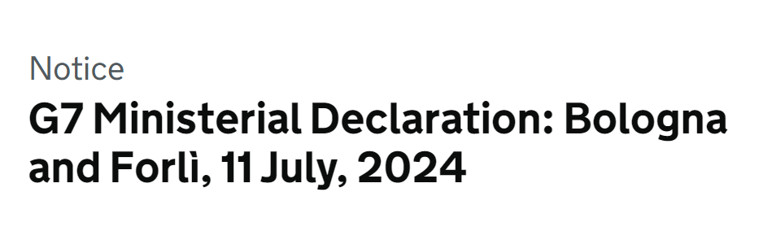
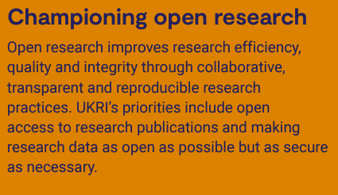
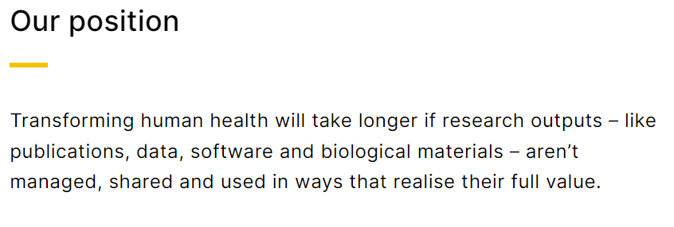
Why is this important?
Good RDM and FAIR practices: accelerate research, boost collaboration, facilitate data reuse
Cost of not having FAIR data in Europe is a minimum of €10.2bn/year + potential €16bn/year impact on innovation.
Strategic priorities

Slide 3
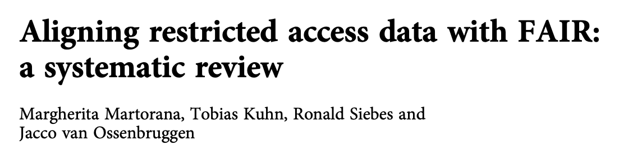
Why is sensitive data challenging?
Legal restrictions
Vague regulations & lack of technical guidance for compliance
Social issues
Risk aversion – consequences when data sharing goes wrong
Lack of recognition for RDM/FAIR tasks in REF/promotions
Poor adoption of technical guidance and tools
Lack of accessible & machine actionable metadata
“no FAIR framework has yet been proposed that directly addresses the issues concerning research with confidential and restricted access data”

Slide 4

Open Research Fellowship
Investigating:
What do researchers who work with sensitive health data know and understand about Research Data Management (RDM) and FAIR?
What are their current practices?
What are their perceived incentives and barriers?

Slide 5


Interviews - methods
We conducted semi-structured interviews* with 9 researchers and project managers in the Centre for Musculoskeletal Research at the University of Manchester.
*predetermined, open ended questions

Slide 7

Interviews - results
Most had not heard of FAIR.
RDM and FAIR are important, and overall, motivations outweigh barriers.

Slide 8


Interviews - results
Motivations:
Trustworthy, high-quality science
Maximising data use
Future proofing research
Limitations:
Limited time/resources
Knowledge of best practice
Limited infrastructure
Lack of human technical support

Slide 9




Interviews - results
Unique to sensitive health data: volume of legal and ethical “red tape” and the people, time, and resources needed to navigate this.
4 mentioned dropping research ideas and collaborations because of “red tape”.

Slide 10
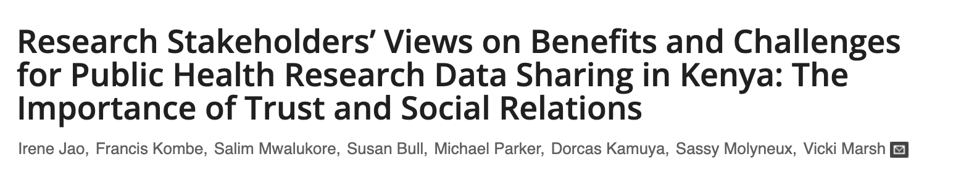

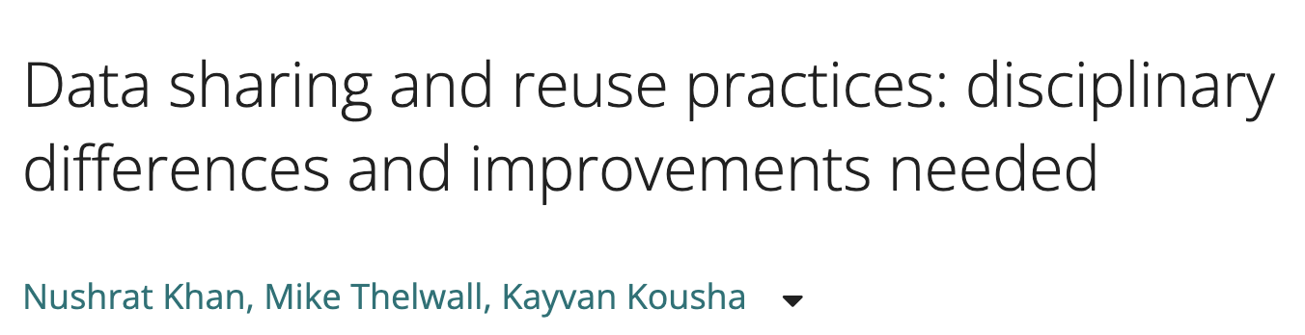
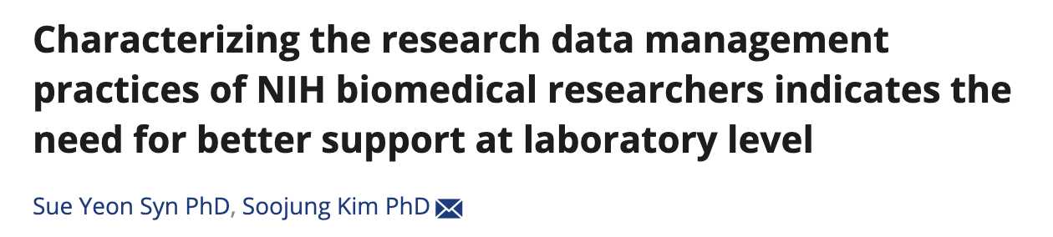
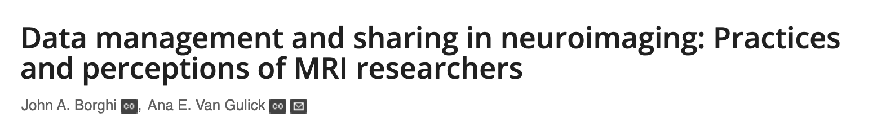
Surveys - methods
Qualtrics survey based on:
Interview questions
Literature:

Slide 11







Surveys - distribution
Professional networks
Mailing lists
Social media
Targeted emails

Slide 12
Surveys – results (36 responses total)
Most (28/36) had heard of FAIR.

Slide 13
Surveys - results
Motivations:
Rank | RDM N |  | FAIR N |  | Data Sharing N
1 | Foster good scientific practice, openness, reproducibility | 33 | Foster reuse and reproducibility | 24 | Maximise benefit and output from data | 22
2 | Deliver research project | 27 | Foster transparency and openness | 21 | Allow others to assess validity of research conclusions | 20
3 | Prevent losing data | 26 | Mandated by funder/publisher/institution | 12 | Foster reuse and reproducibility | 20
Interview motivations:
Trustworthy, high-quality science
Maximising data use
Future proofing research

Slide 14
Surveys - results
Limitations: (8 respondents stated no RDM limitations,
14 no FAIR limitations, 10 no data sharing limitations)
 | RDM |  | FAIR |  | Data Sharing
1 | Complexity of data governance or legal contracts | 18 | The amount of time it takes | 10 | Legal/ethical barriers | 12
2 | Lack of staff with RDM knowledge/skills | 16 | Complexity of the data | 9 | Time to prepare data | 11
3 | The amount of time it takes | 15 | Lack of resources | 8 | Data complexity AND patient consent not given for sharing | 10
Interview limitations:
Limited time/resources
Knowledge of best practice
Limited infrastructure
Lack of human technical support

Slide 15
Surveys - results
Other limitations: (8 respondents stated no RDM limitations,
14 no FAIR limitations, 10 no data sharing limitations)
RDM:
No real support
Lack of space for physical data
Legacy data in multiple locations
Logistics/curse of siloed working necessary for data privacy
Senior staff do not see FAIR/sharing benefits
Grant reviewers question requests for RDM funding
FAIR:
Additional work from external researchers’ interest in data
Interview limitations:
Limited time/resources
Knowledge of best practice
Limited infrastructure
Lack of human technical support

Slide 16
Surveys - results
Have you ever had a particularly good or bad experience with data sharing? (10 no data sharing limitations)
Examples of good data sharing and neither good nor bad experiences.
Bad experiences:
MTAs/governance/contracts – ”Years and years of contract negotiations…[when finished] the teams had changed and they backed out”
Data received contained identifiable information
Time consuming with little reward/obvious gain *3
“[People who want data access] but lack the tools/knowledge to work with the data and analyse it. Then take out frustrations on us…”
Interview limitations:
Limited time/resources
Knowledge of best practice
Limited infrastructure
Lack of human technical support

Slide 17
Institutional support - surveys
“This is not part of [promotion] criteria.”
“Never discussed [institutional views on RDM/FAIR/data sharing]”
“[Institute’s] main activity is healthcare, so sharing…not [top] priority. However, [clinical data] is managed according to best practice”
“Little engagement, though [it is acknowledged]. It’s something we feel we need to do”
Strong verbal support but considerable difficulties with infrastructure and contacting IG for further support.
“Institution support idea…but doesn’t provide time/resources or value in promotion etc.”
“[Institution lacks] IT infrastructure for good data storage. We don’t have a competent person to help with making data FAIR”

Slide 18
Improvement – RDM - surveys
Institutional improvements:
Simpler, streamlined data/governance processes *6
Reduce risk aversion
Increase knowledge and capacity (inc. training/tools) *8
Increase in skilled professionals *7
Awareness of confidentiality differences between research and operational data
Recognition
System improvements:
Same as suggestions for institutional improvements
Change journal expectations
Increase in skilled professionals (inc. community & career pathways) *3
Funders fund RDM, have stricter rules around RDM and review grant reviewer attitudes to funding RDM

Slide 19
Improvement – FAIR - surveys
Institutional improvements:
Streamlined, clear processes
Reduce risk aversion
Increase knowledge and capacity (inc. training/tools) *6
Increase in skilled professionals *7
Recognition
More FAIR focus/better understanding of why FAIR is needed, esp. by IG *3
System improvements:
Same as suggestions for institutional improvements
Make mandatory for publication/funding *3
Better work environment
Increase public trust in FAIR/open science

Slide 20
Improvement – Data sharing - surveys
Institutional improvements:
Streamlined data/governance processes
Reduce risk aversion in IG/contracts teams
Increase knowledge and capacity *3
Increase in skilled professionals (inc. legal professionals) *6
Better systems and tools *4
Recognition
System improvements:
Same as suggestions for institutional improvements
Mandatory if sharing possible *2
Data sharing statement for every publication
Clear vocabulary and legislation *2
Established informed consents
Increase in willingness to share

Slide 21

What next?
Further work needed to investigate:
how to overcome barriers,
and create widespread shifts in practice.
“no FAIR framework has yet been proposed that directly addresses the issues concerning research with confidential and restricted access data”

Slide 22
Call to action
What can you do to help overcome these barriers?

Slide 23
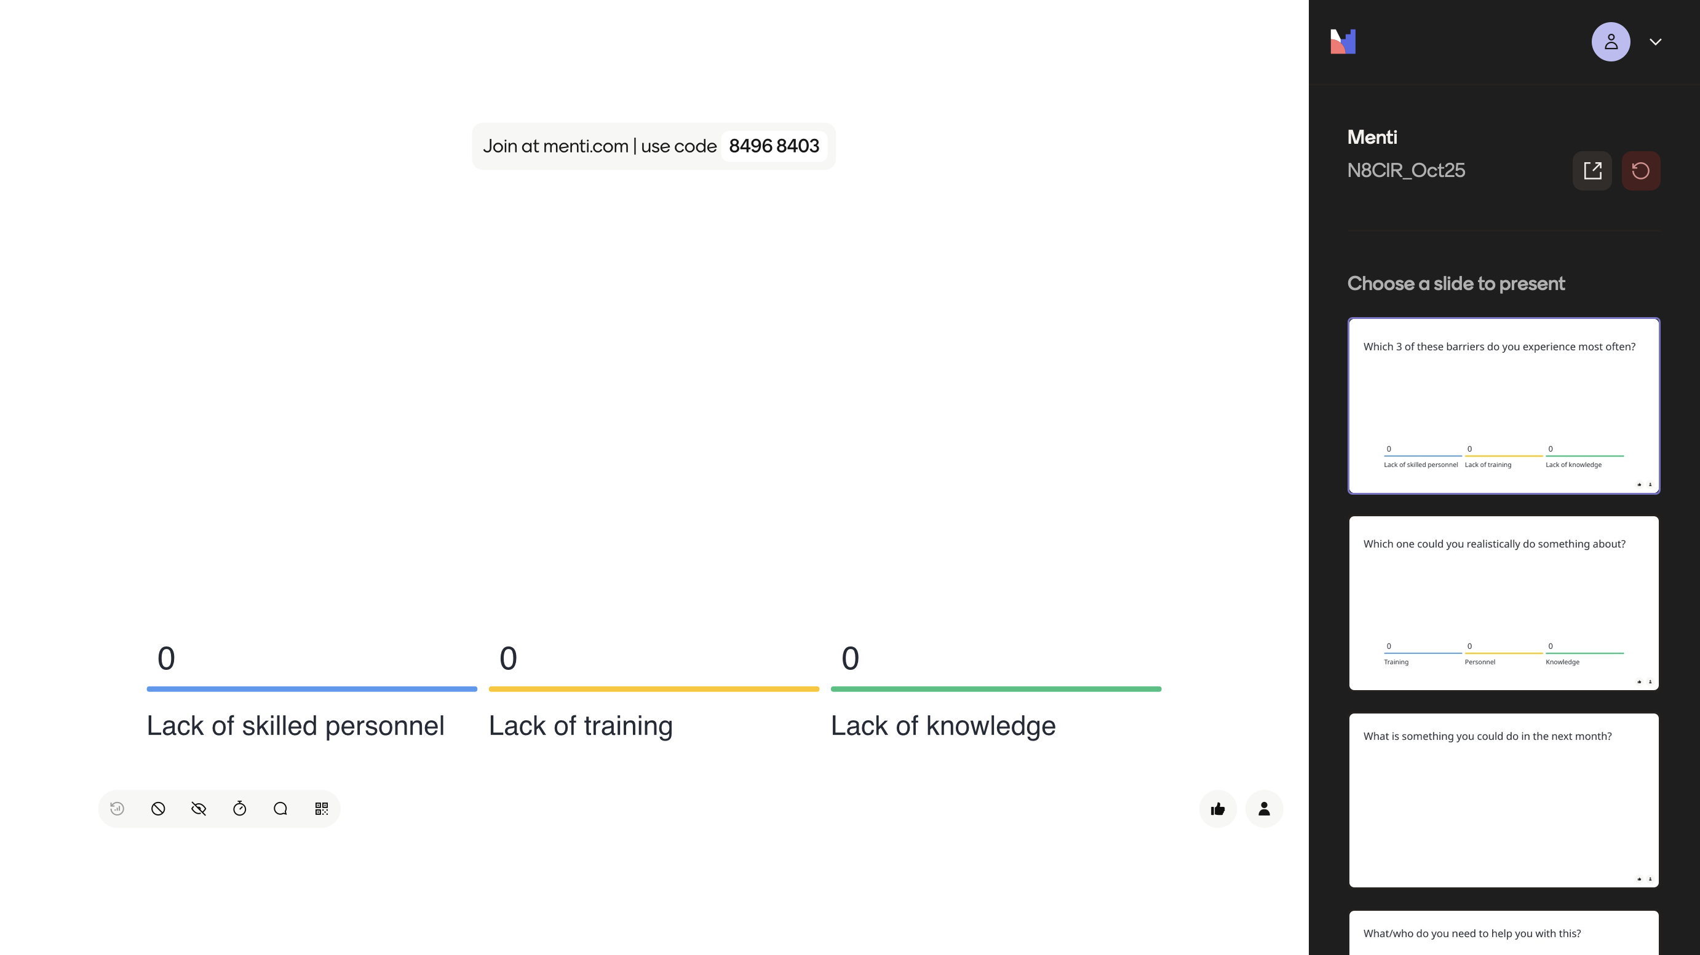
Groups of biggest challenges – which 3 do you experience most often?

Slide 24
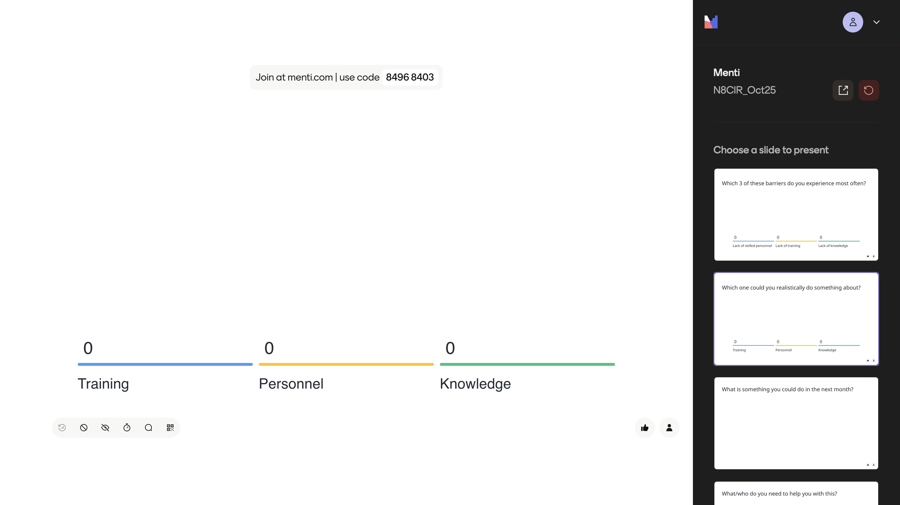
Groups of biggest challenges – which one do you think you could realistically do something about?

Slide 25
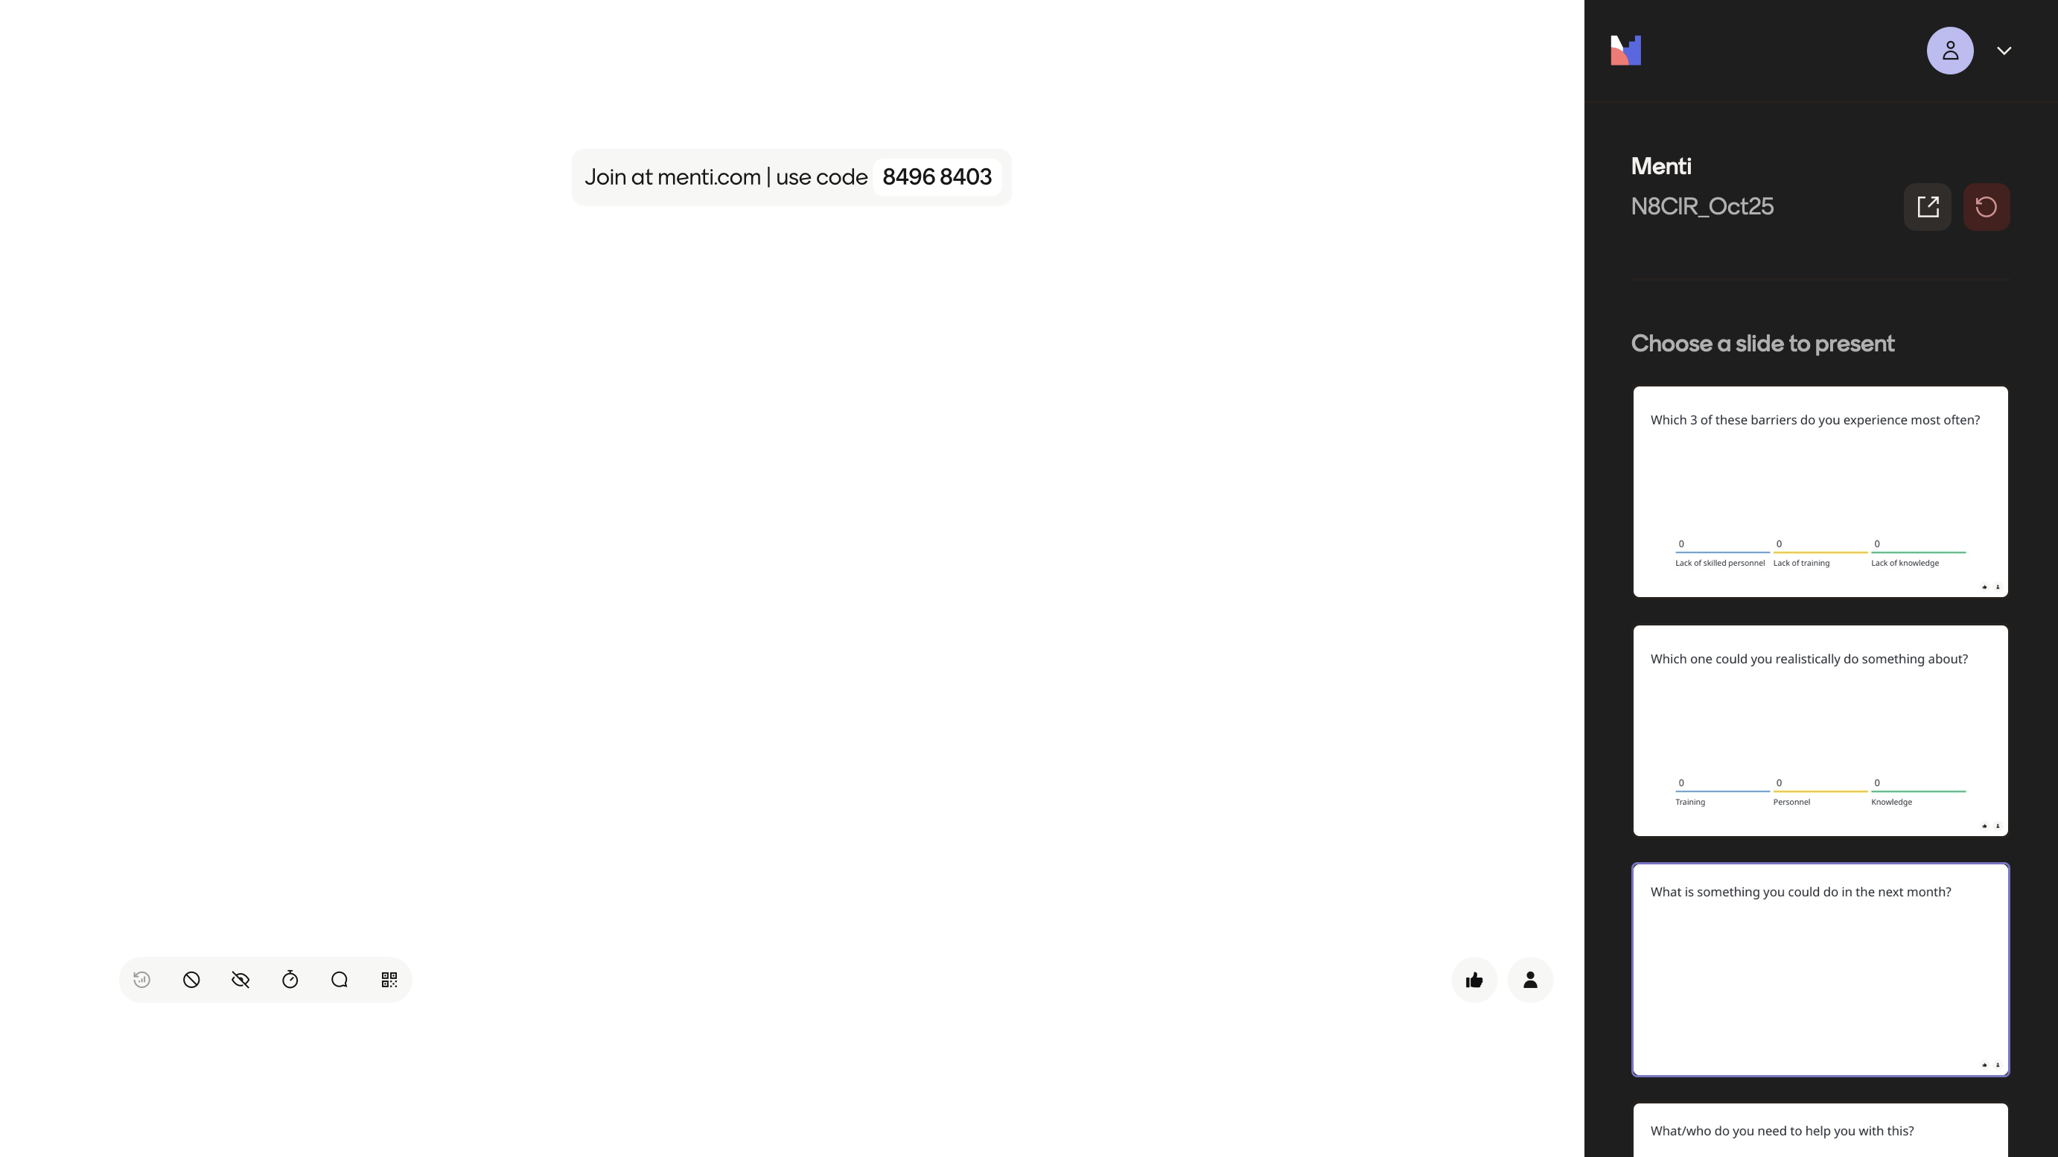
What is something you could do in the next month?

Slide 26
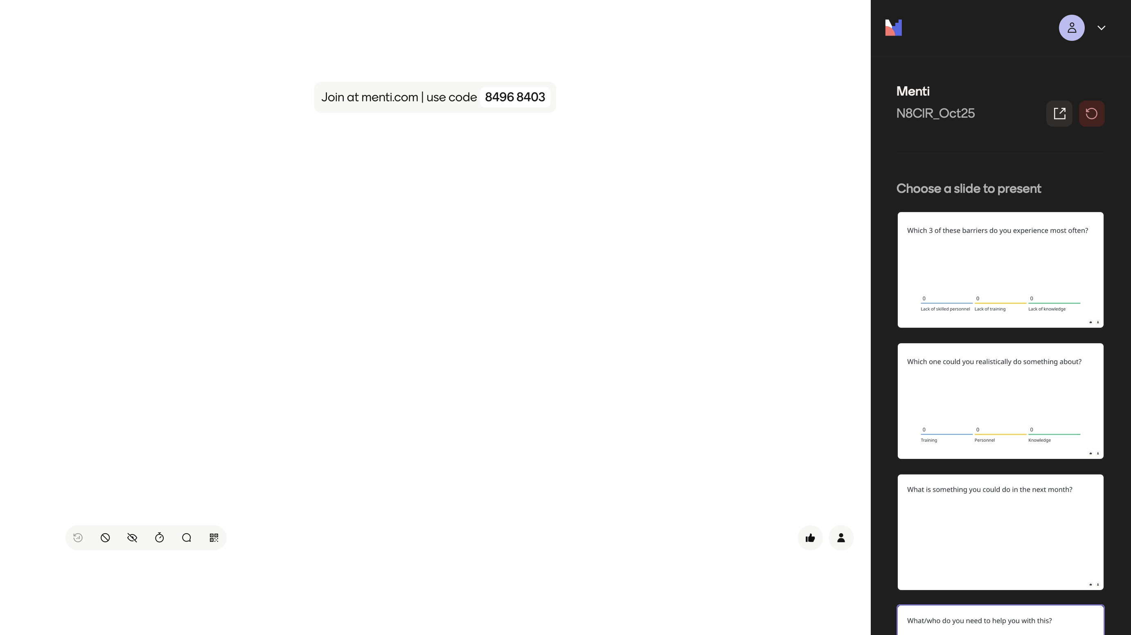
What/who do you need to help you with this?

Slide 27
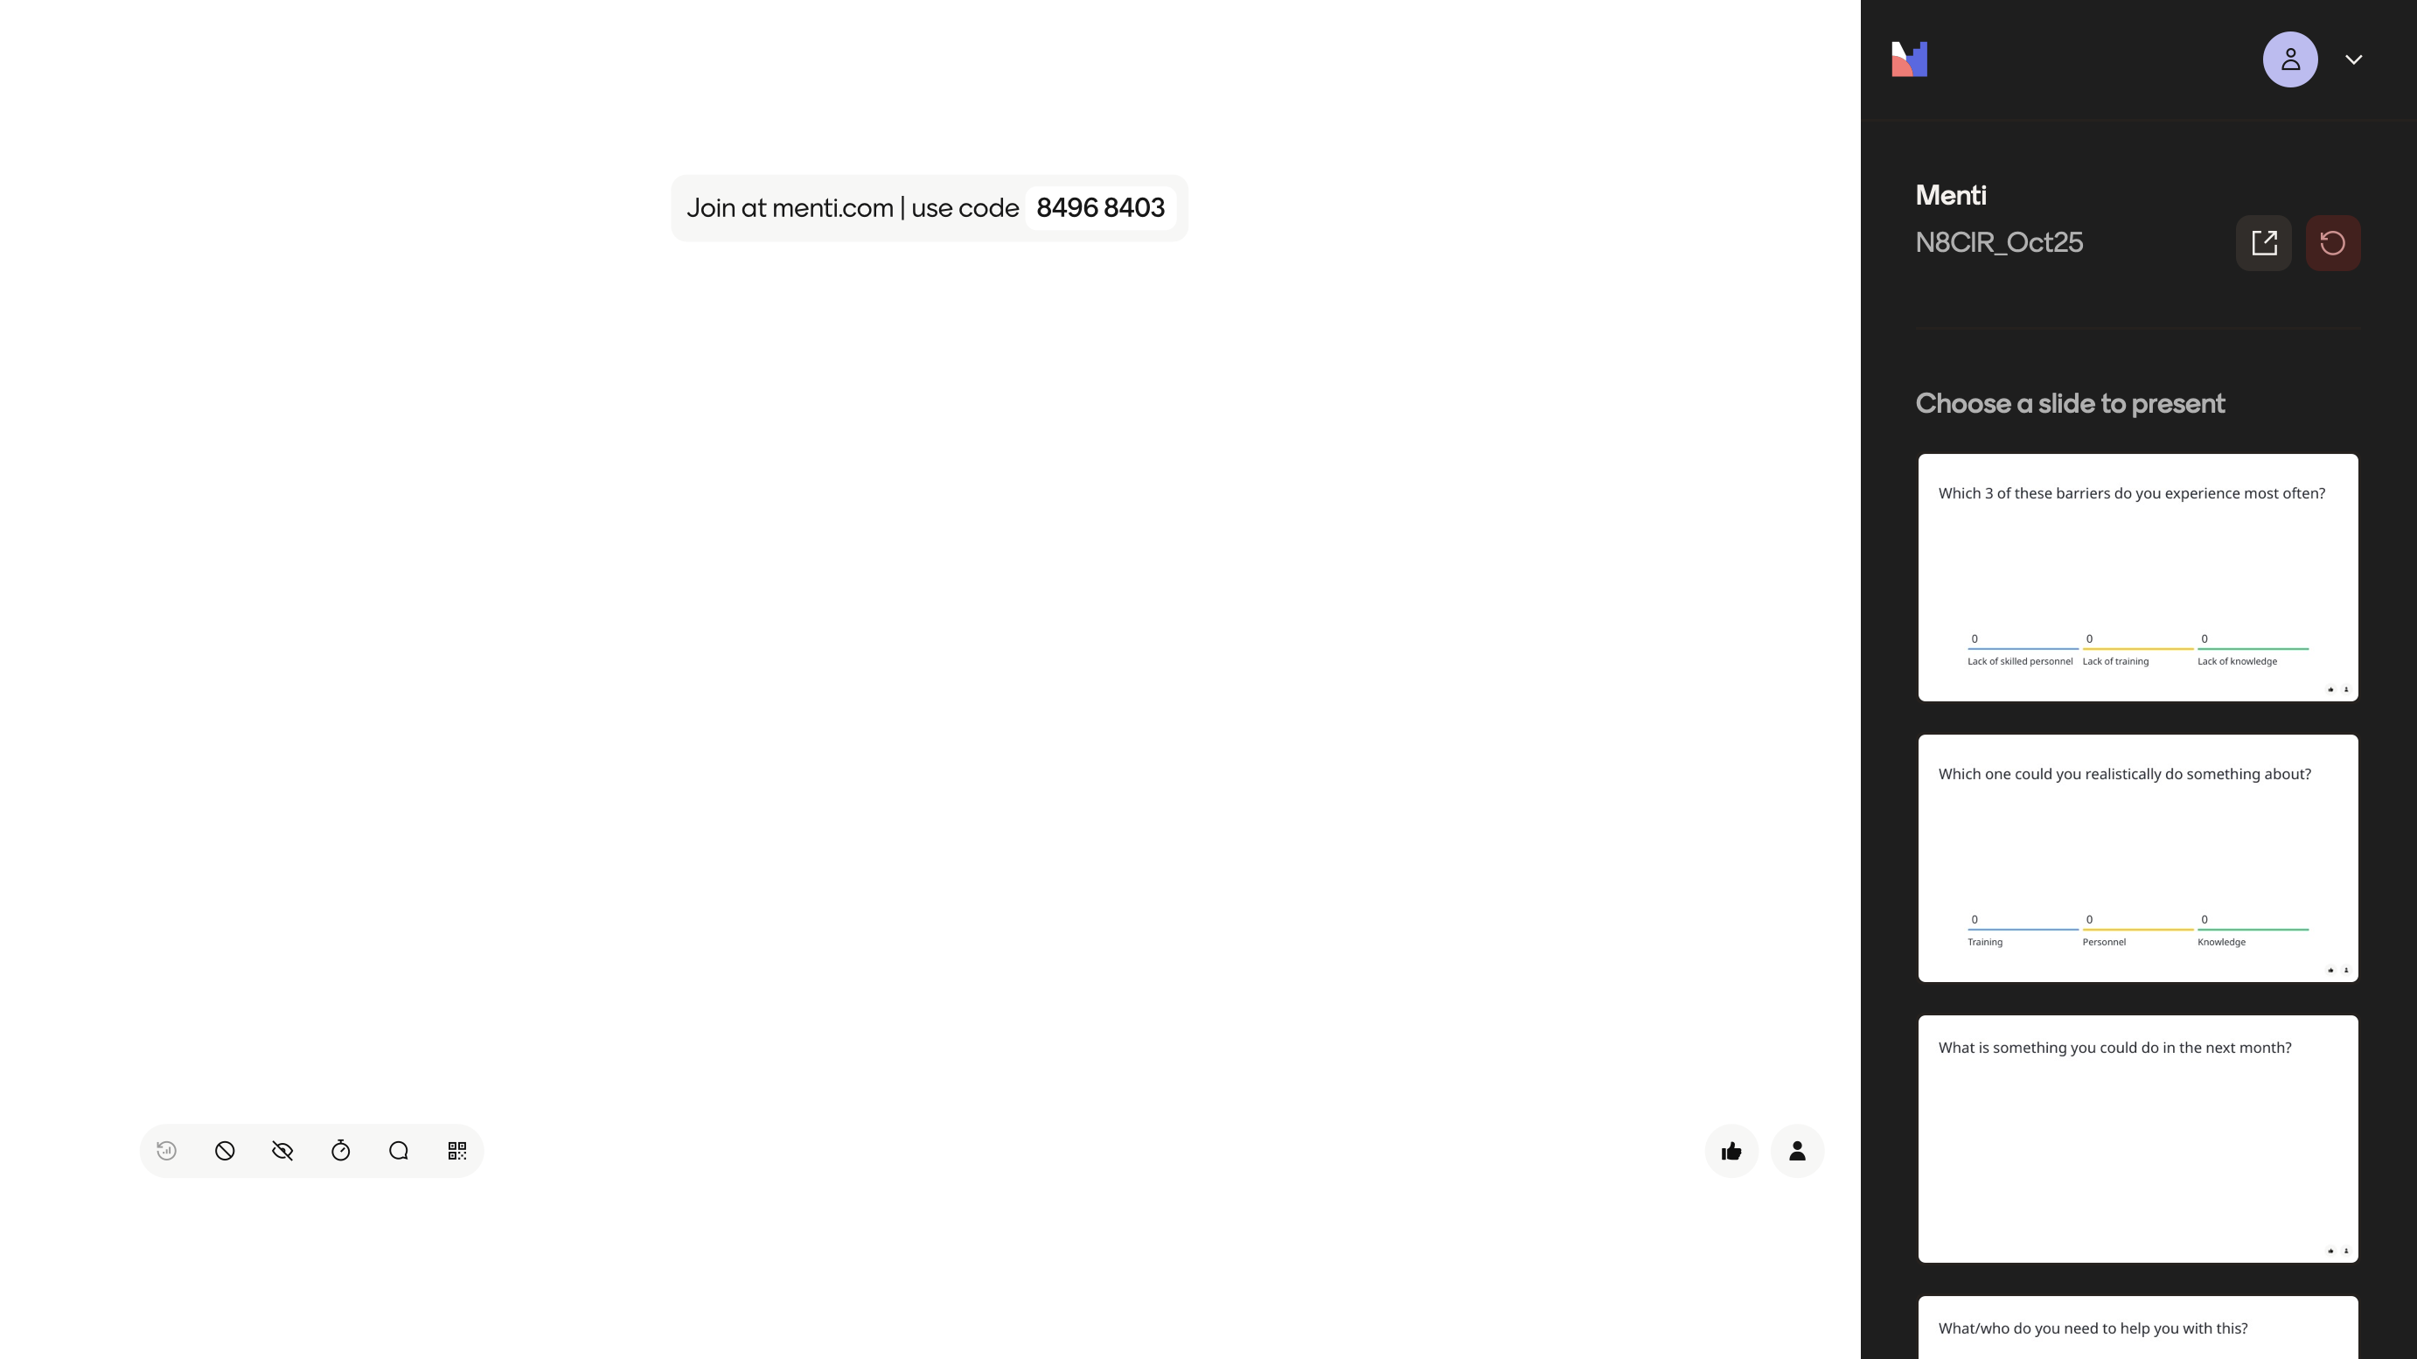
What can N8 CIR do to help overcome these barriers?

Slide 28
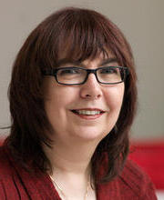
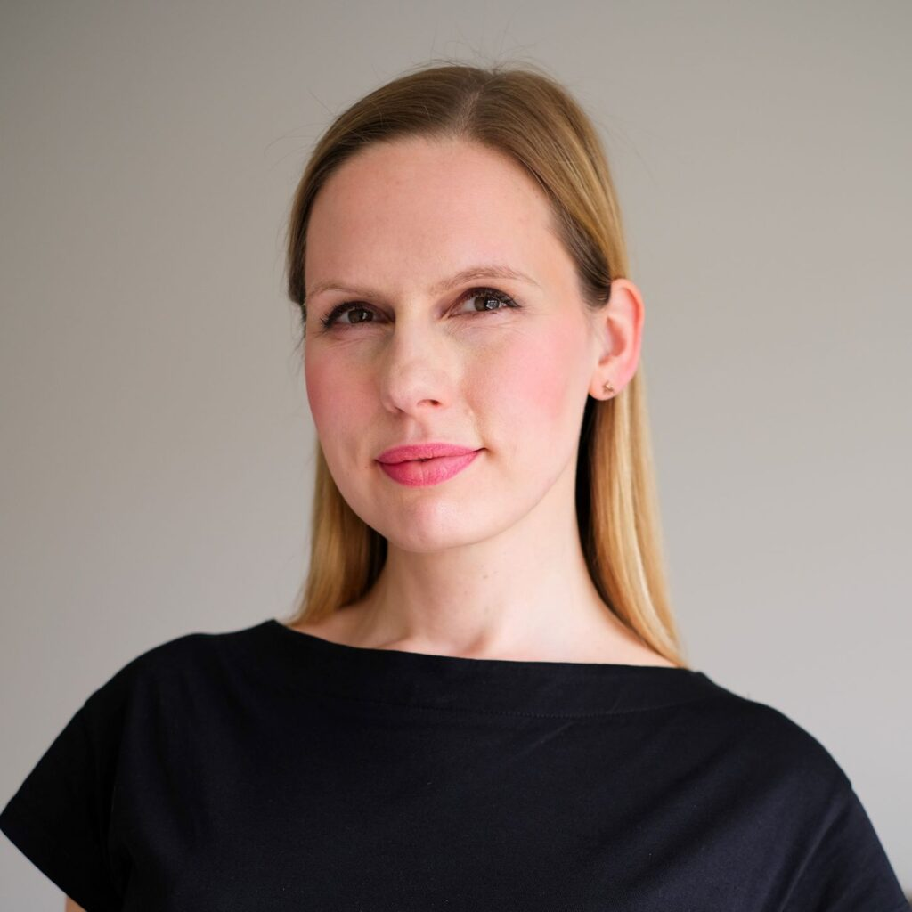
Thank you
Professors Carole Goble & Caroline Jay
Colleagues at ELIXIR and HDR UK
This work was funded by a University of Manchester Open Research Fellowship
saskia.lawson-tovey@manchester.ac.uk

