Slide 1


Data Publication in Internet Archaeology
Judith Winters
Internet Archaeology
@IntarchEditor
editor@intarch.ac.uk

Slide 2
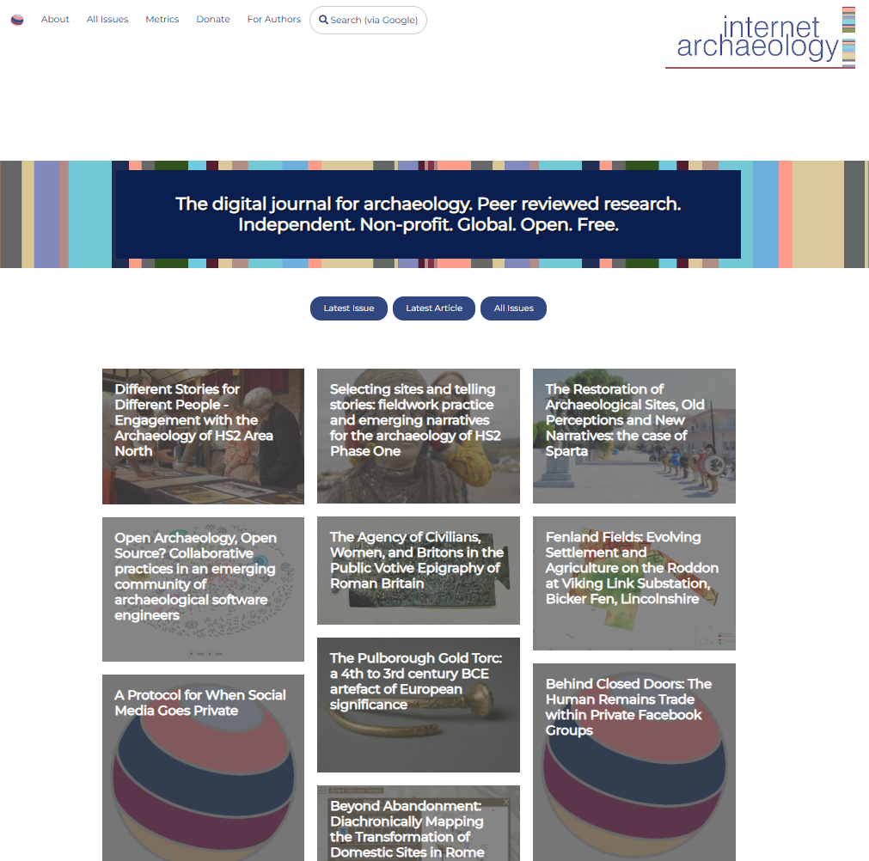

Slide 3
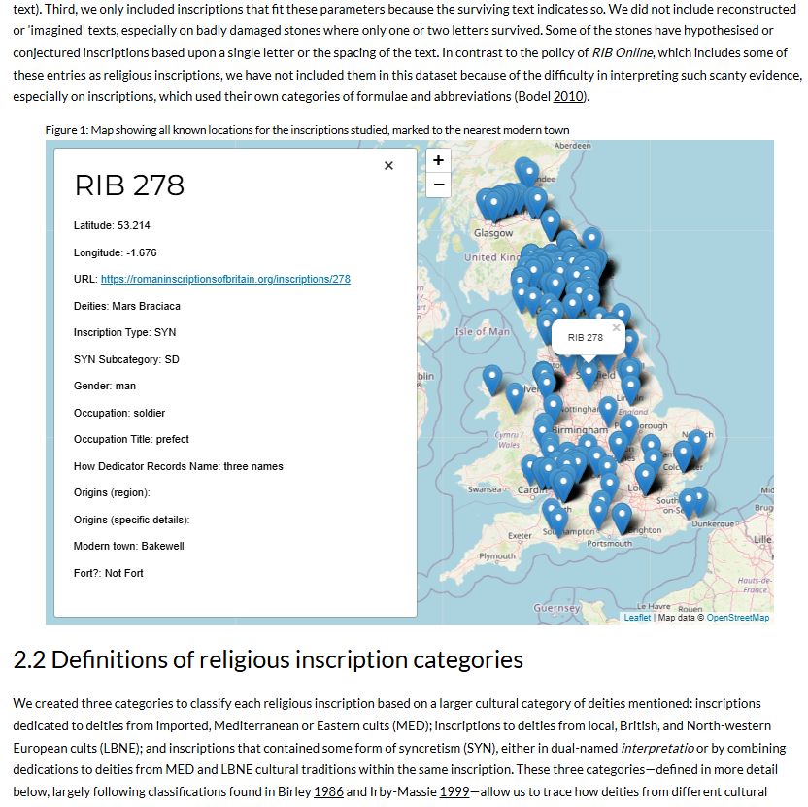
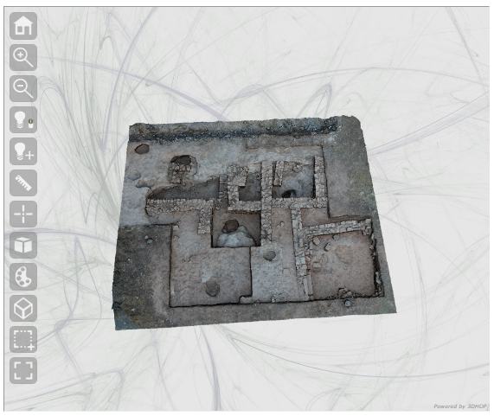
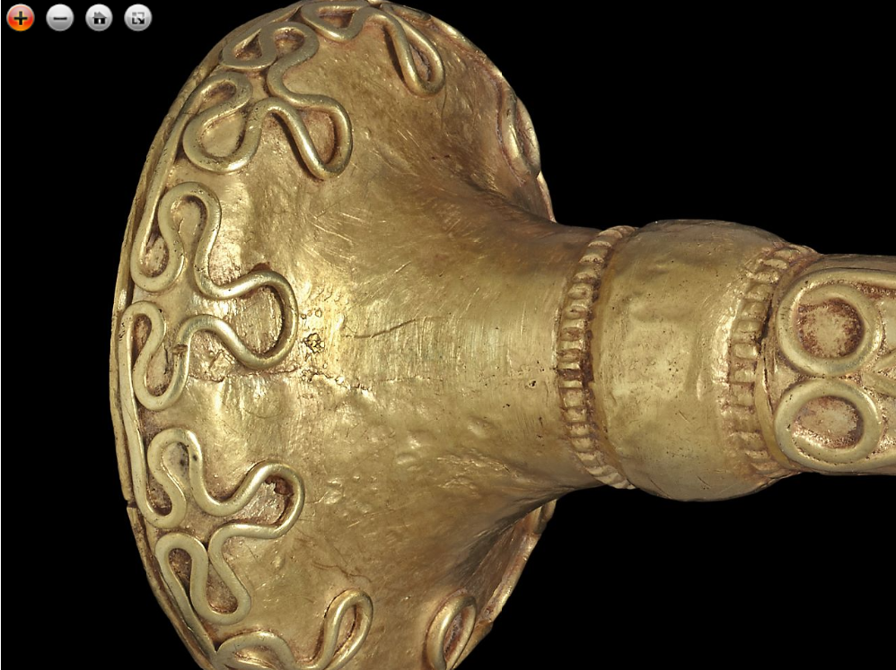
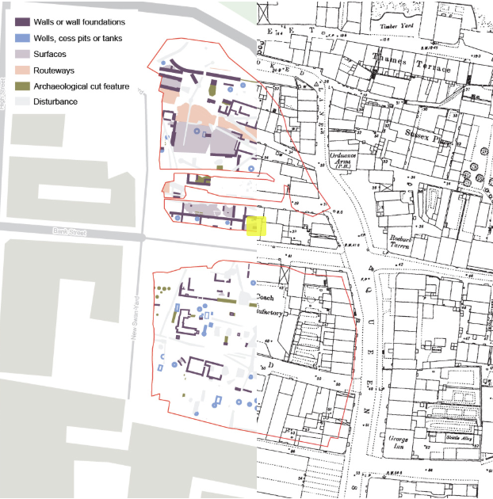
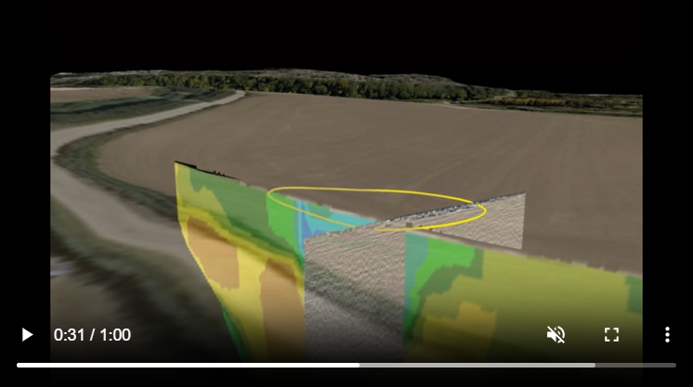

Slide 4
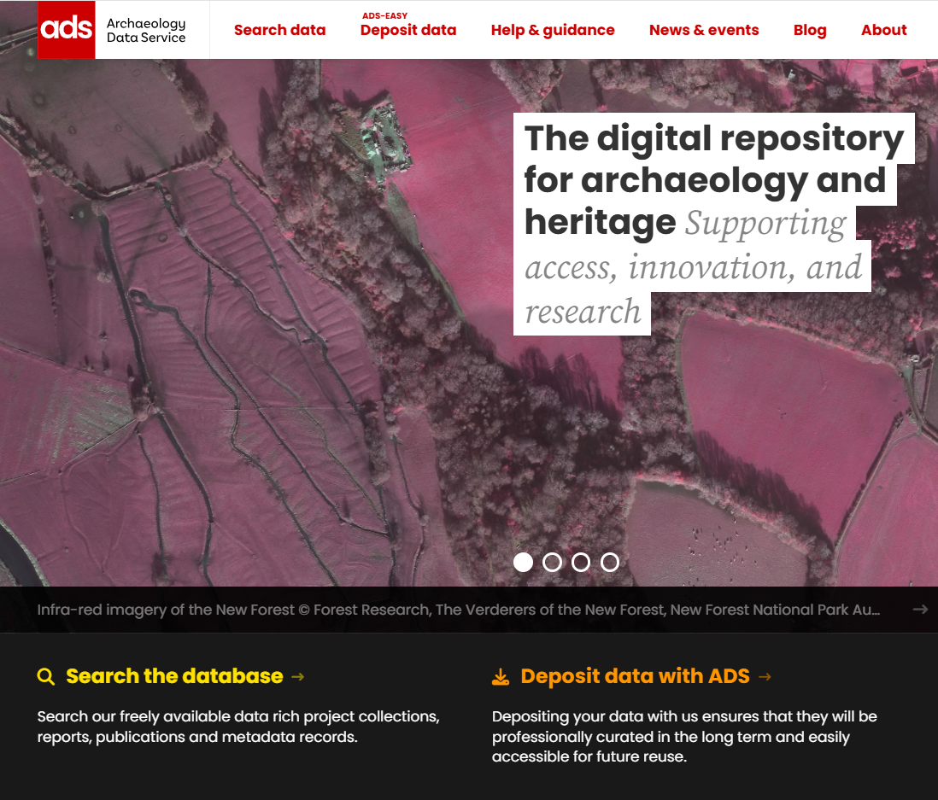

Slide 5
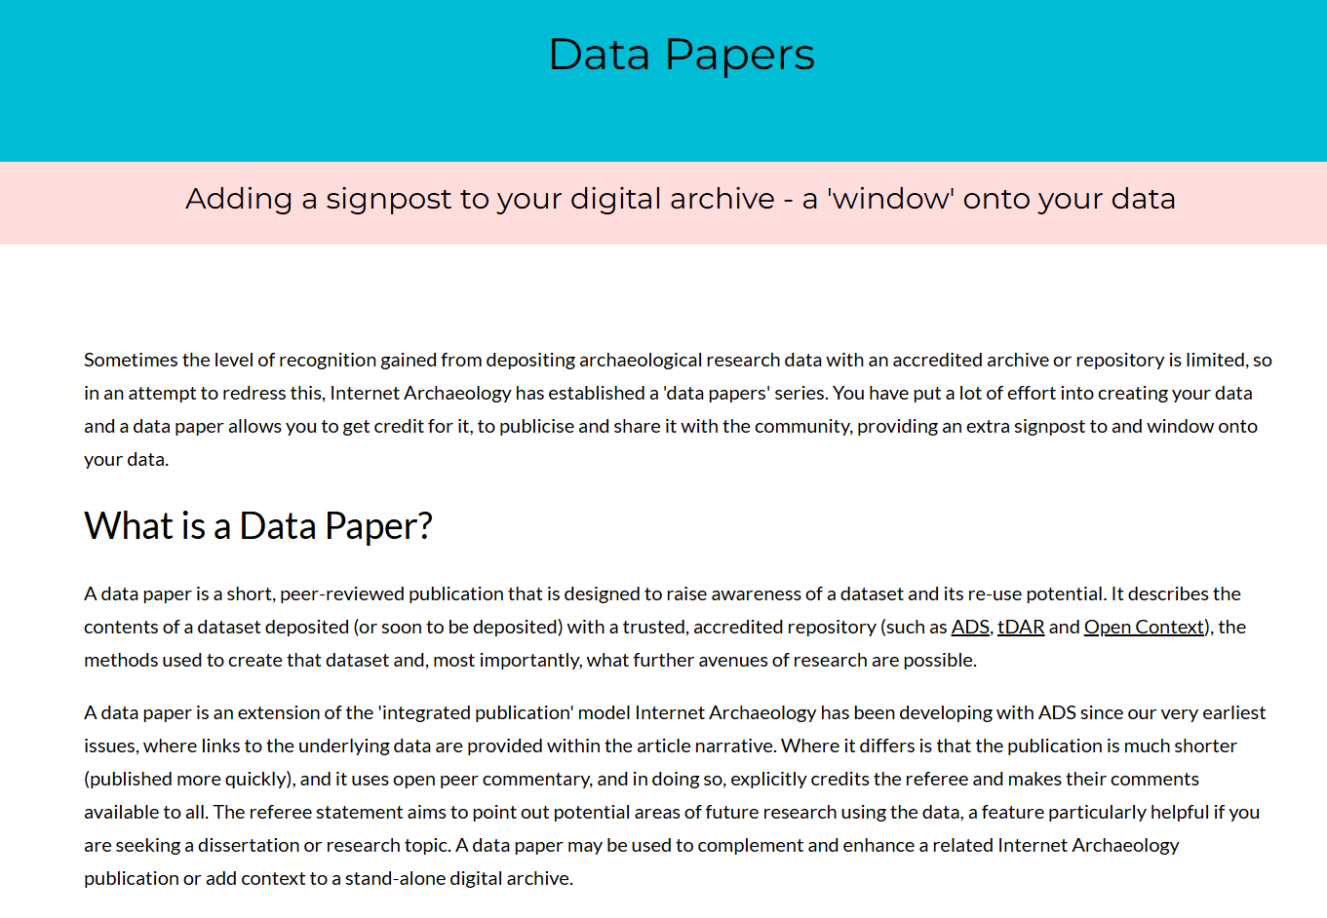
What is a data paper?
https://intarch.ac.uk/authors/data-papers.html

Slide 6
Advice to authors
Use structure template in guidelines, incl. the re-use potential
<2000 words
Option of including some interactive elements
Deposit with archive/repository before or at same time as data paper (so that links can be made)

Slide 7
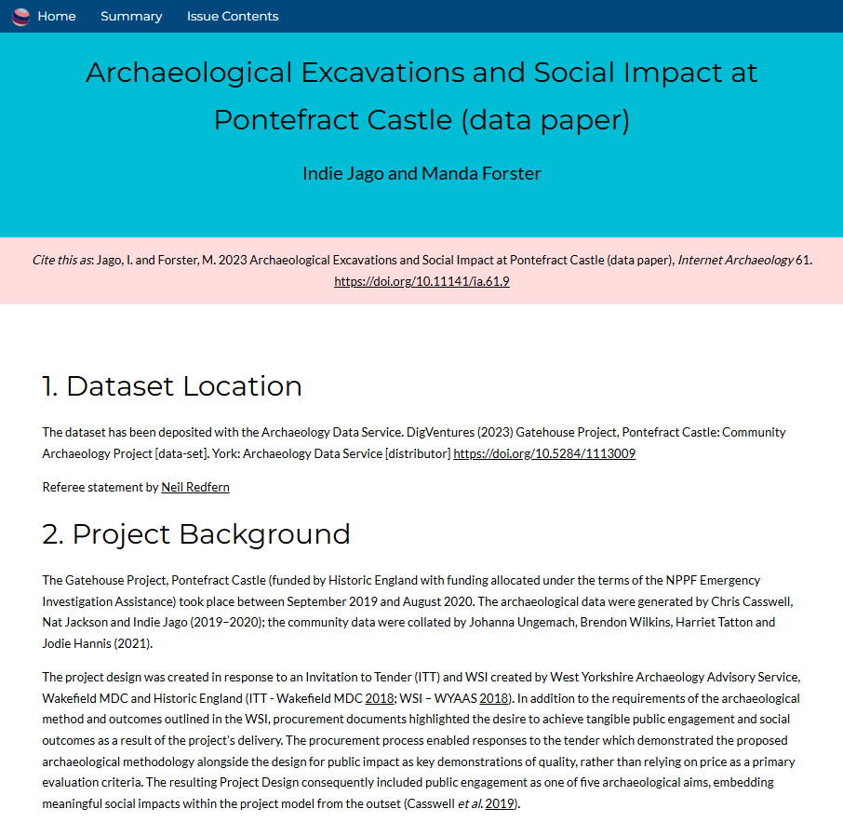

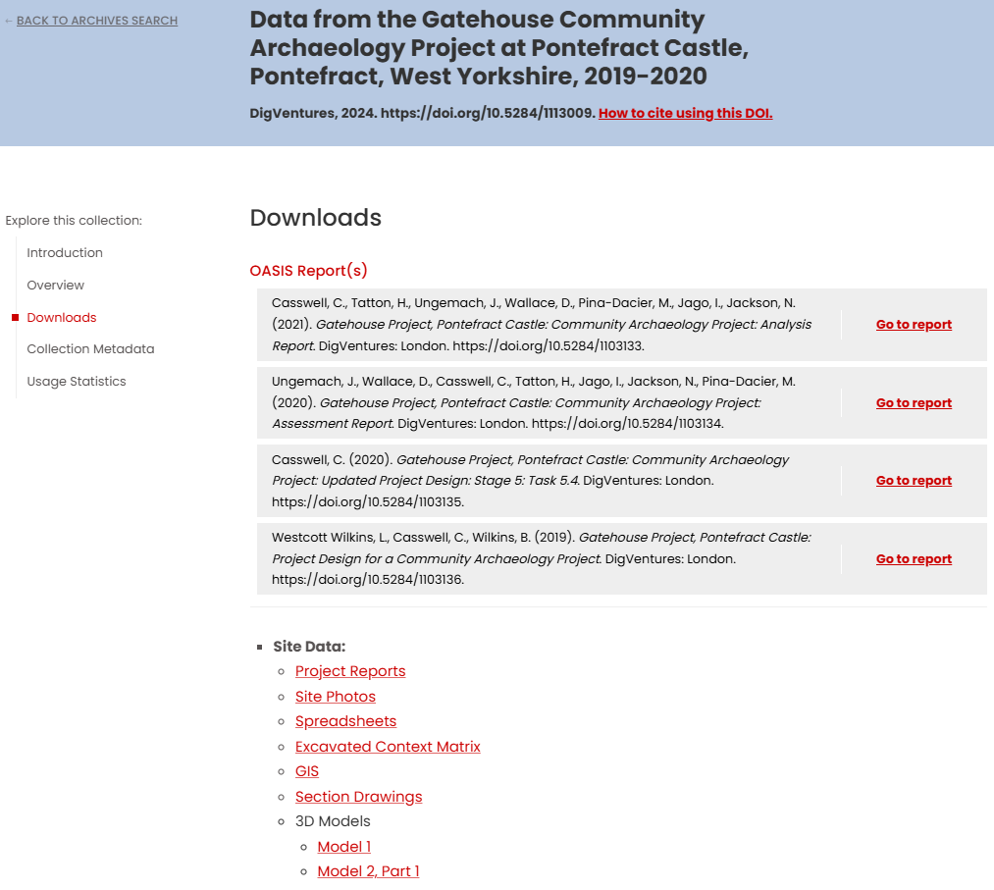
Data Paper: Pontefract

Slide 8
Data papers
Increase data visibility and accessibility
Provides formal citation and attribution
Documentation and facilitating reuse and reproducibility
Encourages collaboration/connections
Supports open science
Data papers shift focus toward data as a standalone research output, providing a structured and accessible way to share information with the broader scientific community.

