Slide 1

Demystifying Data Journals: Experiences of data journal editors
Research Data Journal for the Humanities and Social Sciences
Prof. Vanessa Higgins
UK Data Service, University of Manchester
10 March 2026
Copyright © 2026 University of Manchester. Created by Cathie Marsh Institute for Social Research , UK Data Service.

Slide 2
What are data journals and why are they marvellous things?
Data journals enable the author to focus on the data itself, rather than data analysis which occurs in the traditional journal model.
This primary purpose of showcasing the data
raises awareness and encourage re-use
increases the original value and impact of the data
provides valuable context – adding dimensions beyond metadata level documentation of data in a repository.
research by McGillivray et al (2022) show mean citation counts for research articles higher if they have an associated data paper.
They give credit to those who share data: grants recognition to those who may not qualify for authorship on traditional articles.
Encourage good research data management practice - FAIR principles.
Notes:
Research data journals are not the same as traditional research papers. The focus is on the data, not the data analysis.
The aim is to document a published dataset and highlight opportunities for the data to be re-used in different contexts.
So they raise awareness of the data – but they also show how valuable the data are, and how they can be re-used.
Research data journals provide valuable context to the data. So a researcher may know already that they need to go to a specific data repository to access the data – but the data journal adds value by describing the data in details and showing examples of how the data can be re-used.
Researchers in the audience will be interested to hear that a paper by McGillivray et al (2022) which was based on articles within 2 HSS data journals, showed that a data paper within a RDJ can increase mean citation counts for associated research articles.
A really important point for me is that data papers give credit to those who create, prepare and share the data (which are not always the same people as those who analyse the data and publish research articles) – so people with job titles such as ‘data stewards’ or ‘Research data manager; or those who work in data archives or data services such as the UKDS where I work. These people don’t get many opportunities to publish as they are not doing the ‘research analysis’ – but they do really important, valuable work
Final point is that they encourage good RDM. One of the requirements for (most) data journal articles is that the data are deposited in a responsible repository with appropriate metadata. This means that they encourage data to be
Findable, Accessible, Interoperable, Reproducible.

Slide 3
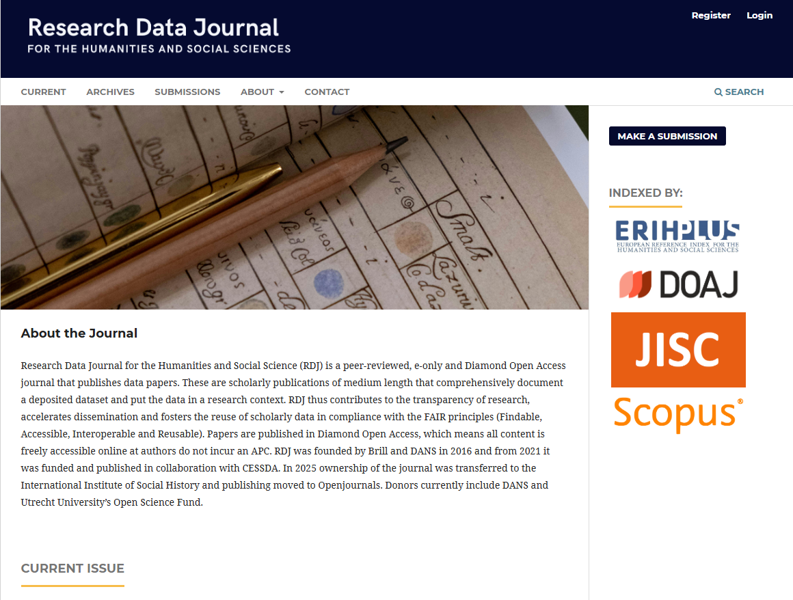
Founded in 2016.
Scholarly peer-reviewed publications containing a description of a dataset and putting the data in a research context.
Max 2500 words
Requirement: datasets that underpin the data papers are formally published in a trusted digital archive or repository (with DOI).
Diamond Open Access i.e. no cost to the author.
Indexed in Scopus.
https://researchdatajournal.org/
Creative Commons Attribution 4.0 International License.

Slide 4
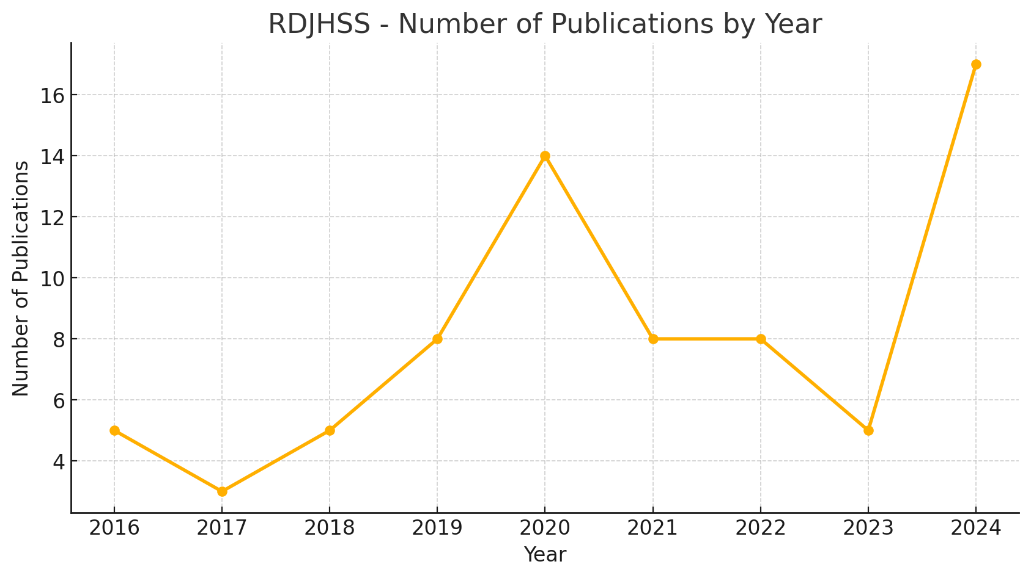
Total papers = 75
Chart produced by V. Higgins, 2025

Slide 5
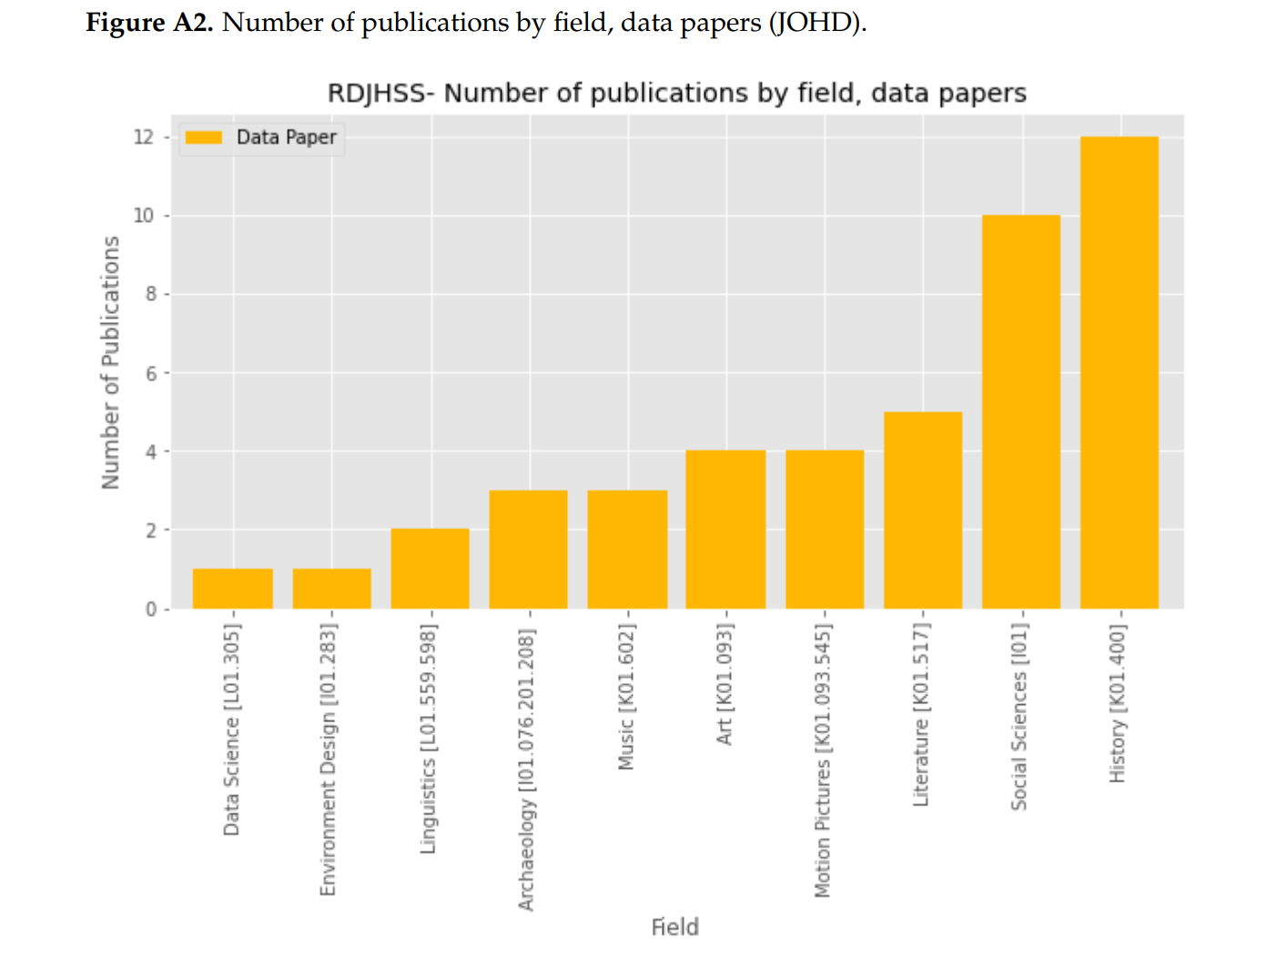
McGillivray, B.; Marongiu, P.; Pedrazzini, N.; Ribary, M.; Wigdorowitz, M.; Zordan, E. Deep Impact: A Study on the Impact of Data Papers and Datasets in the Humanities and Social Sciences. Publications 2022, 10, 39. https://doi.org/10.3390/publications10040039, page 18 of 40.
https://www.mdpi.com/2304-6775/10/4/39;
Copyright: © 2022 by the authors. Licensee MDPI, Basel, Switzerland. This article is an open access article distributed under the terms and conditions of the Creative Commons Attribution (CC BY) license (https:// creativecommons.org/licenses/by/ 4.0/).

Slide 6
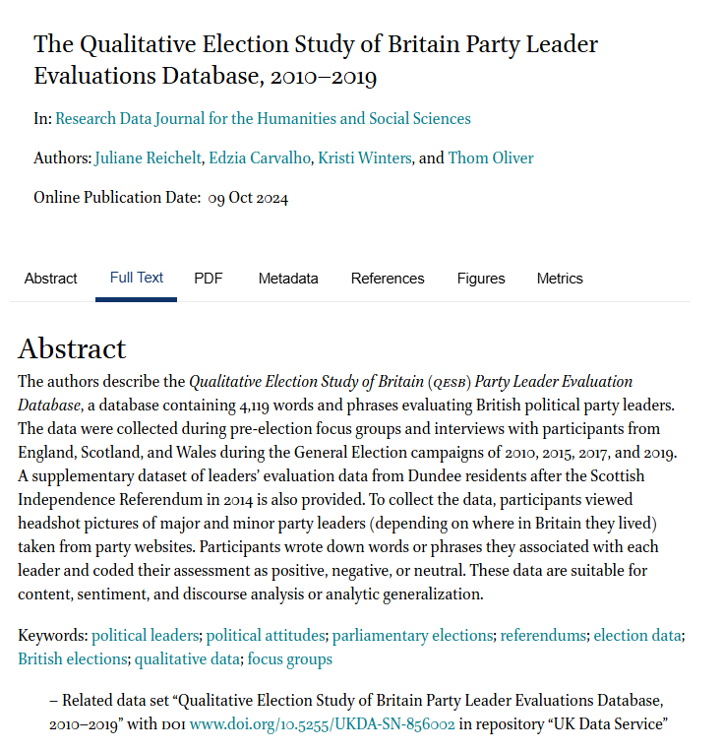
Example article from RDJ:
Article contents:
Introduction
Research Aim
Data Collection Method
The Database
Description of the database
Quality and usage
Context and relevance
https://doi.org/10.1163/24523666-bja10049
Creative Commons Attribution 4.0 International License.

Slide 7
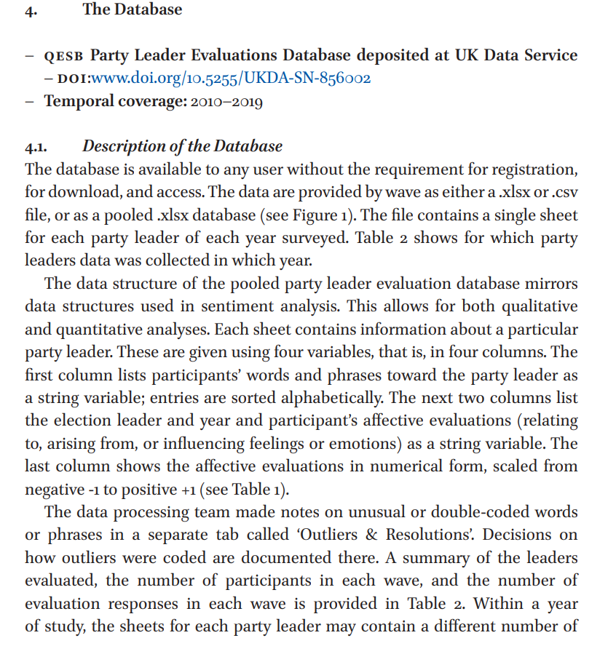
Links to the archived data
Detailed description of the data
https://doi.org/10.1163/24523666-bja10049
Creative Commons Attribution 4.0 International License.

Slide 8
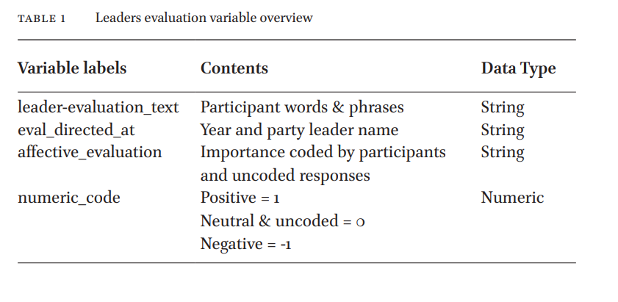
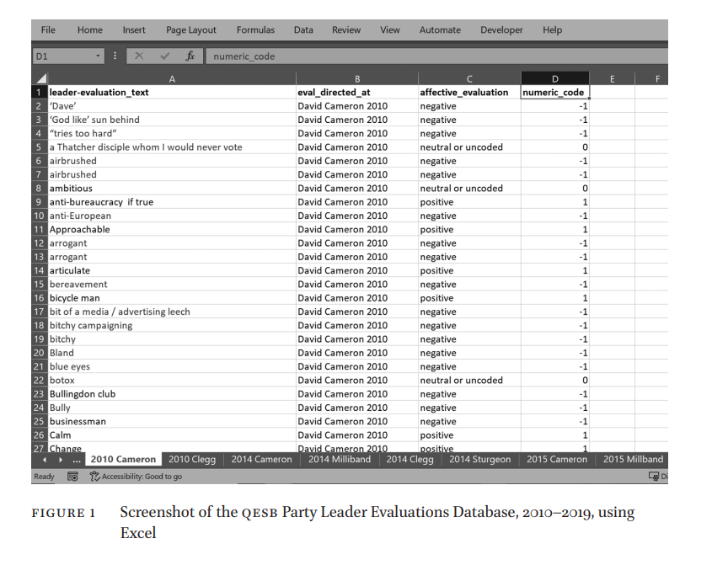
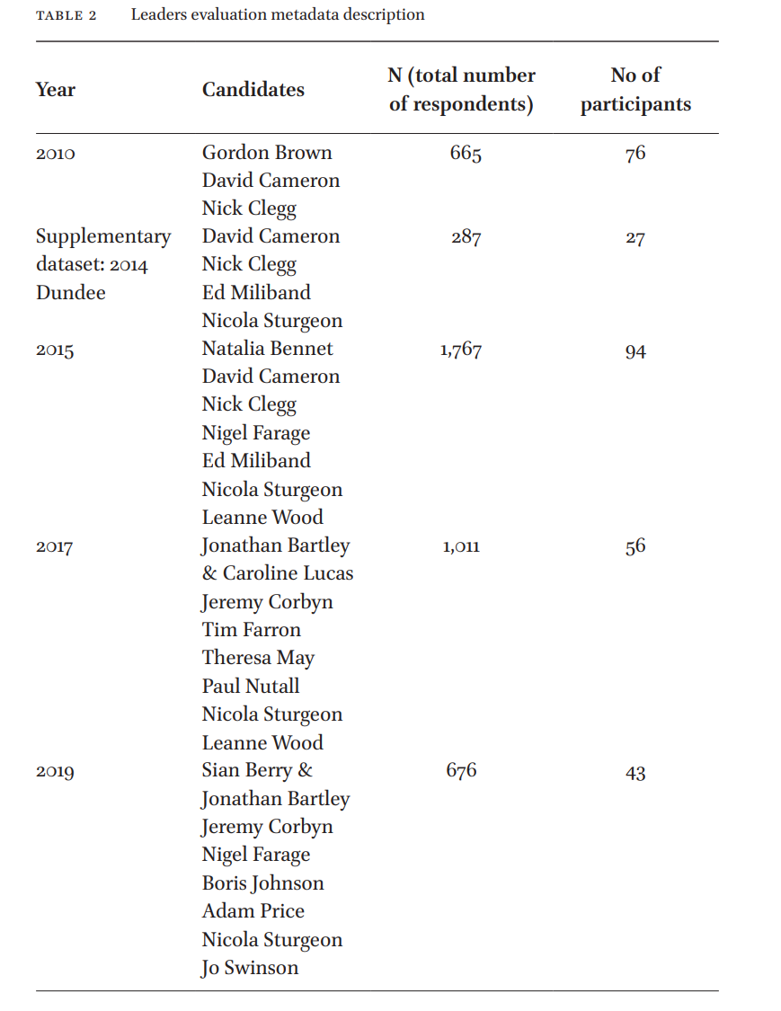
https://doi.org/10.1163/24523666-bja10049
Creative Commons Attribution 4.0 International License.

Slide 9
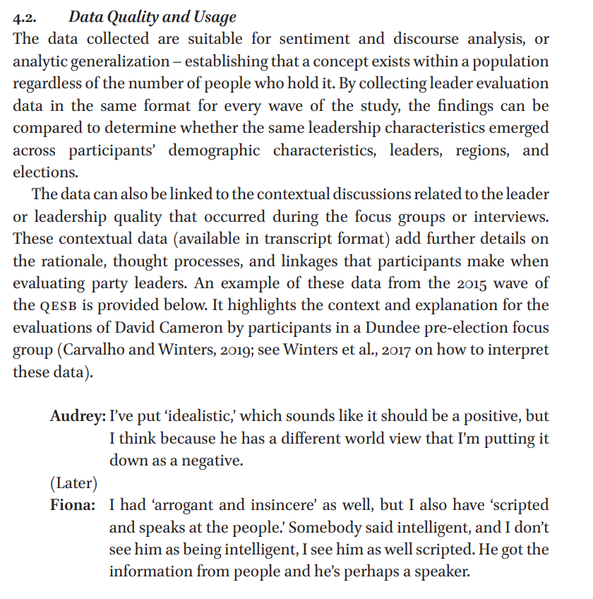
Examples of analysis methods
that can be conducted with the data
Ideas for research projects
https://doi.org/10.1163/24523666-bja10049
Creative Commons Attribution 4.0 International License.

Slide 10
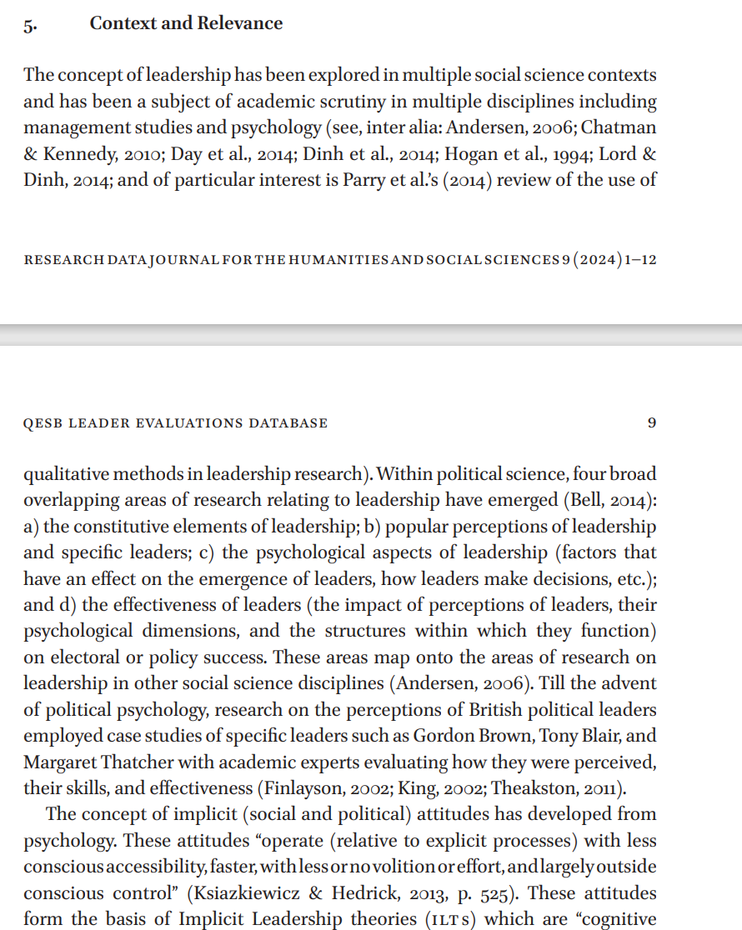
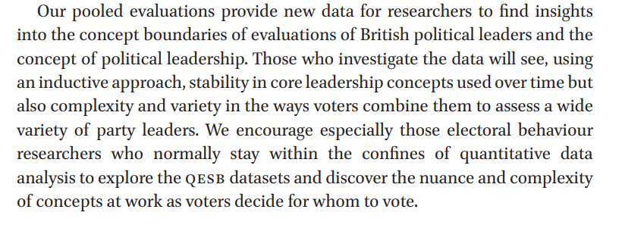
Context and relevance comes last in this paper – this is like an Introduction/Literature review of a research article.
https://doi.org/10.1163/24523666-bja10049
Creative Commons Attribution 4.0 International License.

Slide 11
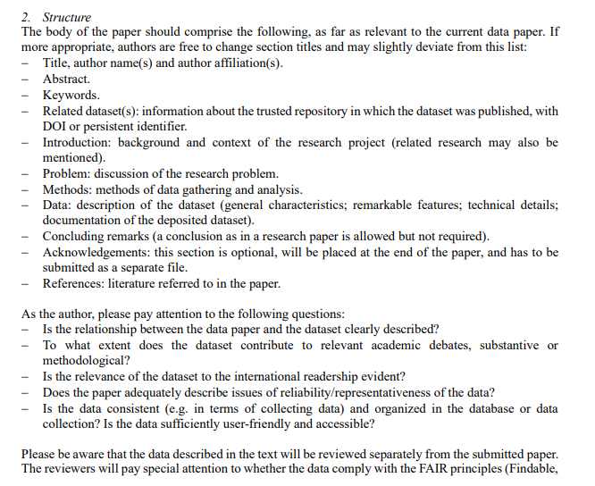
https://researchdatajournal.org/libraryFiles/downloadPublic/211

Slide 12
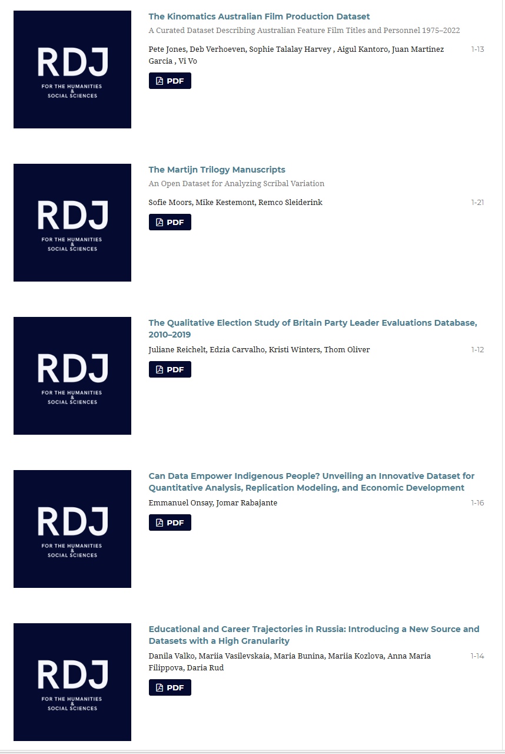
Data journals in Humanities and Social Science
Data journals are fairly new compared to STEM and Health
Humanities and Social Science encompasses many disciplines.
Data take many forms: maps, text, social media, survey, audio/visual recordings.
Qualitative data:
Sharing can be difficult due to confidentiality/disclosure risk
Archiving can involve a lot of thought and preparation
Often need to put data behind licences
https://researchdatajournal.org/issue/view/1696
Creative Commons Attribution 4.0 International License.

Slide 13
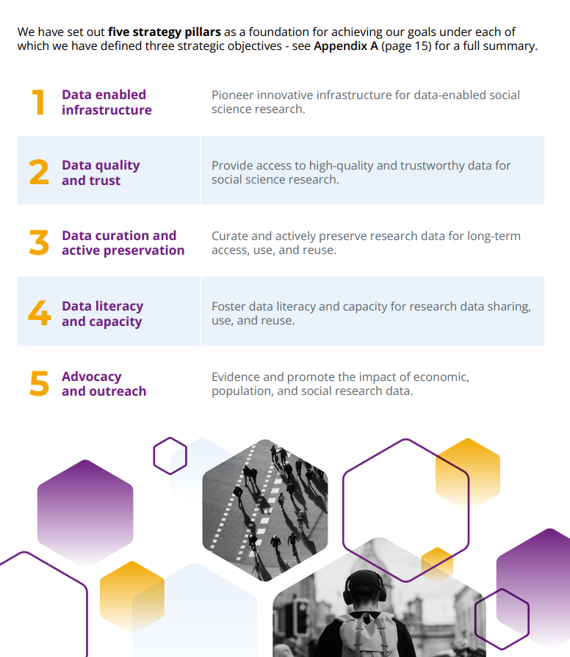
The UK Data Service (social science data repository)
Flagship data infrastructure service, funded by Economic and Social Research Council
Largest UK repository of social science research data (> 7,300 datasets) with >47,000 users from 148 countries.
Curate datasets from trusted data providers such as Govt departments, ONS, ESRC and more
Nationally significant datasets: survey microdata, longitudinal studies, census data, international macrodata, qualitative/mixed methods
For users from any sector: academic researchers/lecturers and students (70%); government analysts; charities; think tanks; school students etc
Also have a data skills training programme
https://ukdataservice.ac.uk/
Notes:
If you are a social scientist and you are wondering where to deposit your data – this is the place.
As well as hosting a large number of social science datasets, we also deliver a lot of online training events/resources, including training in how to deposit your data, anonymise your data and other research data management webinars. So go and have a look.

Slide 14
Thank you.
Vanessa.higgins@manchester.ac.uk
https://www.linkedin.com/in/vanessah1935/ https://bsky.app/profile/vanessahiggins.bsky.social

