Slide 1
Publishing a Data Descriptor in Scientific Data
Derek Gatherer
Biomedical & Life Sciences
Lancaster University
Editorial Board
Scientific Data
https://www.nature.com/sdata/

Slide 2
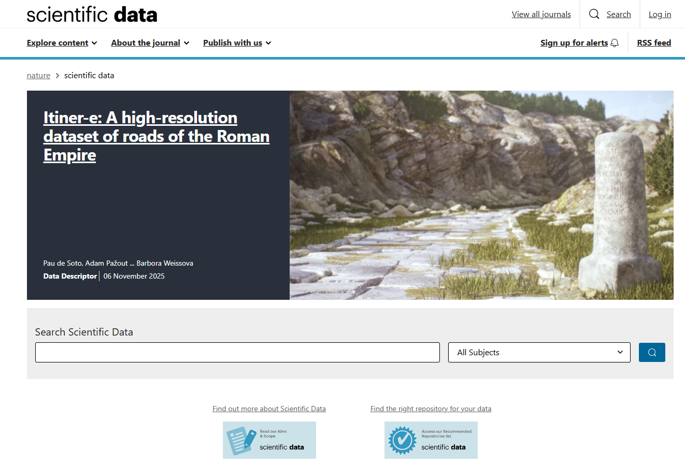

Slide 3
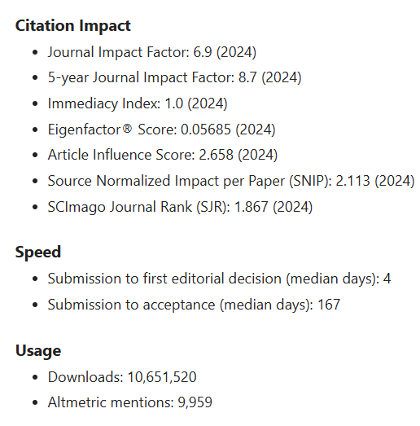

Slide 4
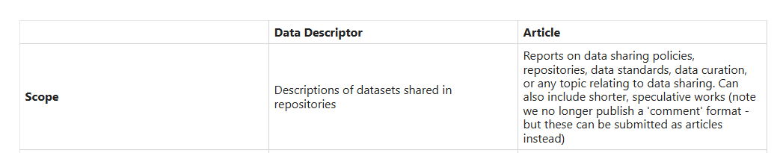
https://www.nature.com/sdata/policies/repositories
Public sector, governmental and institutional data repositories preferred.

Slide 5
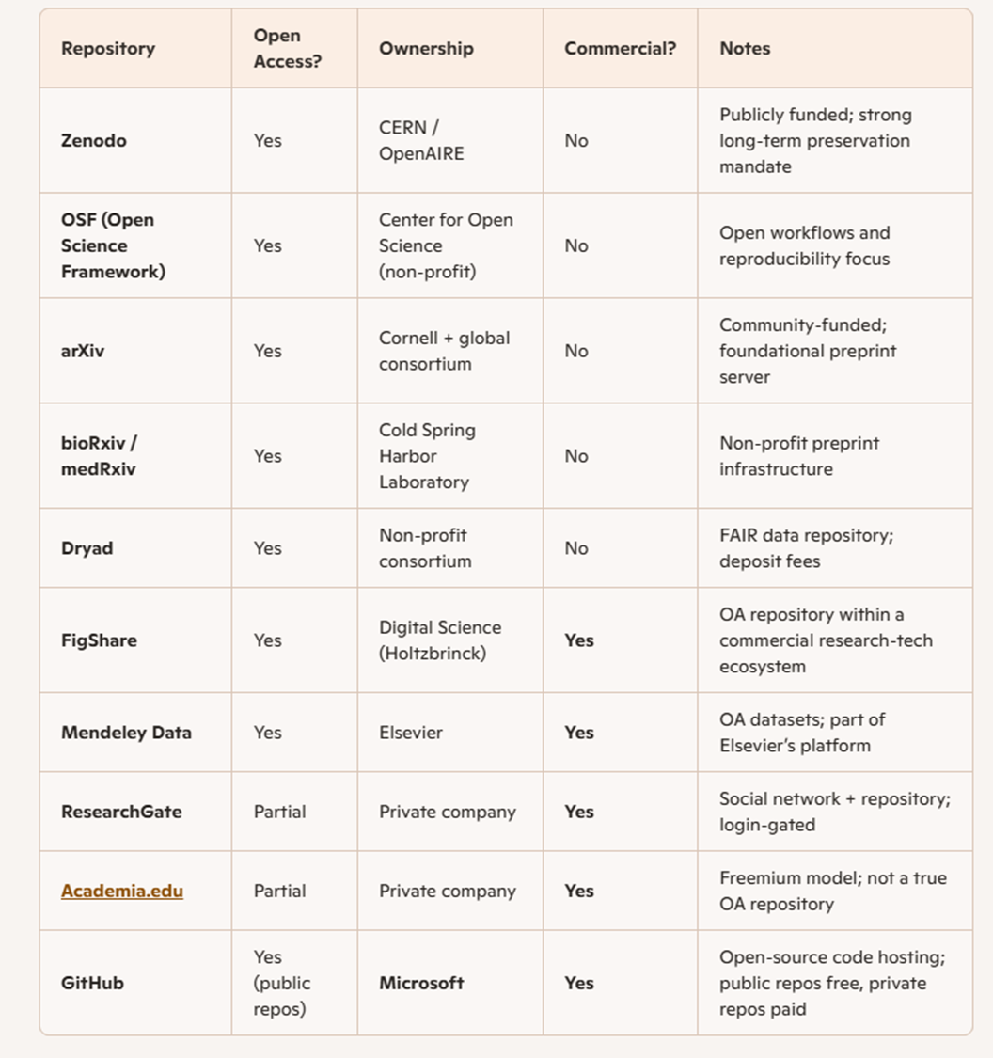
Generated by Copilot

Slide 6
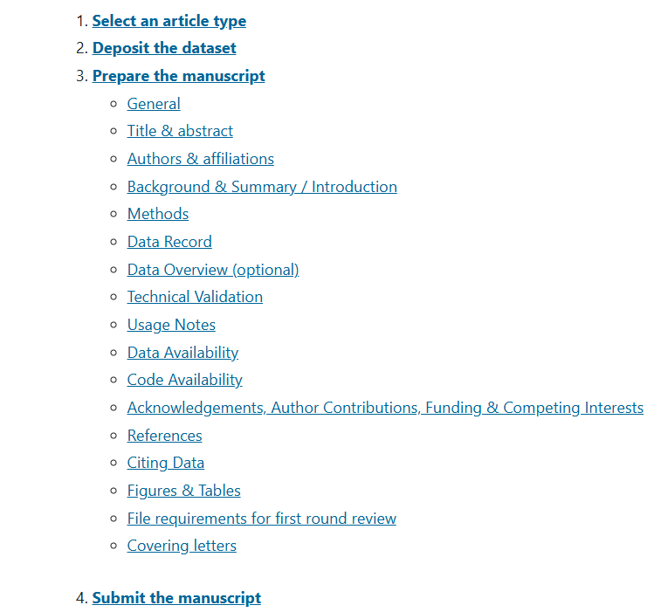
Results?
Discussion?

Slide 7
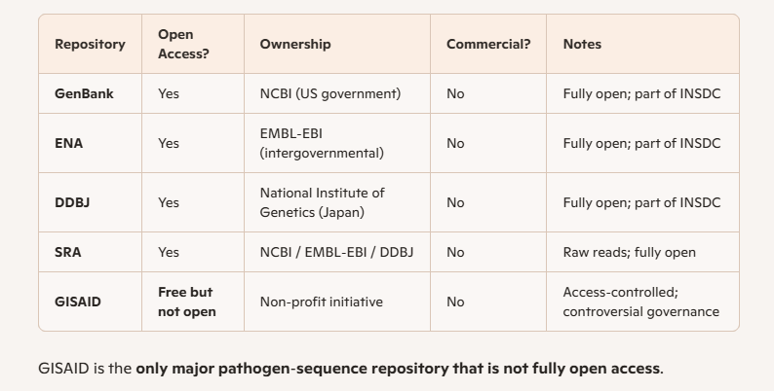
Things to consider
Do you have a dataset?
Is your data public domain?
Is your data primary or derived from another dataset?

Slide 8
Things to consider
Do you have a dataset?
Is your data public domain?
Is your data primary or derived from another dataset?
Do you have a Data Descriptor?
Do you have a Research Paper?
Write both, by all means
Only submit the Data Descriptor to SciData
Find another journal for the Research Paper

