Slide 1






Demystifying Data Journals: Experiences of data journal editors
An N8 CIR Data Stewards Network Event
Tom Morley,
Lancaster University
Tristan Martin,
University of Manchester
Jenny McHugh,
UK-Ireland Digital Humanities Association
Ric Campbell,
University of Sheffield
Notes:
Hello and thank you for joining us today for this workshop all around data journals
[Intro - including explaining the initialisms! And also online so fine to be outside of N8 as well]
This is our first event for this theme, so that’s why it’s so great to see everyone here, showing that there is demand and want for such a network.

Slide 2

N8CIR Meeting Code of Conduct
If you have a question or input please raise your hand during the Q&A session
Moments of pause will be included at the end of each discussion to allow time for any additional questions
All participants’ inputs are equally valued, and participants are expected to share all relevant information.
We will be recording the talks when possible, but not the Q&A sections.
All AI transcribers will be turned off and removed from the meeting.
Notes:
So there’s just a tiny bit of housekeeping to go through before we get going today which come from the N8 CIR code of conduct.
So the key takeaway points are please keep your microphone muted during the talks, we’ll have time for Q&A at the end of each talk, so pop any questions in the Q&A bit (it’s under the 9 dots on he bottom right), but also feel free to put any questions in the chat as well.
Everyone here is equally valued, so please be polite while others are asking questions and speaking.
And we’ll be recording the talks where we have permission, which will go on the webpage, but we will not be recording the Q&A sessions, there are no wrong questions of course, but it’s just to allow and encourage any questions that people want to ask (if Q&As are recorded of course these will be destroyed and not used).

Slide 3
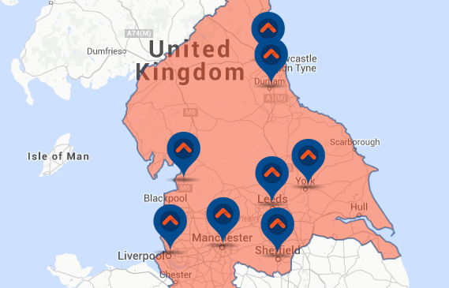
RSE
RIE
RDM
…
DRI professionals
The N8 CIR is a Centre of Excellence in Computationally Intensive Research methods, skills, and facilities to underpin the strategic research objectives of the N8 universities.
We accelerate progress in areas of research that are of strategic importance to the N8 partners, including some that have not made heavy use of technology in the past.
Find out more about the N8 CIR at https://n8cir.org.uk/
Digital Health,
Digital Humanities,
Machine Learning
Notes:
A quick overview of the N8 CIR, a collaboration of the eight northern universities to help accelerate progress in areas of research that are of strategic important to all partners.
It also looks to help and promote a wide range of professionals some of which are listed in the top right there (list them all out, software, infrastructure, digital research infrastructure)
Bede the shared tier two super computer, as well as RSE and Women in HPC networks, a DRI retreat, and internship programs that are all run out of the n8 CIR.

Slide 4


N8 CIR Data Stewards Network
“Anyone who interacts with data in a significant way, at any point in the research data lifecycle, is a data steward”
An non exhaustive list of jobs that are covered by this statement include: Data Librarian, Data Curator, Data Wrangler, Bioinformatician, Data Consultant, Data Specialist
Notes:
And the new network, the Data Stewards Network.
So a network, to help bring people together, share best practice, learn from each other and each others mistakes or hard earned victories, and ideally bring people in touch with their counterparts at other institutions,
Some of you might already be members, thank you, but if not a please do go sign up if you wish [link in chat]
Oh and join the Slack channel as well, we try not to bombard the mailing list and keep it to important things, but the Slack has more in ways of events run by others, funding opportunities, news/updates of interest

Slide 5
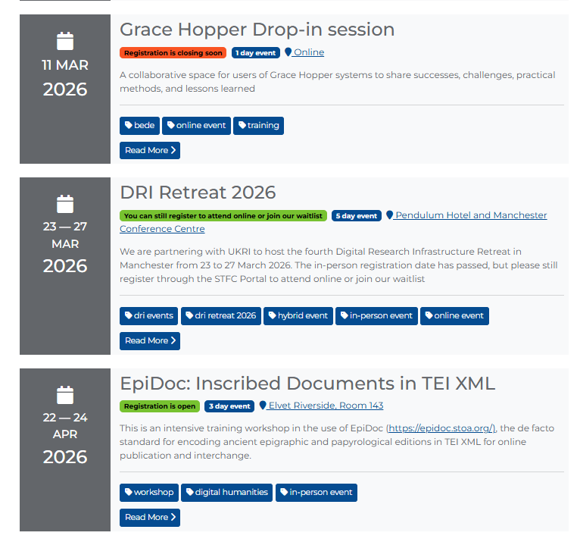
Upcoming Events
Each day of the retreat will focus on a different priority of the UKRI Digital Research Infrastructure Programme to support the UK's goal of building a strong, connected, and sustainable digital research system. These priorities, while distinct, are interconnected and work together to enhance the DRI and deliver better research solutions for the UK research community.
These priorities are :
Interconnected DRI
Human DRI
FAIR DRI
Sustainable DRI
The first four days of the retreat will focus on one of these themes, and on the final day, we will discuss Sovereign AI. The structure of each session is yet to be confirmed, and the format may vary (e.g., a panel, a roundtable discussion, or a workshop).
Notes:
Upcoming events - https://n8cir.org.uk/training-and-events/upcoming-events/
Retreat is week long and is great, still time to sign up but believe it might be online only now.
Also if you have an event that you would like to put on, please do get in touch (with Ric) - https://n8cir.org.uk/about/contact-us/

Slide 6
13:00 - Introduction and welcome
13:05 - Prof. Vanessa Higgins, University of Manchester. Editorial Board Member for the Research Data Journal for the Humanities and Social Sciences.
13:20- Judith Winters, University of York. Editor of Internet Archaeology.
13:35- Dr Derek Gatherer, Lancaster University. Editorial Board, Scientific Data.
13:50- Dr Laura Sbaffi, University of Sheffield. Section Editor for PLOS Digital Health and Associate Editor for JASIST
14:05 – Q and A session
14:30: Final comments
Agenda
Notes:
Anyway, back to today, and we have a great agenda, six talks all about different aspects around working with and managing sensitive data.
We'll be having 5 minutes between each just to allow for switch around and a tiny amount of technical difficulties, and lunch is at 12:20 as that’s when the timings fell.
So again, thank you for coming, and I’ll introduce our first speaker

Slide 7
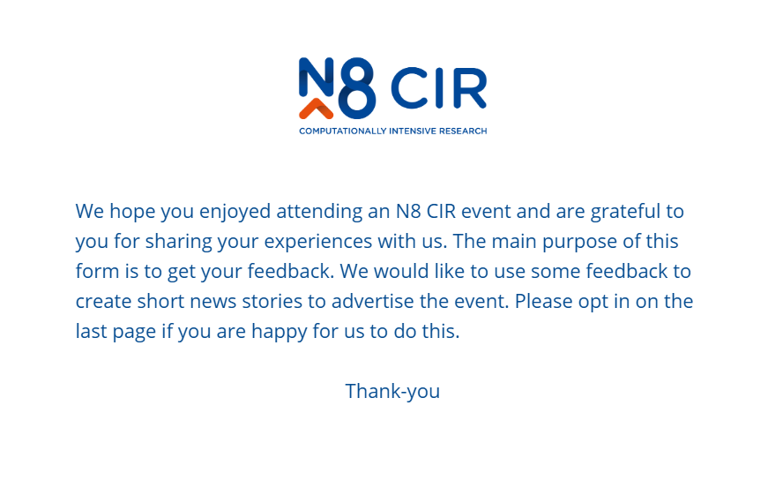
Post Event Questionnaire
Link in the chat
Notes:
One final thing, it would be great if you could at some point complete our post event questionnaire.
As this is for members of all N8 institutions (and more today), we really do listen to the feedback that we get as we hear experience as often it’s from areas and setups that aren’t the same to our own.
I’ll post this throughout the day as a reminder, thank you
https://www.qualtrics.manchester.ac.uk/jfe/form/SV_8HOV7QPk29Dz6DQ

